Slide 1
Warranty Registration
Online warranty registration

Slide 2
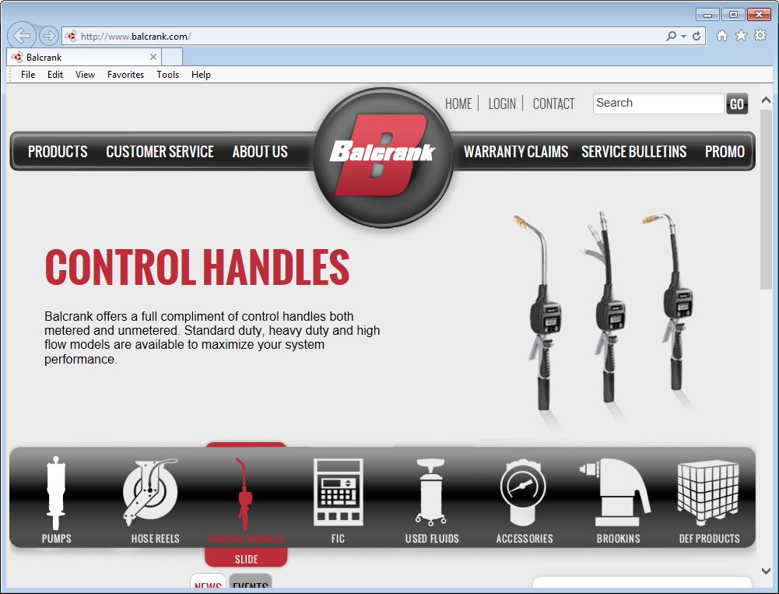
Go to www.balcrank.com
Click on Warranty Claims

Slide 3
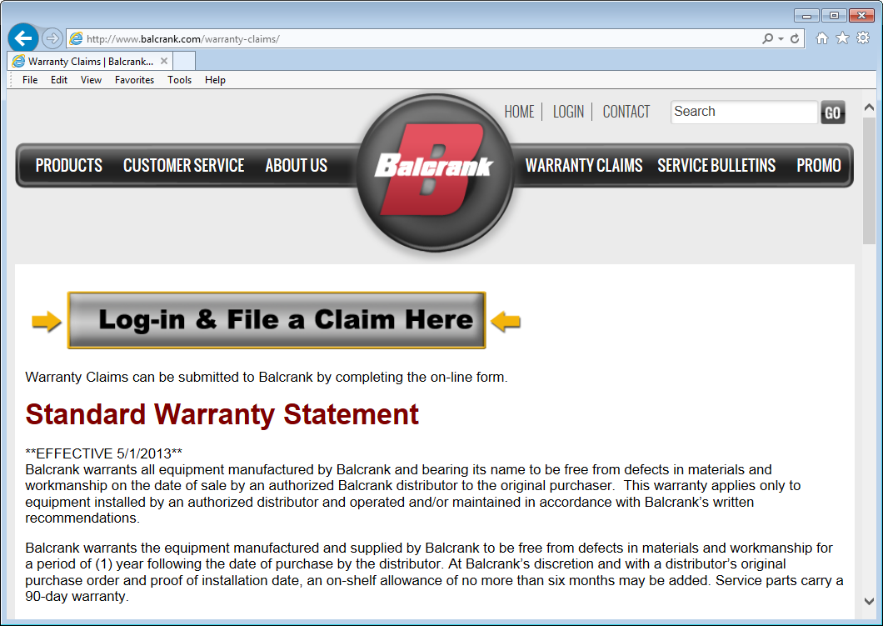
Click on:
Log-In & File a Claim Here

Slide 4
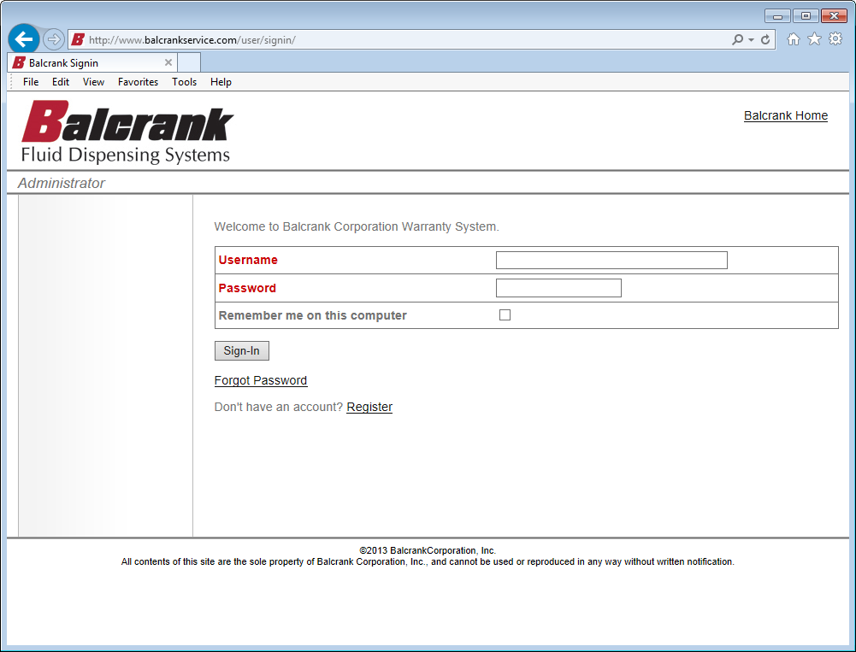
Click on Register

Slide 5
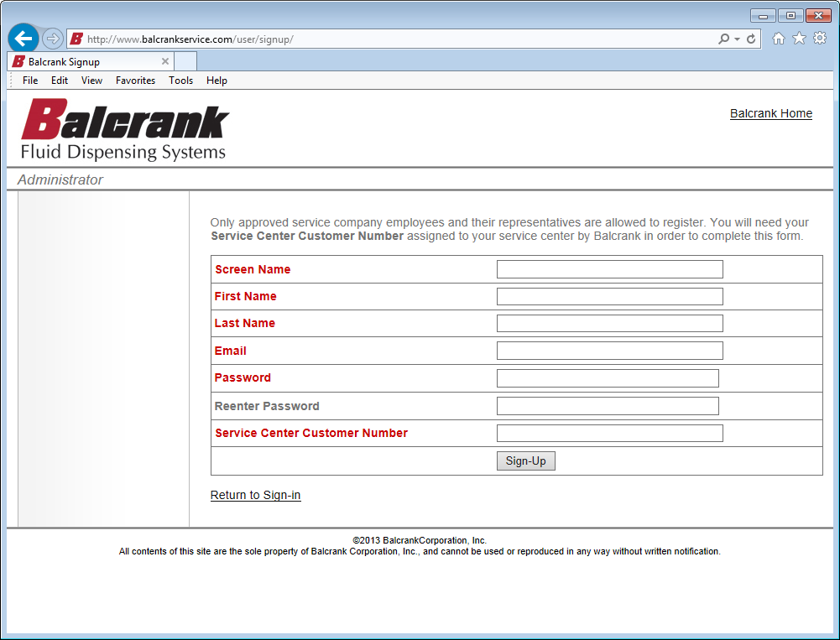
Enter the appropriate information in each field. Your screen name will be your username when you log in
Your password is case sensitive.
You must be a Balcrank distributor to register and have your Service Center Customer Number (Balcrank customer number) to create your account. If you do not know your customer number, contact Balcrank @: 1-800-747-5300

Slide 6
Once all of the required information has been entered, click on Sign-Up

Slide 7
If any field is incorrect or incomplete, you will be brought back to the sign up screen to make the necessary changes
Once the changes have been made, you will need to re-enter your password and click on Sign- Up

Slide 8
Upon successful sign-up, you will be taken the this screen
Check your email for your registration confirmation and a link to complete your sign-up

Slide 9
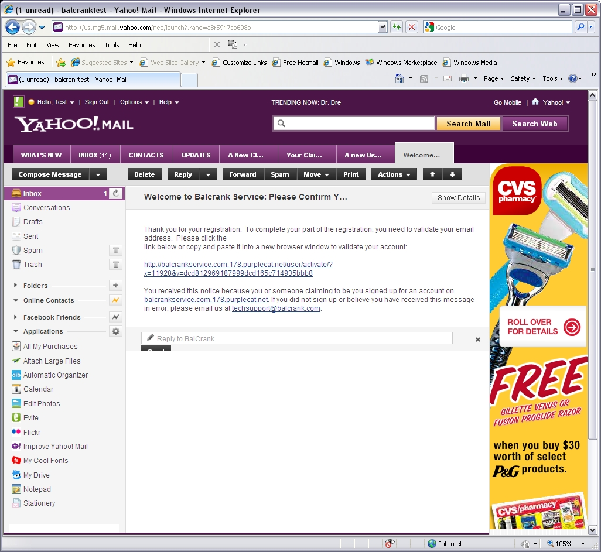
Click on the link or copy and paste it into a new browser window to validate your account

Slide 10
If you clicked on the link in your email (previous slide), your browser will open a new window and you will see this screen
Click on the “click here”, this will take you to the sign-in screen

Slide 11
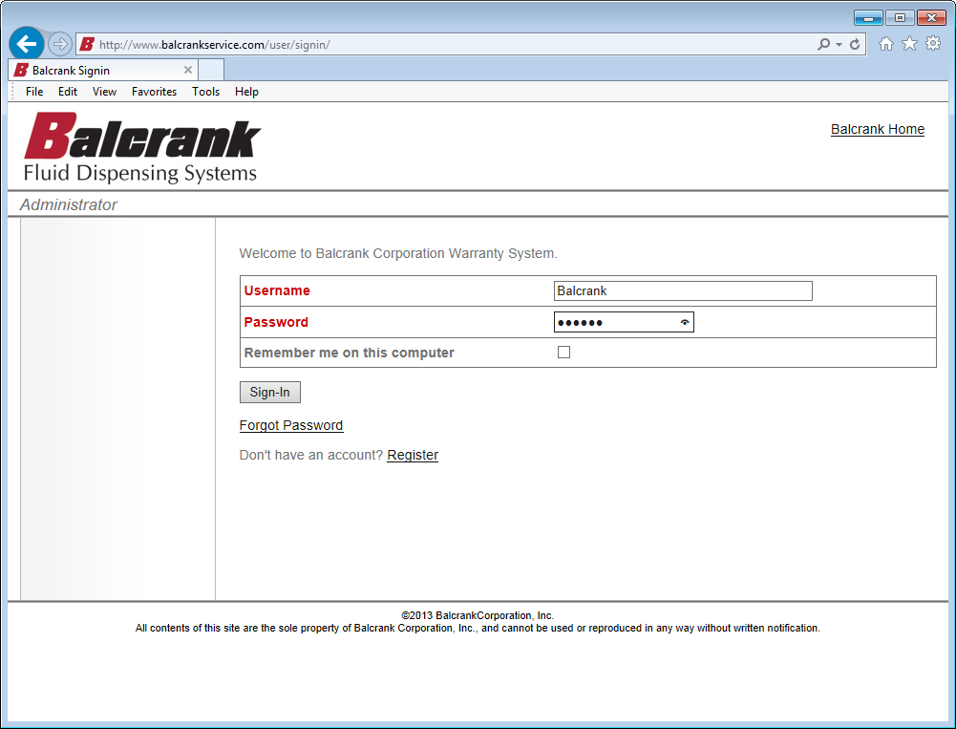
Once on the sign-in screen, enter your username & password and click the Sign-In button

Slide 12
At this point, all you will to be able to do is update your profile & view the user guide. Please allow 72 hours for your account to be activated. If you need immediate access, or your account is not activated within 72 hours, please call Balcrank Tech Service at 800-747-5300 or email techsupport@balcrank.com

Slide 13
Once your account is active, you will have additional menu options available depending on your role
This concludes the Registration tutorial. For additional information about Balcrank warranty, please review:
Warranty training REV C
Warranty filing a claim REV D

