Slide 1
Warranty Guidelines

Slide 2
Topics
This presentation is designed to bring clarity to Balcrank’s warranty program
Standard warranty
Warranty exclusions
Extended warranties
Flat rate chart
Filing a warranty claim
What constitutes a warranty
Common mistakes when filing a claim
Representing and clarifying warranty with your customer

Slide 3
Balcrank Standard Warranty
Standard Warranty
Balcrank warrants the equipment manufactured by Balcrank and bearing its name to be free from defects in materials and workmanship for a period of (1) year following the date of purchase by the distributor. This warranty applies only to equipment installed by an authorized distributor and operated and/or maintained in accordance with Balcrank’s written recommendations. At Balcrank’s discretion and with a distributor’s original purchase order and proof of installation date, an on-shelf allowance of no more than six months may be added. Service parts carry a 90-day warranty.
Items sold, but not manufactured by Balcrank (including materials, equipment, or components such as hoses, FRLs, electric motors, etc.) are subject to the warranty, if any, of the original manufacturer. Balcrank will provide purchaser with reasonable assistance in making any claim for breach of these warranties. However, if the original manufacturer denies such warranty claims, Balcrank has no additional liability.
All equipment determined by Balcrank to have defective materials or workmanship within the warranty period will be repaired or replaced at Balcrank’s discretion. This warranty specifically excludes soft parts and normal wear parts.

Slide 4
Warranty Exclusions
Balcrank standard warranty covers defects in materials and workmanship only. This warranty does not cover, nor shall Balcrank be liable for repair or replacement of parts or equipment resulting from:
Failure of normal wear parts including but not limited to: O-rings, packing's, seals and valves
Wear and tear through normal use
Damage or failure caused by not following proper installation procedures found in Balcrank Service Bulletins and/or installation by non-authorized Balcrank Service Center
Abuse, misapplication, abrasion, corrosion, insufficient or improper maintenance, negligence, accident, alteration
Damage caused by thermal expansion when adequate pressure relief was not included in the system
Fluid incompatibility
Substitution of non-Balcrank component parts
Dirt, water, or debris in air and/or fluid lines; this includes, but is not limited to clogged inlet filters, strainers, regulators, meters, control handles, tips and valves
Hose reel spring tension adjustment

Slide 5
Standard Warranty Conditions
This warranty is conditioned upon the prepaid return of the defective equipment to an authorized Balcrank distributor or Balcrank directly for verification of the claimed defect. If the claim is valid, Balcrank will repair or replace, free of charge, any defective parts.
The equipment will be returned to the original purchaser, transportation prepaid. If the claim is not valid, Balcrank will contact the distributor via e-mail to determine disposition - either the product will be sent back to the customer per customer’s expense, or the customer must provide written authorization to Balcrank allowing Balcrank to dispose of the customer’s equipment.

Slide 6
Extended Warranty Details
*Outfits/Packages - Warranted by the individual components (e.g. hoses within packages are covered by standard warranty while pumps are covered by extended warranty)
If service must be performed on-site, Authorized Balcrank Service Centers may claim required repair/replacement labor within the limits of the Balcrank Flat Rate Chart (see page 8) plus a one-time per incident travel allowance of $1.25 per mile, not to exceed $105.00 (US) for performing on-site warranty service.
Pre-approval from Balcrank Technical Service Department must be obtained BEFORE warranty work is performed in any of the following instances:
• Repair time/labor will exceed the Balcrank Flat Rate Chart • Travel expenses will exceed the allotted $105.00 travel allowance • A second trip is required to a service site (ex. Loaner equipment installation and removal)

Slide 7
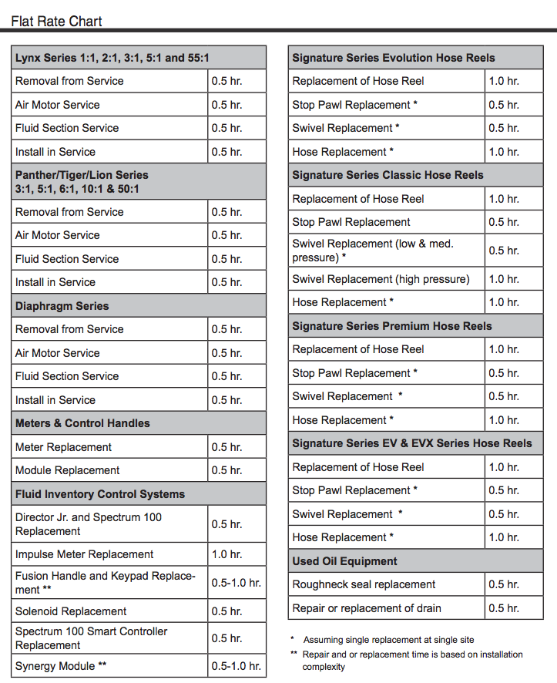
Flat Rate Chart

Slide 8
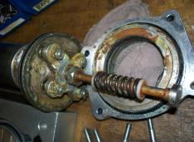
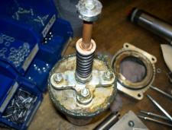
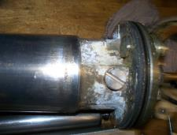
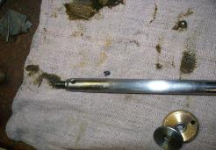
Examples of non-warranty items

