Slide 1

Filing a Warranty Claim
On-Line Claim Filing

Slide 2
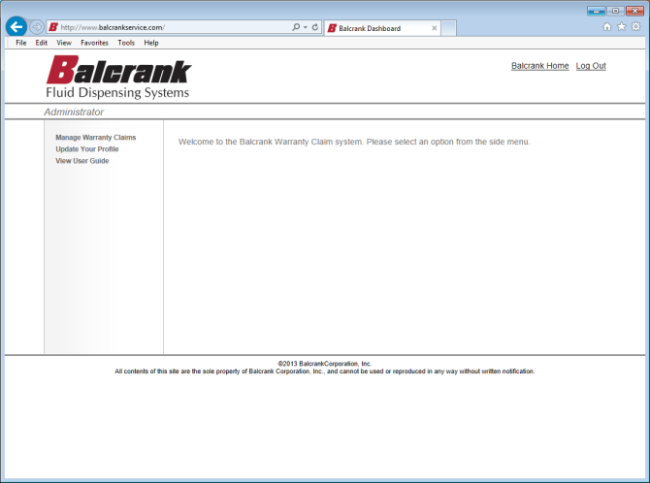
Upon successful login, the screen to the right appears.
To start a new warranty claim or check the status of an existing claim, click on Manage Warranty Claims.

Slide 3
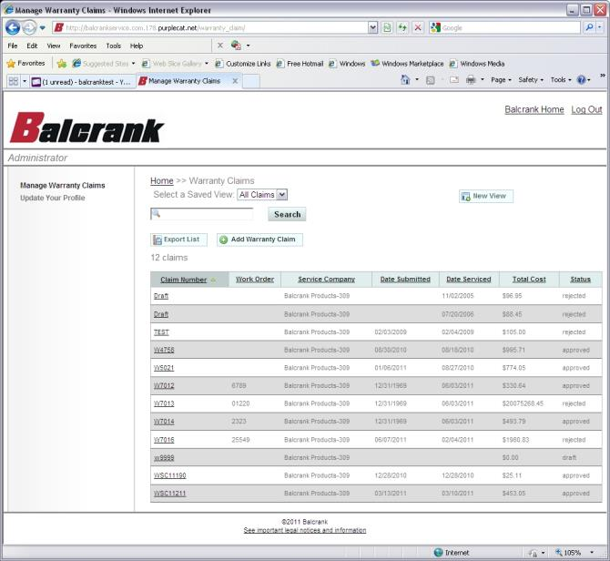
The Manage Warranty Claims screen shows all claims that have previously been filed. These can be sorted by clicking on the headers:
  Claim Number
  Work Order
  Service Company
  Date Submitted
  Date Serviced
  Total Cost
  Status
To create a new claim, click on the Add Warranty Claim button.
Note: A claim that has previously been filed can be viewed by clicking on the warranty claim number.

Slide 4
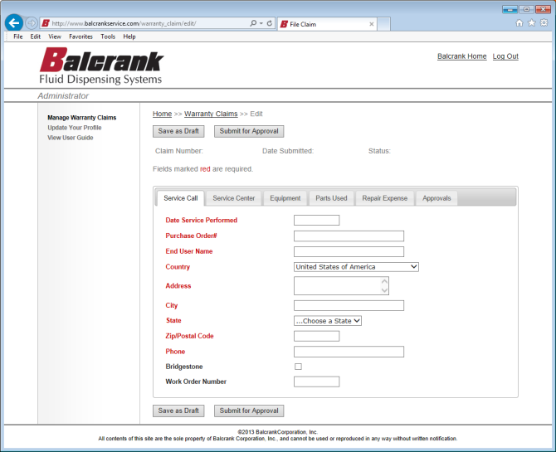
After clicking on the Add Warranty Claim button on the previous screen, the screen to the right appears. This is the online warranty claim form.
There are six “tabs” along the top of the form, the first five have fields for data entry, the Approvals tab is for Balcrank use only. Fields marked in red are required.

Slide 5
Service Call Tab
  Date Service Performed
    Enter the date the warranty service was completed
  Purchase Order#
    Enter the purchase order number that the item being serviced was originally purchased on.
  End User Name
    The customers name/company
  Country
  Address
  City
  State
  Zip/Postal Code
  Phone
    End use information
  Bridgestone
    Check if this claim pertains to a Bridgestone service dispatch.
  Work Order Number
    If Bridgestone is checked enter the case number from the service dispatch form.

Slide 6
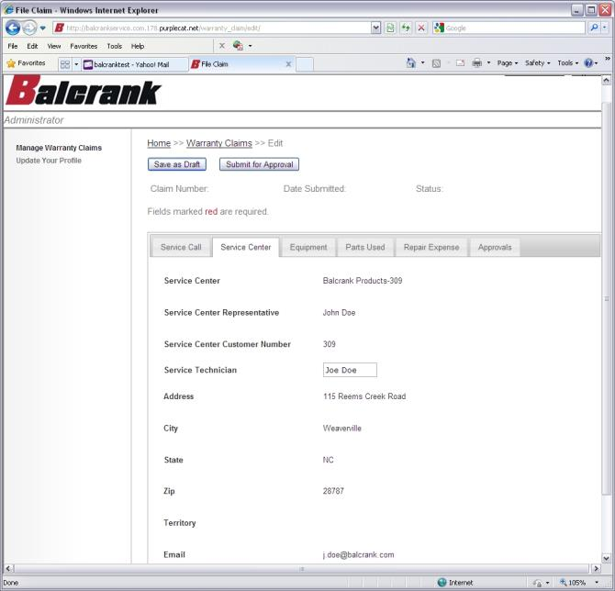
Service Center Tab
  This tab is auto-populated by the system with the servicing distributors information. If desired, an entry may be made in the Service Technician field to identify the technician that performed the service.

Slide 7
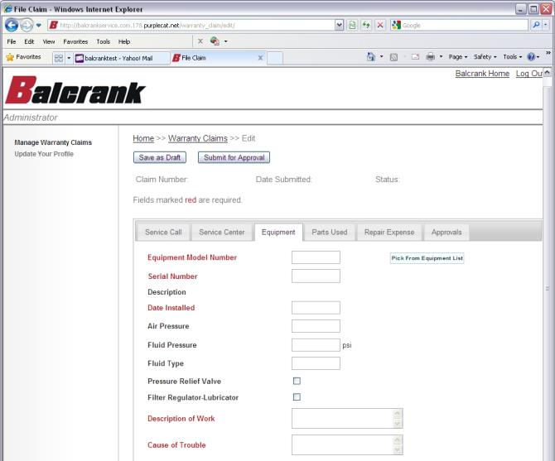
Equipment Tab
  Equipment Model Number
    The model number of the equipment (i.e. pump, hose reel, control handle) that was serviced.
  Serial Number
    Of the equipment
  Description
    Auto-populated by the system.
  Date Installed
    The date that the equipment was originally installed.
  Air pressure
  Fluid pressure
  Fluid Type
  Pressure Relief Valve (PRV)
    Check if PRV was used.
  Filter Regulator/Lubricator
    Check if FRL was used.
  Description of Work
    Describe the service that was performed.
  Cause of Trouble
    Describe the cause of the failure.

Slide 8
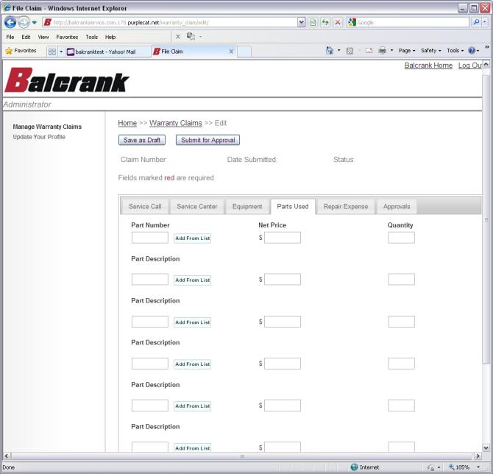
Parts Used Tab
  Part Number
    Enter the part number for all parts that were required to complete the service work.
  Net Price
    Of the part
  Quantity
    Of the part
NOTE: You can browse or search for a Part Number by clicking on the “Add From List” button

Slide 9
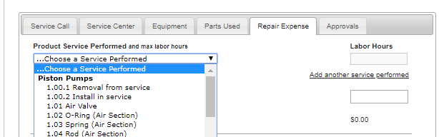
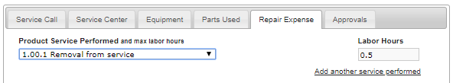
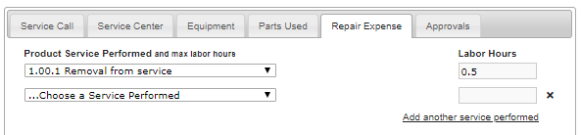
Repair Expense Tab
Choose Product Service Performed
  Here you will select removal from service, any work performed, install in service, or any combination that best depicts the services that have been performed.
  Labor hours will auto populate - this is based on the published flat rate.
How to add more than one service performed?
  Click on Add another service performed. Please ensure that any services added best depict the services that have been performed.

Slide 10
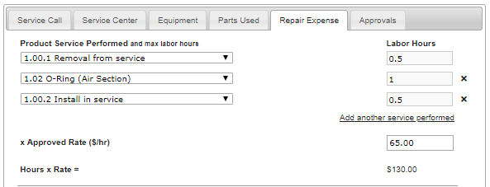
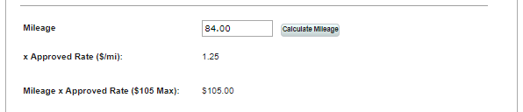

Repair Expense Tab
Enter your labor rate
  Total hours x Rate is auto calculated
Calculate Mileage
  Click on the button, this will auto-calculate the mileage
Freight Cost
  Enter freight cost if applicable
  Your total claim is shown here
Submit your claim
  Click on the Submit for Approval button

Slide 11
Repair Expense Tab
Save as Draft
  If some of the data required to complete the claim is not readily available, chose Save as Draft. This will save the data that has been entered as a Draft which can be re-opened from the Manage Warranty Claims screen to be completed and submitted at a later time.

Slide 12
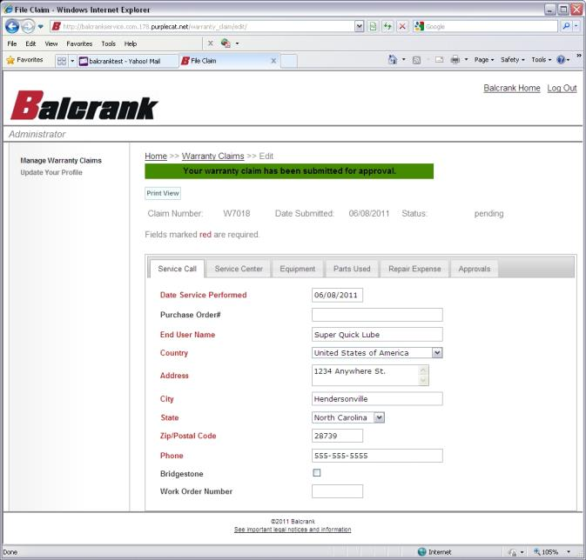
After clicking the Submit for Approval button, if all of the data is complete and correct, the system will accept the claim, assign a Claim Number, and update the status of the warranty claim to pending.

Slide 13
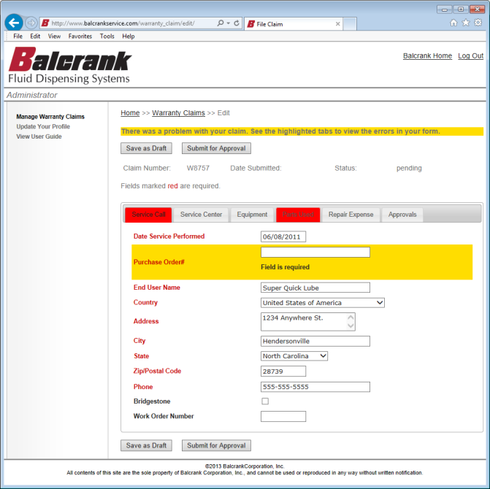
After clicking the Submit for Approval button, if any of the required data is missing or any of the data that was input is incorrect (such as an invalid model or part number), the system will mark the tab(s) in red and the field that is incorrect in yellow. Make the appropriate corrections and click on the Submit for Approval button.

Slide 14
Warranty Policy / Procedures
Most commonly made mistakes when filing warranty claim
FORM NOT FILLED OUT COMPLETELY
  NO DATE OF PURCHASE
  NO SERIAL #
  NATURE OF COMPLAINT OR CAUSE OF TROUBLE NOT FILLED IN
  NO MILEAGE LISTED---JUST A FLAT RATE INDICATED
INCORRECT PRICING FOR EQUIPMENT OR PARTS USED.
  SHOULD BE WHAT THE DISTRIBUTOR PAID BALCRANK FOR THE PART,
  NOT WHAT THEY CHARGE THE END USER.
INSTEAD OF MILES TRAVELED THEY PUT DOWN THEIR HOURLY RATE
FOR TRAVEL. WE MUST HAVE ACTUAL MILEAGE TRAVELED ROUND-TRIP.
NOT FOLLOWING ALLOWABLE REPAIR TIMES CHART FOR LABOR HOURS.
A LOT OF THE DISTRIBUTORS CHARGE EXCESSIVE HOURS FOR REPAIRS.
AUTOMATIC AND MANUAL TIPS: WE DO NOT ALLOW LABOR AND MILEAGE!!
WE ONLY PAY THE TIP ITSELF AND ANY FREIGHT TO SHIP THE TIP TO END
USER.
NOT INDICATING ON CLAIM FORM IF CUSTOMER IS UNDER AN MEP PROGRAM (ex. Bridgestone).
NOT RETURNING PARTS WITHIN 45 DAYS OF REQUEST FOR RETURN.
THROWING AWAY PARTS THAT ARE REQUESTED TO BE RETURNED.
NOT USING OUR RATE OF $1.25/MILE. OFTEN TIMES THEY PUT WHAT THEY
CHARGE THEIR CUSTOMER.
NOT RESPONDING TO REQUEST FOR MORE INFORMATION OR PARTS
WITHIN THE 45 DAY TIME LIMIT.

Slide 15
Suggested ways to represent warranty to your end-user customer?
Below are suggestions that might make handling potential warranties easier:
If called for service during the warranty period, never call it a warranty service call because if you do refer to it as (warranty) your customer will expect it to be done at no-charge regardless if it is warranty or not.
Notify your customer upfront that you will be billing them for the service call and if warranty is approved after factory dignosis, the bill will be reversed.
After initial installation, when training on equipment operation, also cover warranty coverage, procedures and clarify expectations of use and maintenance.
When installing equipment, be aware of potential problems that could cause product failure i.e. Contaminated air, high moisture content, abusive environment or employee and bring these to the attention of the customer.
Ensure your customer knows what is covered and what is not. Warranty covers defects in workmanship and materials. Items not covered under warranty are listed in our distributor handbook.
Make sure you do not commit yourself to warranty coverage until confirmed by Balcrank. Many times, you will not be aware of what failed and why until the product is disassembled and tested at the factory.

Slide 16
Equipment Quality Expectation
Balcrank manufactures high quality products that if the recommended installation is followed, will operate well beyond the warranty period. Before any new product is offered to our distributors, Balcrank has put those products through extensive testing.
Recommended installation includes evaluating the air supply to be sure it is free of water, dirt and debris which can be a result of the piping installation or air compressor maintenance. Balcrank cannot be held responsible for faulty installation and lack of maintenance procedures that cause damage to the equipment resulting in premature failure.
During the installation, Balcrank will not be on site. We rely on the installing distributor to ensure the proper installation guidelines are followed and the customer has been trained regarding the proper maintenance of the equipment. We also rely on the installer to ensure the end-user customer fully understands the equipment warranty.

