Slide 1
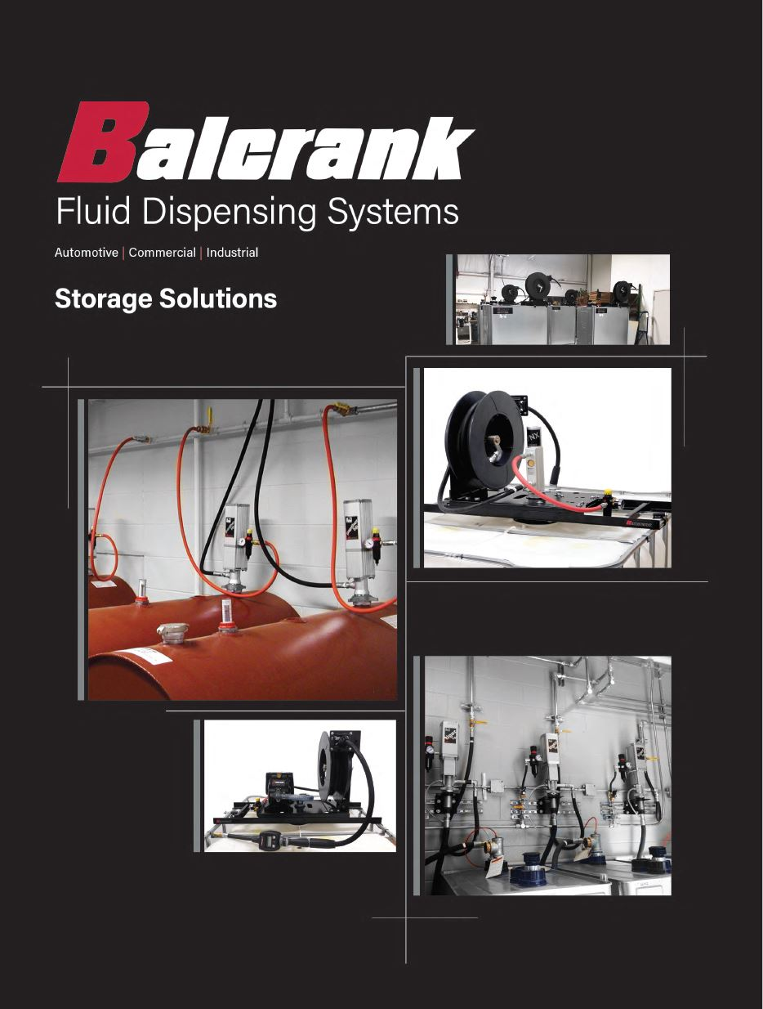
Storage Solutions
Tank Packages & Components

Slide 2
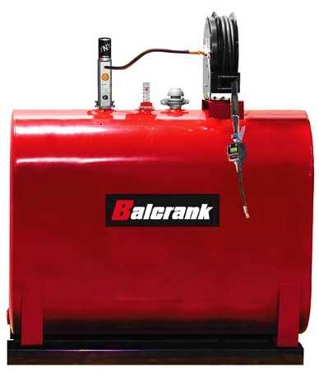
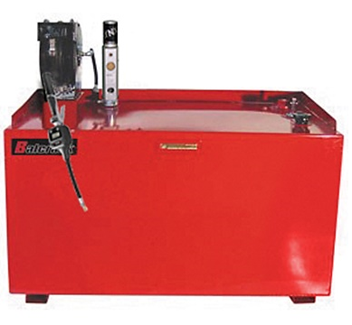
Tank Packages - Connect, Fill, Dispense
All Double Wall Tanks
165, 275, 400 gallon options
Lynx 3:1/5:1 HD or Panther 3:1
Evolution/Classic reels 30’ or 50’
F/R auto drain/ 2.5’ inlet hose/quick connect coupler & nipple/sight gauge/pump & reel brackets
DR handle W/Flex memory ext. ¼ turn manual tip for oil
Steel Tanks / Assembled & Ready for use
UL 142 single & double wall options
Includes
Signature or Evolution ½” X 50’ reel
Mechanical or Electronic Meter W/Flex extension & auto tip
Lynx or Panther 3:1
¼’” Filter/Regulator
2” Lockable fill cap / gauge

Slide 3
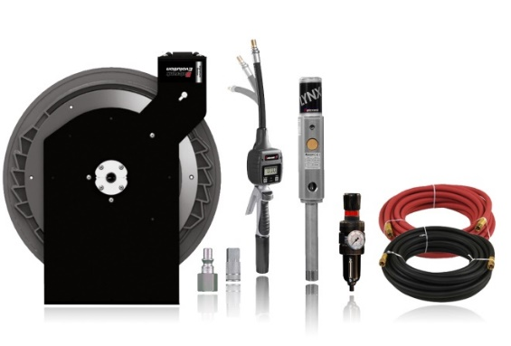
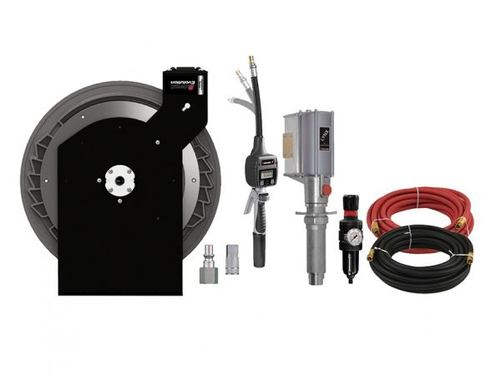
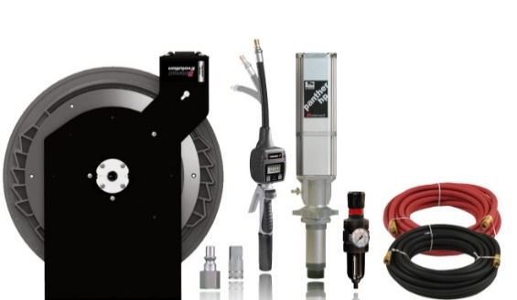
Piston Pump - Tankless Packages
All packages include:
Pump connecting hose kit
2.5’ reel inlet hose
F/R auto drain 1/4” NPT(F)
DR handle w/flex-m ext. ¼ turn manual tip for oil
3 pump configuration options
Lynx 3:1
Lynx 5:1 HD
Panther 3:1
2-reel choice configurations in ½ x 30’ or 50’
Evolution
Classic

Slide 4
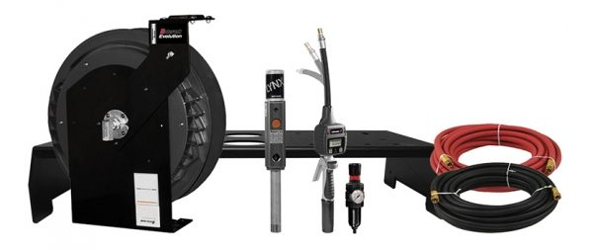
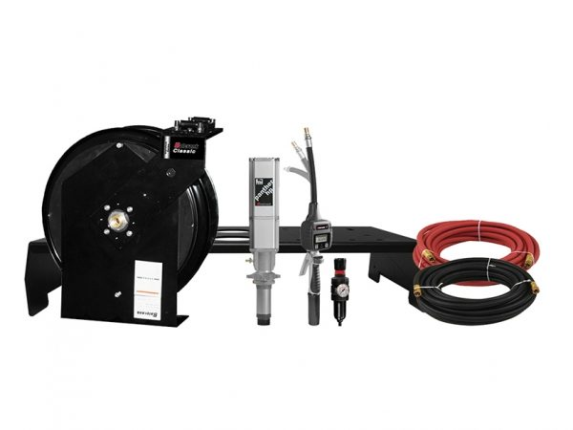
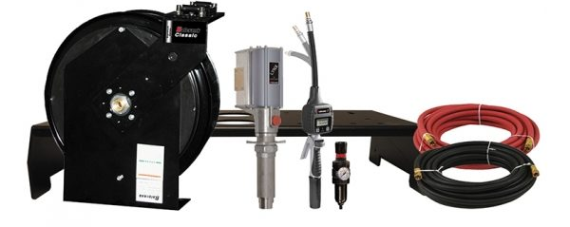
Piston Pump - Lightweight Double Wall Tankless Packages
All packages include:
Vented fill cap
DR handle w/flex-m ext, & ¼ turn manual tip for oil
F/R auto drain ¼” NPT(F)
2.5’ reel inlet hose
5’ air connecting hose
Air quick connecter coupler/nipple
Sight gauge
Pump & reel bracket
3 pump configuration options
Lynx 3:1
Lynx 5:1 HD
Panther 3:1
2 reel configuration options in ½” x 30’ or 50’
Evolution
Classic
*Down tubes and tanks supplied by customer. We do not recommend using PVC down tubes for long term applications.

Slide 5
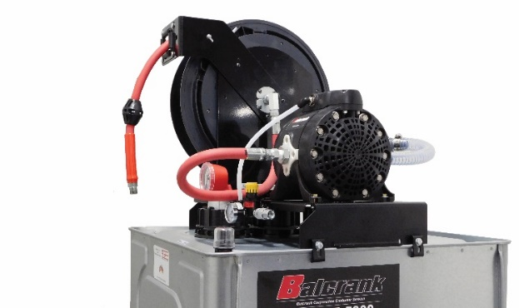
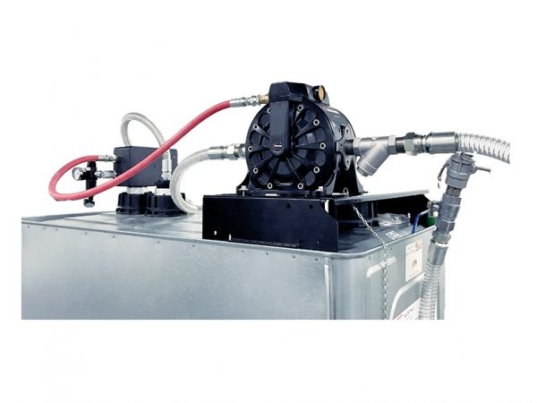
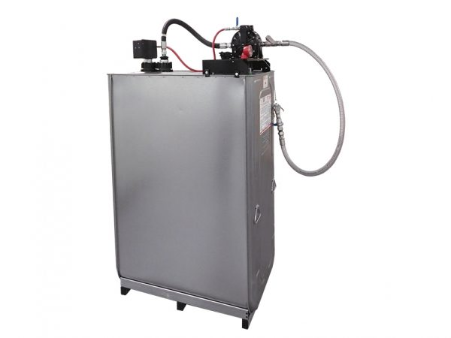
AODD Pump Anti-freeze & Washer Fluid - Lightweight Double Wall Used Fluid Tank Packages
AODD Pump
Anti-freeze & Windshield Wash Fluid
Package Includes:
Double wall tank choice 165 or 275 gallon
CF-30 polypropylene AODD pump
Pump bracket
F/R auto drain ¼” NPT(F)
Tank Sight Gauge/Vented 2”evac cap/port
Air supply hose with quick coupler
Evolution hose reel 30’ or 50’
Control handle not included
Lightweight Double Wall Waste Fluid
Package Includes:
Double wall tank choice 275 or 400 gallon
CF-30 aluminum AODD pump
Pump bracket, Y-strainer on oil models
F/R auto drain ¼” NPT(F)
1” evacuation hose w/1” cam-lock connecter (3/4” AF)
High level pump shut-off/ Tank site gauge
Vented 2” evac cap/port
Air supply hose w/quick coupler
Shipped completely assembled

Slide 6
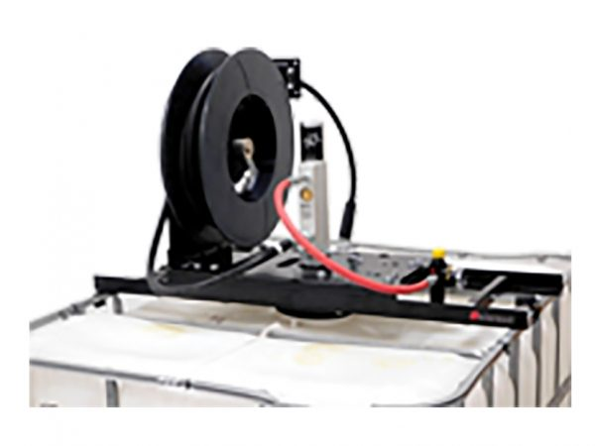
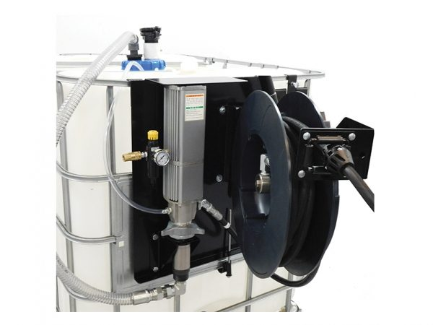
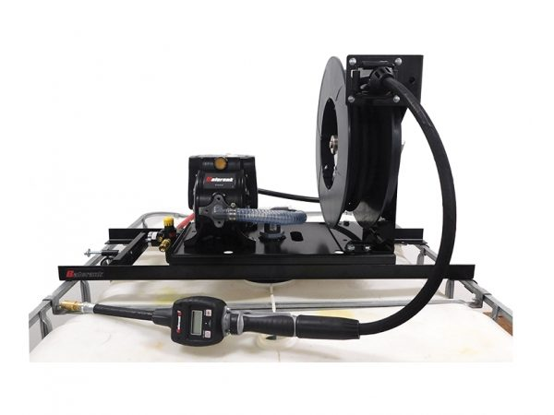
Tote Packages
Top Mount Package includes:
Evolution reel 30’ or 50’
Lynx 3:1/5:1 HD or Panther 3:1 (CenterFlo CF-15/CF-30)
F/R regulator with auto drain
2.5’ reel connecting hose
5’ air connecting hose
Air quick coupler & nipple
Top mount pump & reel bracket
Pump direct immersion suction tube & dust shroud
Top tote suction tube and hose (CenterFlo package)
275 or 330 Gallon
Side Mount Package includes:
Evolution reel 30’ or 50’
Lynx 3:1/5:1 HD or Panther 3:1
F/R regulator with auto drain
2.5’ reel connecting hose
5’ air connecting hose
Air quick coupler & nipple
Side mount pump & reel bracket
6” vented cap w/dual 2” ports & pressure relief port
Vented fill cap, 4530-067
Top tote suction tube and hose
275 or 330 Gallon
Handles not included

Slide 7
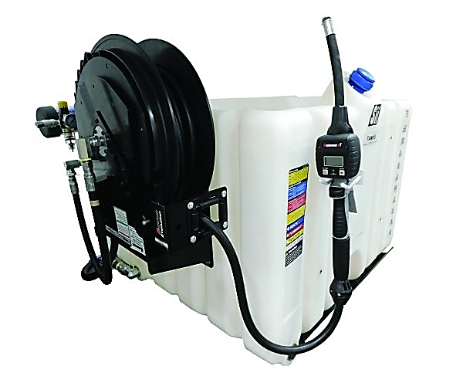
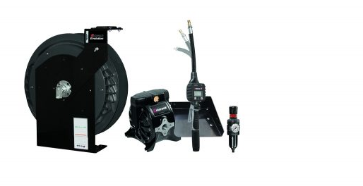
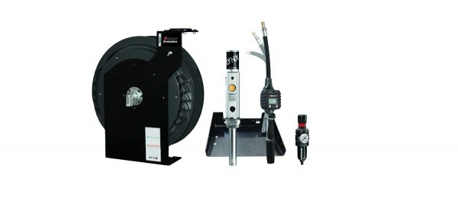
Poly Stackable - Tankless Packages
Packages Include:
Choice of Evolution or Classic reel 30’ or 50’
Choice of Lynx 3:1, CF-15 OR CF-30
DR handle w/flex-m ext, & ¼ turn manual tip or non-metered composite handle
F/R auto drain ¼” NPT(F)
2.5’ reel inlet hose
Pump & reel bracket
*Example
image only

Slide 8
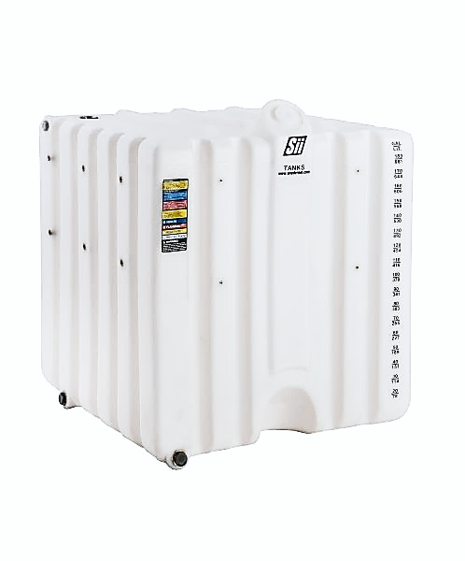
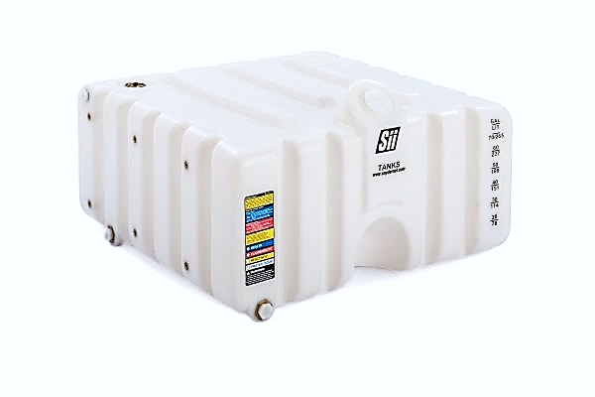
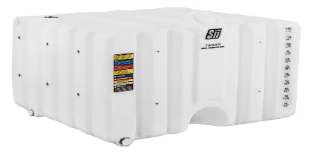
Poly Stackable - Tanks/Gravity Poly Stackable Tanks
Poly Stackable Tanks
Constructed of high density polyethylene
All tanks have same foot print, stack any size or any combination
Graduated ink and stamped gallon measurement on tank front
Optional pallet for portability
Optional secondary containment tubs
60,80,120,180 or 260 gallon options
Fluids
Synthetic and mineral based lubricants
Hydraulic fluid, Transmission fluid, Gear oil, Anti-freeze
Gravity System Poly Stackable Tank Packages
Choice of 60,80,120,180 or 260 gallon
Frame with drip tray
Connecting hose and release valve
*Tanks should not be stacked higher than 82” or less from the stand base to the top of the tank.

Slide 9
Tank & Tote Accessories
BUNG ADAPTERS
TOTE CAPS
TANK LEVEL GAUGE
VENTS
BRACKETS & TRAYS
TANK SADDLE
SECONDARY CONTAINMENT

Slide 10
Tank & Tote Accessories
PALLET
GRAVITY FEED CONNECTOR
STRAP
SPRING RELEASE VALVE
STEEL STAND
AIR BREATHER
DRIP TRAY

