Slide 1
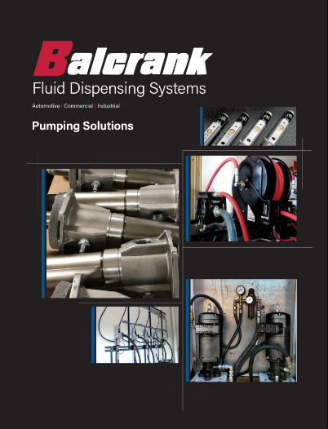
Pumping Solutions
Lynx, Panther, Tiger, Lion
Lube oils and Grease
AODD – Fresh and used fluids

Slide 2
Content
  Pump 101
  Oil Pumps
  Grease Pumps
  AODD Pumps
Notes:
Review the course contents.

Slide 3
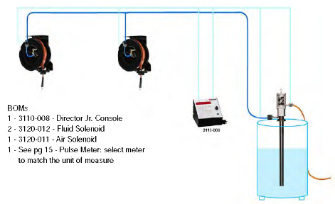
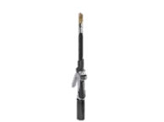
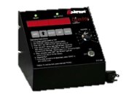
Pump 101 Basics – Typical System
Typical fluid system is made up of:
  Air supply
    Supply pump
      Downtube, inlet valve, pressure relief, filter/regulator, connecting hoses
  Piping from pump to dispense points
      Hose reels/control handles
      Lube consoles
    Automated systems
      Fluid Inventory Control System
Notes:
Identifying system components
“Follow the oil trail” from pump inlet to dispense and everything in between.
Short discussion on each critical point and the potential issues that can occur.
Large % of failures occur due to improper installation or sizing of the down tube and inlet value.
The selection of the correct pipe size becomes more critical in large systems with higher flow requirements.
Proper tip selection to match the application and flow requirements.
FIC will be discussed in depth later in the presentation.

Slide 4
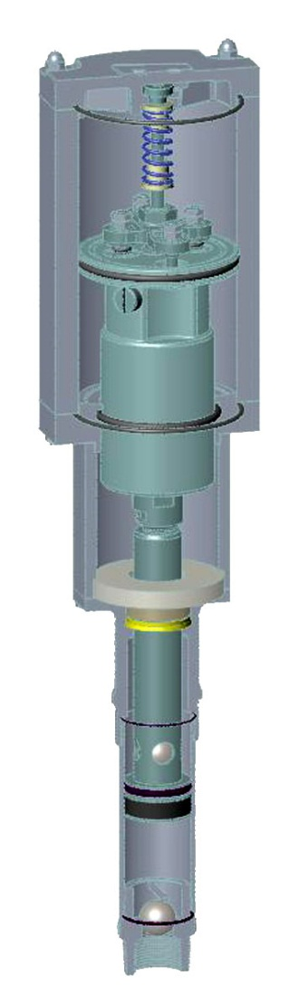
Pump 101 Basics – How A Piston Pump Works
A piston pump loads 100% of its volume on the upstroke.
At the same time the pump is dispensing 50% of its volume on the upstroke which is pushed out by the piston packages.
The remaining 50% of the volume is displaced on the down stroke by the pump rod.
This is called a double ball/acting positive displacement piston pump
Notes:
- Describe the parts of the pumps and explain the bullet points utilizing the illustration on page

Slide 5
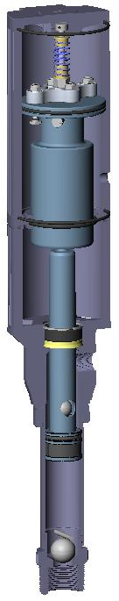
Pump 101 Basics – Ratio
What does the ratio tell you?
  Fluid to air ratio: Ex: 5:1 for every 1 lb. of compressed air you supply = 5 lbs. of outbound fluid pressure
  The diameter of the air motor piston vs. the diameter of the fluid piston. This air motor piston is 5 times the size of the fluid pump piston
5:1 Ratio
Air Motor Piston
Fluid piston
Notes:
- All air operated pumps are categorized by ratio, i.e. 3:1, 5:1, 10;1, 12:1 and 50:1 are most common
This slide illustrates the relationship between the inbound air and the outbound fluid pressure.
Explain why ratio is important when dealing with different fluid viscosity and length of furthest dispense point. Ratio has nothing to do with flow!
- Review illustration showing air motor piston vs. fluid piston.

Slide 6
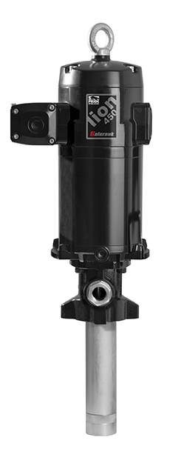
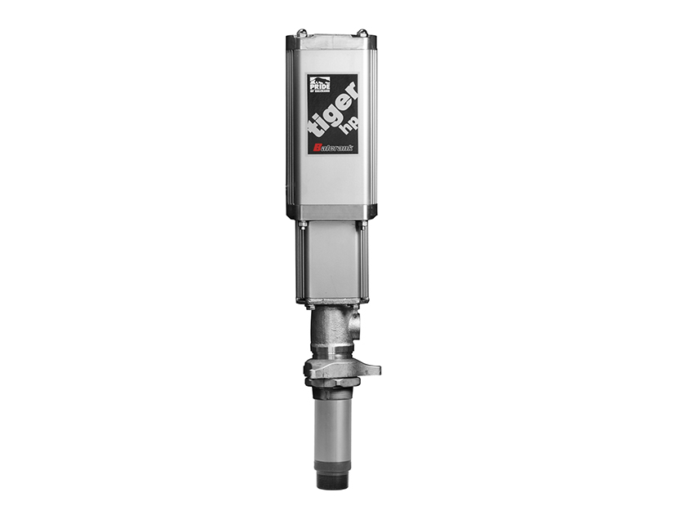
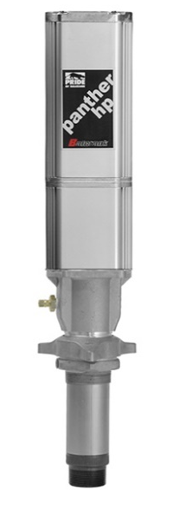
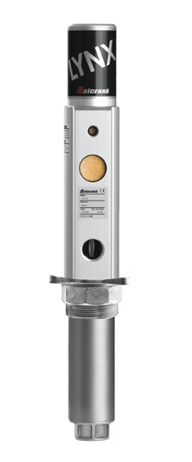
Pump 101 Basics – Flow Rate
Why do the 6:1 pumps have different flow rates?
Why does the small 3:1 have a greater flow rate than the 5:1?
6:1 Ratio
26 GPM
@ 100 PSI
6:1 Ratio
16 GPM
@ 100 PSI
3:1 Ratio
6.6 GPM
@ 150PSI
5:1 Ratio
6.0 GPM
@ 100 PSI
Faster cycle
Rate
3:1 = 98 C/G
5:1 = 57 C/G
Notes:
Key points:
5:1 flow rates – Why do they have different flow rates? Difference in air motor size (diameter) and fluid pump size (diameter).
3:1 flow rates- Why does the 3:1 have a greater flow rate than the 5:1? Smaller displacement, higher air pressure and greater cycle rate.

Slide 7
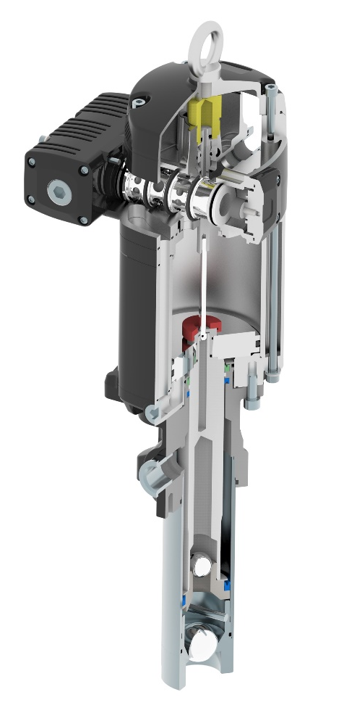
Pump 101 Pump Summary – Flow Rate VS Cycles
2.50” 4.5”
Air motor piston size is 5x the fluid pump piston size
The Lion with the larger air motor also has a larger fluid pump displacement. Therefore, although both pumps are similar ratios, the Lion has a much higher flow rate
Fluid pump size
6 GPM
57 cycles/gallon
26 GPM
11 cycles/gallon
Notes:
- Reiterate the relationship of the air motor piston size as well as the overall pump size with how this relates to flow and number of pump cycles to produce a gallon of fluid. Larger is better in case of work load and wear and tear!

Slide 8
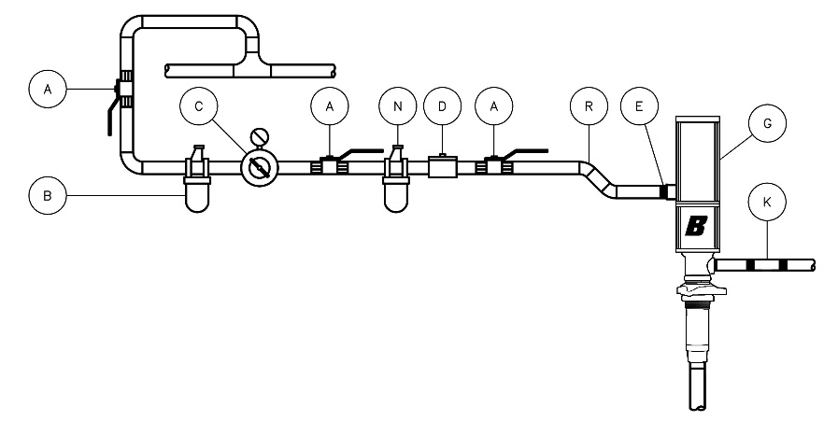
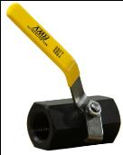

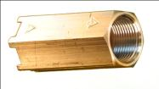
Pump 101 Basics – System Components
Down tube/check-valve- used to reach the bottom of the tank/drum, prevents pump from loosing prime if material runs out
Filter reduces the risk from contaminants such as water, rust, scale etc. from entering the pump.
Regulator; regulates the air pressure to pump based on viscosity of fluid and flow needed and should be set between 40-80 psi.
Lubricator should only be used in cases that a maintenance prevention schedule is established and maintained on the equipment for it to be of any benefit to the end user.
Hose connections to air system and fluid piping
Pressure relief- prevents the system from over pressurizing due to thermal expansion
Ball valves- isolating components for ease of repair
Notes:
Describe the critical components and their function.
Balcrank recommends including a check valve be placed on the bottom of the down tube for applications greater than 42” vertical lift.
The air supply components (air hose and FLR) should match the air requirements of the pump.
Filter/Regulators are required for warranty.
Lubricators are only recommended when specified or under extreme conditions. If used, the lubricator must be maintained and adjusted properly using 10W non-detergent only.
Pressure relief must be installed in hard piped systems. Lack of pressure relief valves can cause tips, hose reel swivels, and the hose to burst in extreme conditions.
Ball valve locations should include air supply to the pump, out-bound fluid supply to piping, and all hose reels.
The inclusion of the suggested air and fluid components can add significantly to your sales and commissions!

Slide 9
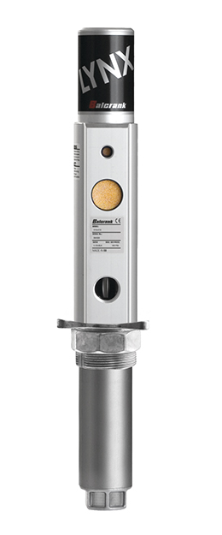
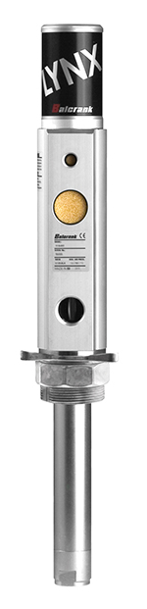
Lynx Oil Pumps – 1:1 / 3:1 Lube & S/S for WWF
Customer type
  Low annual volume user
  Portable package
  1 or 2 plumbed dispense points
  1:1 ratio good for transfer filling
Fluids
  Synthetic and Mineral based oils
  ATF
  Hydraulic fluid
  WWF (stainless pump)
  Anti-freeze (stainless pump)
Applications
  Portable outfits, tank-packages
  16/55 gallon drum supply pump
  Oil bar & tapper applications
  Transfer / Short run plumbed systems
Notes:
After bullet point have been discussed have everyone go to the catalog page and review the page content and how to find and read the information provided.
Cover the Pump Matrix page of the pump section of catalog before moving to next bullet point
Explain that the flow of information is the same from one pump to another in the pump section of the catalog.

Slide 10
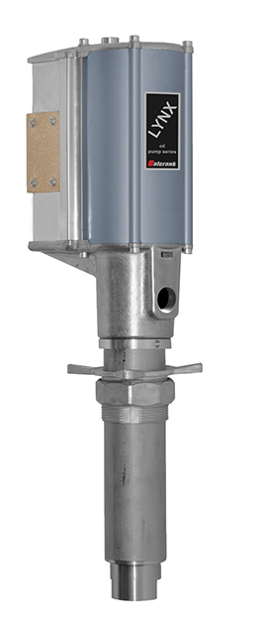
Lynx HD Oil Pump – 5:1 Ratio / Lubes
Customer type
  Medium annual volume user
  Portable package
  Multiple dispense points
Fluids
  Synthetic and Mineral based oils
  ATF
  Hydraulic fluid
  Gear oil
Applications
  55 gallon portable dispense packages
  Small tank package
  Small dealership
  Quick Lube
  Tank package
  Price conscious user
  Oil Jobber
Notes:
Before going into bullet points discuss topics below;
Cover 5:1 ratio / spoil valve differences and how a spoil valve design is more susceptible to moisture and debris in air lines over a mechanical valve design like Panther/Tiger – 3:1, 5:1 & 6:1 pumps
Know what competitive product you are selling against – The Lynx 5:1 is great product when comparing to Lincoln/PMV, Alemite/RAM, Graco/LD products. Not a good match when comparing to the GRACO 300 - 203876, 225 – 246775
Lastly cover the catalog page information and how to read and find the information.

Slide 11

Pride Series Lube Pumps – 3:1 / 5:1 & 6:1 Ratios
Customer type
  Medium/Large volume users (5:1 & 6:1)
  Portable outfit (3:1)
  Multiple dispense points
  Longer piping runs/Higher flow rates (6:1)
Fluids
  Synthetic / Mineral based oils
  ATF
  Hydraulic fluid
  Gear oil
  WWS (6:1 stainless pump)
  Anti-freeze (6:1 stainless pump)
Applications
  Tank package / Portable outfits
  Quick Lubes / Tire Stores
  Medium/large maintenance facilities
  Simultaneous dispensing requirements
  Fleet Facilities
  Mobile Lube trucks
Notes:
Before going into bullet points discuss topics below;
Cover 3:1 VS 5:1 VS 6:1 ratio’s / spoil valve VS MECHANICAL valve differences in design and spool valve design is more susceptible to moisture and debris in air lines that may lead to premature failure
Know what competitive product you are selling against – If the customer already has a GRACO 225, 300, or 425 product they probably already know the value of a mechanical valve design
Lastly cover the catalog page information and how to read and find the information.

Slide 12
Cycles Per Gallon Review – Small Pumps
Name/Ratio | Piston | Cycles/Gallon | Free Flow/GPM
LYNX 1:1 | 1.375” | 31 | 10
LYNX 3:1 | 1.375” | 98 | 6
LYNX HD 5:1 | 3.000” | 20 | 24
Panther 3:1 | 2.250” | 34 | 8
Panther 5:1 | 2.250” | 57 | 6
Tiger 6:1 | 3.200” | 31 | 16

Slide 13
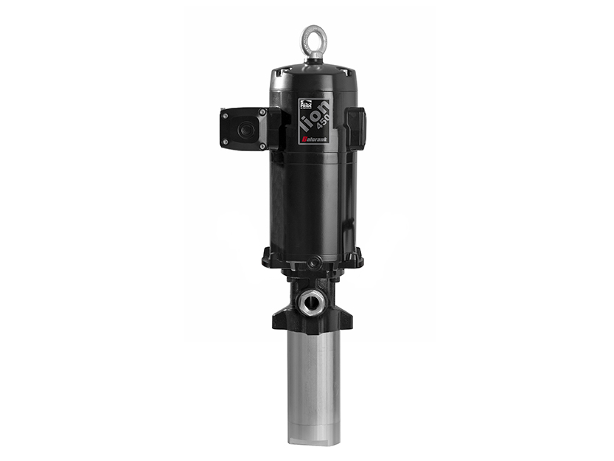
Lion 450 3:1 Oil Pump
Customer type
  High annual volume user
  Multiple dispense points
  Rapid/High fill requirements
Fluids
  Synthetic and Mineral based oils
  ATF
  Hydraulic fluid
Applications
  Lube transfer
  Automotive Dealerships
  Commercial dealerships
  Fleet facilities
  Industrial plants
  Lube trucks
  Mining
Notes:
Lion pneumatic pump motor provides:
Fast/efficient double acting action through a HYBRID motor design that utilizes only three moving parts; this means fewer parts to wear and break down.
The Hybrid air valve design has no springs, with virtually no moving parts. The design utilizes a end of stroke mechanism, which large air porting for maximum reliability, efficient non icing or stalling operation.
Air exhaust muffler included which assist in eliminating icing that can cause other pumps to have erratic pump operations. The muffler meets OSHA requirements on noise level in the working environment.
Aluminum motor housing provides superb heat transfer that together with a well dimensioned air exhaust eliminate the risk of ice formation.
Lion medium pressure pumps are for oil systems where higher volume dispensing is needed to fill larger reservoirs and/or reduction in labor is expected
Lion 3:1 ratio pump moves large amounts of oil FAST! Dispenses up to 32 gallons of oil per minute with a cycle rate of 6 cycle per gallon of fluid.
Markets – This is a great pump for In-Plants systems, AG centers, High volume transfer

Slide 14
Lion 450 Oil Pumps – 6:1 / 10:1 Ratios
Customer type
  High annual volume user
  Multiple dispense points
  High flow requirements
  Longer pumping distance
Fluids
  Synthetic and Mineral based oils
  ATF
  Hydraulic fluid
  Gear oil
Applications
  Lube transfer
  Automotive Dealerships
  Commercial dealerships
  Fleet facilities
  Industrial plants
  Lube trucks
  Mining
Larger 4.5” diameter air motor allows the pump to work at slower cycle rates
Notes:
- Lion Oil Pumps Lower Feature:
- In-line design - the in-line configuration aligns the axis of the air motor with the plunger rod and piston assembly, the anti-corrosive, hardened plunger design provides low-friction, which minimize wear, maximize tightness and increase the packings life.
- Stub/universal oil pump – Utilizes a double-Valve, stub pump tube, used for positive priming and pumping of all grades of oil. Extensions, rigid or flexible, that screw directly into the pump inlet valve allow the pump to accommodate different size drums and tanks.
- High quality materials -
• Aluminum die-cast air motor with hard anodized aluminum cylinder.
• Light weight drive piston.
• High tensile hard-chrome plated steel on fluid plunger rod.
• “U-cup” polyurethane (oil) packings.
• Cast iron outlet body.
• Thick-wall polished tube.
• Barrel, piston and prime valve made of hardened, precision fitted, ground steel for perfect seal and long life of grease pumps.
• Piston and inlet valves made of hardened steel and polyurethane
piston packing on oil pumps.

Slide 15

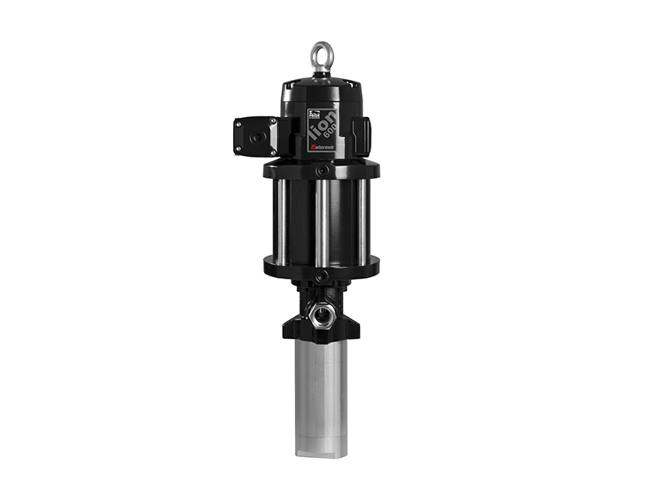
Lion 600 Oil Pumps – 6:1 / 12:1 Ratios
Customer type
  High annual volume user
  Multiple dispense points
  High flow requirements
  Longer pumping distance
Fluids
  Synthetic and Mineral based oils
  ATF
  Hydraulic fluid
  Gear oil
Applications
  Lube transfer
  Automotive Dealerships
  Commercial dealerships
  Fleet facilities
  Industrial plants
  Lube trucks
  Mining
Larger 6” diameter air motor allows the pump to work at slower cycle rates
Notes:
Lion Oil Pumps Lower Feature:
- In-line design - the in-line configuration aligns the axis of the air motor with the plunger rod and piston assembly, the anti-corrosive, hardened plunger design provides low-friction, which minimize wear, maximize tightness and increase the packings life.
- Stub/universal oil pump – Utilizes a double-Valve, stub pump tube, used for positive priming and pumping of all grades of oil. Extensions, rigid or flexible, that screw directly into the pump inlet valve allow the pump to accommodate different size drums and tanks.
- High quality materials -
• Aluminum die-cast air motor with hard anodized aluminum cylinder.
• Light weight drive piston.
• High tensile hard-chrome plated steel on fluid plunger rod.
• “U-cup” polyurethane (oil) packings.
• Cast iron outlet body.
• Thick-wall polished tube.
• Barrel, piston and prime valve made of hardened, precision fitted, ground steel for perfect seal and long life of grease pumps.
• Piston and inlet valves made of hardened steel and polyurethane
piston packing on oil pumps.

Slide 16
Cycles Per Gallon Review – Large Pumps
Name/Ratio | Piston | Cycles/Gallon | Free Flow/GPM
Lion 450 3:1 | 4.500” | 6 | 32
Lion 450 6:1 | 4.500” | 11 | 26
Lion 450 6:1 | 4.500” | 19 | 18
Lion 600 6:1 | 6.000” | 6 | 26
Lion 12:1 | 6.000” | 11 | 17
LYNX 3:1 | 1.375” | 98 | 6
LYNX HD 5:1 | 3.000” | 20 | 24
Panther 3:1 | 2.250” | 34 | 8
Panther 5:1 | 2.250” | 57 | 6
Tiger 6:1 | 3.200” | 31 | 16
Notes:
Note: how much air motor/piston size makes a difference in cycles per gallon PLUS the Higher the Flow rate becomes VS cycles

Slide 17
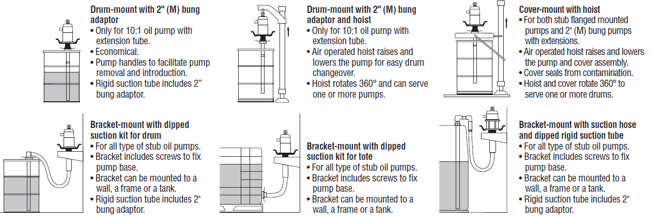
Lube Pump – Installation
Lube pump Installation
  Wall mount illustration for all stub length pumps

Slide 18
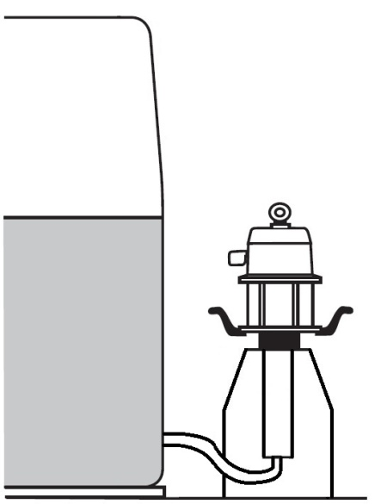
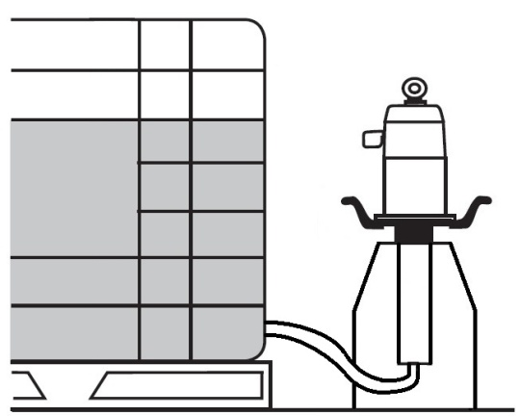
Lube Pump – Installation
Oil pump Installation: for all stub pump models
  Floor stand mount for all stub pumps for bottom ports of bulk container.

Slide 19
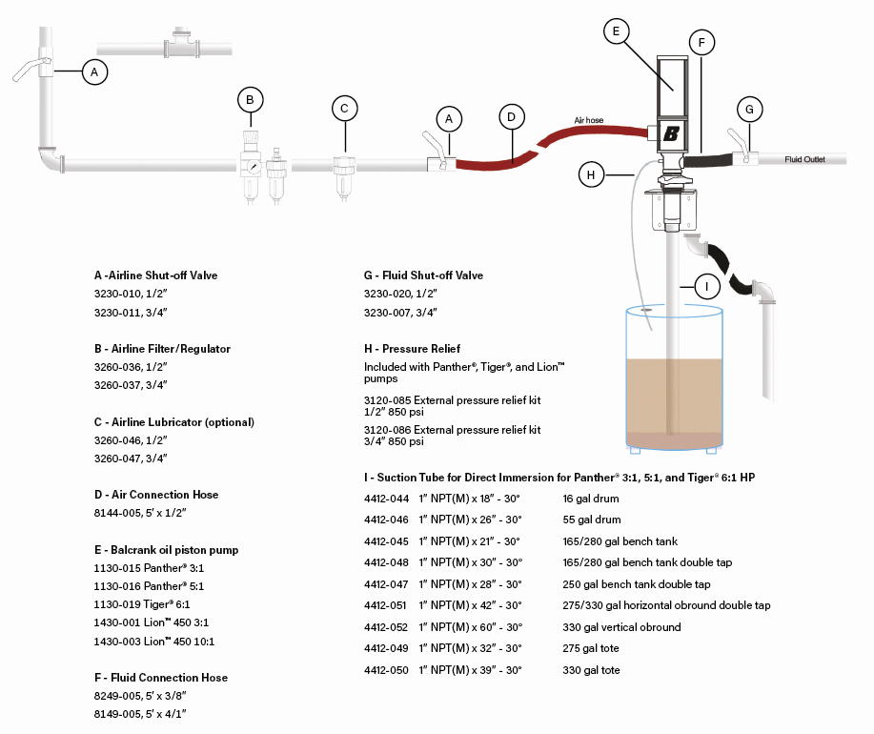
Typical Oil System Components
When assembling a system BOM, follow the trail of the oil from pump intake to dispense point

Slide 20
Pumping Solutions
Grease Fundamentals
Grease types and applications

Slide 21
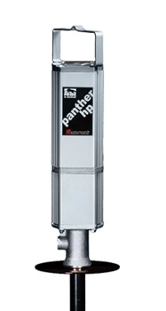
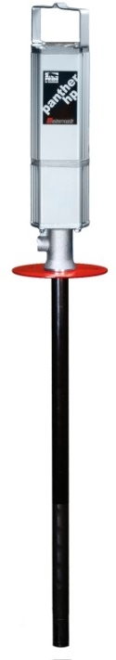
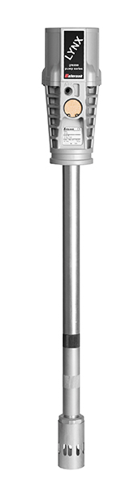
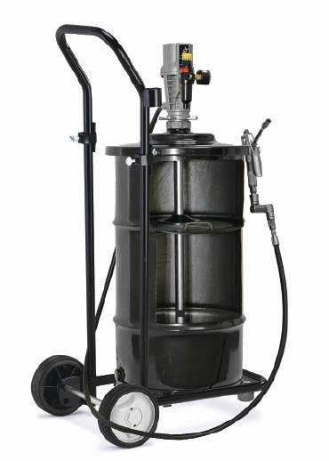
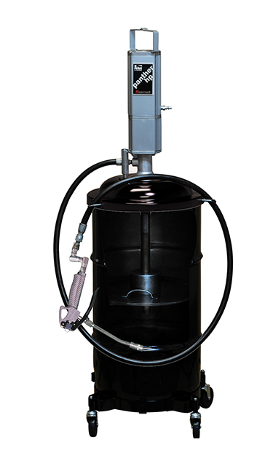

Grease Application
Volume from 1.2 lbs. (.7 kg) to 88 lbs. (40 kg) per minute
Containers from 35 lb. (16 kg) pails to bulk totes
Portable & stationary applications
Mobile service truck applications
Notes:
Complete line of portable and stationary grease dispense products.
All of our grease pumps are priming piston. Describe how a priming piston works

Slide 22
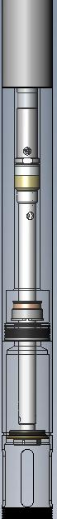
Priming Piston Pump
2) Once loaded, the up-stroke of the piston causes the grease to be pushed into the pump tube and travels up the pump and through the outlet.
3) The flat piston attached to the bottom of the piston rod. As the piston travels to the bottom of the stroke it creates a vacuum which pulls the grease into the pump tube.
AIR
MOTOR
OUT
1) To properly load a grease pump, grease must travel through the slots in the foot valve.
FLUID
ASSEMBLY
IN
IN
Notes:
Speak of the slots on the foot of the pump and how these slots allow the grease to enter into the pump. Reason we mention this is that for the fixed follower plate outfit you have to pay close attention to how you fasten the follower plate to the bottom of the pump. If not assembled properly you can clamp down on the pump rod or block the slots. When assembling the follower it should be flush to bottom of foot and set screws should be on the body of the foot valve.

Slide 23
Grease Application – Classification
NLGI Grade | Appearance | Analogy
000 | Fluid | Cooking Oil
00 | Semi-Fluid | Applesauce
0 | Very Soft | Brown mustard
1 | Soft | Tomato Paste
2 | “Normal” Grease | Peanut Butter
3 | Firm | Vegetable Shortening
4 | Very Firm | Frozen Yogurt
5 | Hard | Smooth Pate
6 | Very Hard | Cheddar Cheese
Notes:
This slide shows you the visual picture of the complete range of grease and the varies viscosities we encounter.
Its critical to understand what type and grade of grease you will be pumping.
Today we can pump up to a #3 grease with an inductor pump.
#2 grease is the normal grease in automotive applications.

Slide 24
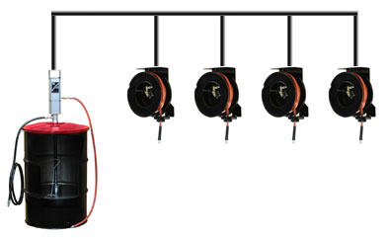
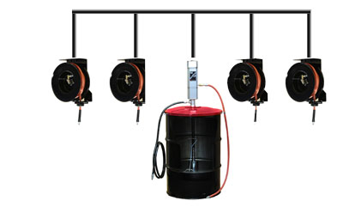
Grease Application
Criteria For Grease Pump Selection
  Type and composition of grease: NLGI grade, petroleum or synthetic based, amount & type of compounds
  Application: Bearings; 5th wheels; Zerk fittings.
  Required Flow
  Distance to be pumped
  System configuration
  Environment
A
B
Notes:
Application, flow and distance are the most critical factors to know and understand.
Do you want pressure or volume? Pumping grease is a balancing act between the two. For zerk fittings you need pressure and for 5th wheel applications you need volume.
Grease is always in lbs. (kg) vs. oil is measured in gal (L).
Assume a 300’ horizontal run. Which illustrations requires more pressure to deliver the same volume of grease?
Answer – System A . Greater pressure loss over the entire 300’ vs. the pressure loss over half the distance in system B

Slide 25
Grease Application
Helpful Tips About Grease
  Grease becomes difficult to pump as the temperature decreases. During winter make sure the grease has been at room temperature for a minimum of 24 hours, otherwise you may need to increase the air pressure to the pump (5 -10 psi) (3.4 – 6.8 bar) to maintain the same grease flow.
    Tip #1 – During winter you can heat the grease with electric drum heaters or blankets which will reduce its viscosity and make it easier to pump.
    Tip #2 – Add 1-3 lbs. of weight evenly distributed on the follower plate to improve pump loading and flow.
Notes:
The term thixotropic defines grease…the colder it gets the thicker it becomes and the more difficult it is to pump.
Worst case scenario – Mobile lube truck operator driving a lube truck in the middle of winter in International Falls, MN.
The information regarding grease pump failures was compiled through several years of warranty data.

Slide 26
Grease Application
Helpful Tips About Grease (cont.)
  Industry wide the 1st cause for grease pump failure is foreign debris getting into the pump and damaging the packings.
    Tip #1 – Strongly recommend during drum change out the technician lay the pump and follower plate on clean paper (not rags). This will prevent foreign debris from attaching itself to the grease on the suction tube and follower plate.
    Tip #2 – During drum change out ensure the follower plate is removed from the empty drum and properly installed in the new drum. 2nd highest cause of grease pump failure is attributable to not replacing the follower plate and removing trapped air.
Notes:
Its important for the distributor to conduct a formal training session with the service technicians at the time of system start-up to review all of this information. Be proactive and save yourself a lot of headaches and phone calls.

Slide 27
Grease Application
Helpful Tips About Grease (cont.)
  Industry wide another common cause of failure is follow plate failure due to drum dents, tacky/fibrous grease pump cavitation.
    Tip #1 – Recommend the use of a fixed follower plate or grease inductor pump system. Benefits include:
      Improved pump loading and performance.
      Reduce waste.
      Easy drum change out with power lift assist
      Clean and convenient method of drum change out.
      Reduced risk of back injuries.
      HR or Safety – Workman’s comp or lost time accidents? Added insurance
Notes:
Its important for the distributor to conduct a formal training session with the service technicians at the time of system start-up to review all of this information. Be proactive and save yourself a lot of headaches and phone calls.

Slide 28
Lynx Grease Pump – 55:1 Ratio
Customer type
  Portable single point dispense unit for grease fittings
  Fits: 25-35, 120 & 400lb. Drums
Fluids
  NLGI #2 grease
Applications
  Roll-around unit for single point greasing
  Agriculture/Farm implement
  Small truck shop
  Auto dealership
  Tire/transmission shops
  Lube & service trucks
  Quick lube
  In-plant service
Notes:
The Lynx 2.75” dia. / 55:1 ratio pump is primarily used for single point dispensing and is ideal for low volume users. The Lynx pump is a double action, positive displacement pump capable of delivering up to 1.2 lbs. per minute @ 318 cycles per lb.. Review cycles per pound as you move forward when comparing the Lynx VS Panther VS Lion 40:1 and speak to the much slower cycle rate as the motor /piston size increases.
Speak to accessories on next page of catalog – outfits, carts, dolly’s.

Slide 29
Panther Grease Pump – 50:1 Ratio
Customer type
  Portable single point dispense unit for grease fittings
  Small overhead reel applications for grease fittings
  35, 120 & 400 lb. drums
Fluids
  NLGI #2 grease
Applications
  Roll-around outfit
  Agriculture/Farm implement
  Independent truck shops
  Auto dealership
  Tire/transmission shops
  Small lube & service trucks
  Quick lube
  In-plant service
Notes:
The Panther 2.5” dia. / 50:1 ratio designed for lower volume user up to 2 dispense points. The Panther pump is a double action, positive displacement pump capable of delivering up to 3.4 lbs. per minute at 70 cycles per lb.. Speak to accessories on next page of catalog – outfits, carts, dolly’s.

Slide 30
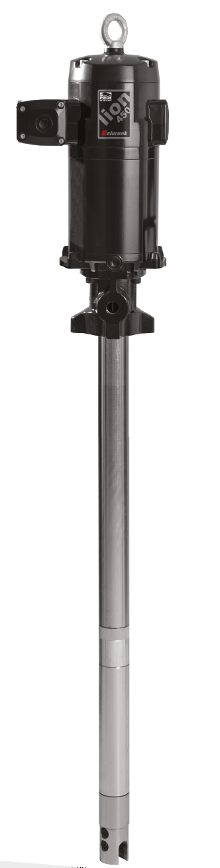
Lion 450 Grease Pump – 40:1 Ratio
Customer type
  Medium volume delivery, high pressure
  Can be used with a follower plate, inductor and double post RAM for high delivery and viscous materials
Fluids
  NLGI #2 grease
Applications
  HD truck grease dispensing needing multiple and simultaneous dispensing
  Trucks/fleets fifth wheel applications
  Lube trucks
  Railroad/mass transit
  In-plant
  Marine
Notes:
The Lion 4.5” dia. / 40:1 ratio is designed for higher volume and up to 4 dispense points. The Lion pump is a double action, positive displacement pump capable of delivering up to 24 lbs. per minute at 10 cycles per lb.. Speak to accessories at the end of the Lion pump section of catalog.
In many cases the end user is not so much interested in pressure but what is needed is flow. Many in trucking industry use these pumps for greasing the fifth wheel on truck. So flow rate is more important!

Slide 31
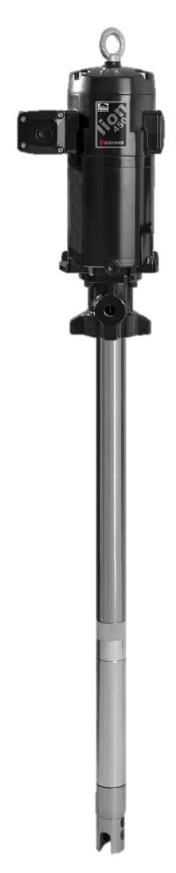
Lion 450 Grease Pump – 70:1 Ratio
Customer type
  Cold weather environments
  Limited air pressure supply (lube trucks)
  Can be used with a follower plate, inductor and double post RAM for high volume applications
Fluids
  NLGI #2 grease
Applications
  Trucks/fleets fifth wheel applications
  Lube trucks
  Railroad/mass transit
  In-plant
  Marine
  Oil fields/fracking
Notes:
The Lion 4.5” dia. / 70:1 ratio is designed for when Higher pressure is needed for heavier grade of Grease and/or very long distance to furthest dispense point. Good for up to 4 simultaneous dispense points. The Lion pump is a double action, positive displacement pump capable of delivering up to 16 lbs. per minute at 17 cycles per lb.. Speak to accessories at the end of the Lion pump section of catalog.
In many cases the end user is not so much interested in pressure but if this pump is needed it will be because additional pressure is required. Be sure to verify the excess pressure need!

Slide 32
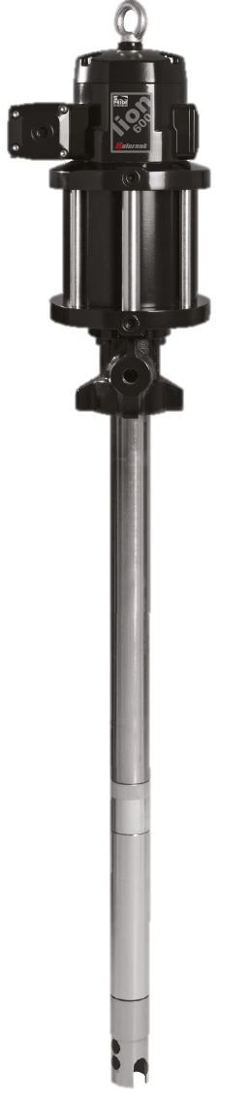
Lion 600 Grease Pump – 80:1 Ratio
Customer type
  Cold weather environments
  Limited air pressure supply (lube trucks)
  Can be used with a follower plate, inductor and double post RAM for high volume applications
  Similar to Lion 450 70:1 but operates at lower cycle rates for severe environments
Fluids
  NLGI #2 grease
Applications
  Trucks/fleets fifth wheel applications
  Lube trucks
  Railroad/mass transit
  In-plant
  Marine
  Oil fields/fracking
Notes:
The Lion 6.0” dia. / 80:1 ratio is designed for when Higher pressure is needed for heavier grades of Grease and/or very long distance to furthest dispense point. Good for up to 4 simultaneous dispense points. The Lion pump is a double action, positive displacement pump capable of delivering up to 18 lbs. per minute at 11 cycles per lb.. Speak to accessories at the end of the Lion pump section of catalog.
In many cases the end user is not so much interested in pressure but if this pump is needed it will be because additional pressure is required. Be sure to verify the excess pressure need!

Slide 33
Lion 600 High Volume Grease Pump – 12:1 Ratio
Customer type
  Medium pressure pump for high volume short distance bulk transfer
  Large containers (bulk tote)
  3” cam lock connector for totes
Fluids
  NLGI #2 grease
Applications
  Railroad/mass transit
  Mining and construction
  In-plant grease transfer
Notes:
The Lion 6.0” dia. / 12:1 ratio is designed for High volume transfer of grease. This 12:1 pump is available on the double post RAM and is great for the transfer of grease. Think about your distributors/oil marketers that are filling pails/totes from drums or filling from a totes to drums/pails.
The Lion pump is a double action, positive displacement pump capable of delivering up to 88 lbs. per minute at 2 cycles per lb..
In many cases the end user is not so much interested in pressure but if this pump is needed it will be because additional pressure is required. Be sure to verify the excess pressure need!
Speak to accessories at the end of the Lion pump section of catalog.

Slide 34
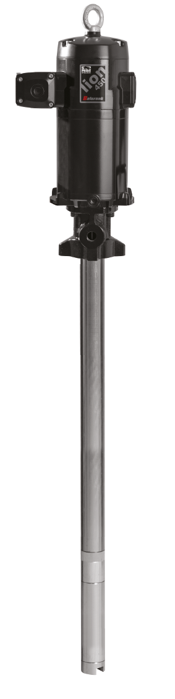
Lion 450 Medium Pressure/High Volume Grease/Oil Pump – 25:1 Ratio
Customer type
  Oil jobber bulk fill
  Can be used for grease and oil
  High volume medium pressure bulk grease transfer applications
  High pressure low volume oil applications for cold environments or very long pumping distance
Fluids
  NLGI #2 grease
Applications
  Lube truck bulk transfer
  Mining and construction; grease and oil transfer
  In-plant supply/maintenance
Notes:
The Lion 4.5” dia. / 25:1 ratio is designed for medium pressure/Higher volume transfer of both oil and/or grease.
The Lion pump is a double action, double ball/positive displacement pump capable of delivering up to 35 lbs. per minute at 6 cycles per lb..
In many cases the end user is not so much interested in pressure but if this pump is needed it will be because additional pressure is required. Be sure to verify the excess pressure need!
Speak to accessories at the end of the Lion pump section of catalog.

Slide 35
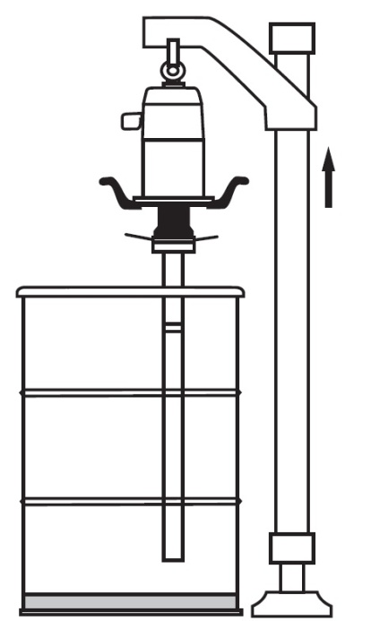
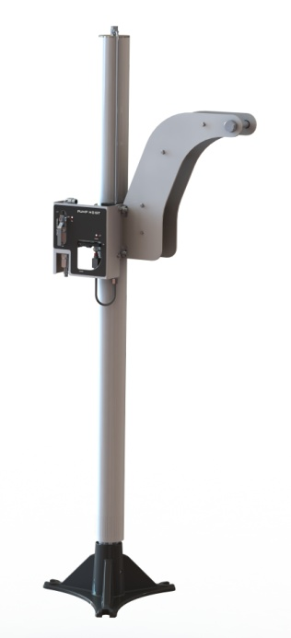
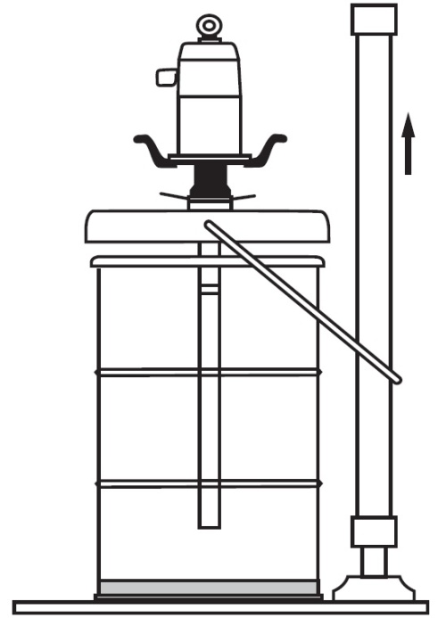
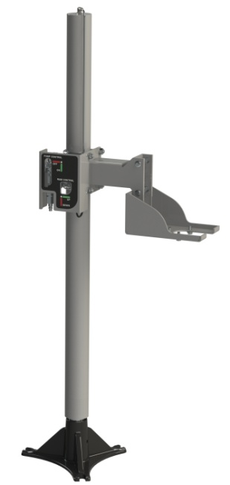
Lube Pump – Accessories
Lube pumps accessories: HOISTS
  Hoists lift the pumps, avoiding injury to the user when changing the drum
Notes:
The air operated pump hoist is used to lift and lower a pump making drum changes; easier, faster and SAFER!

Slide 36
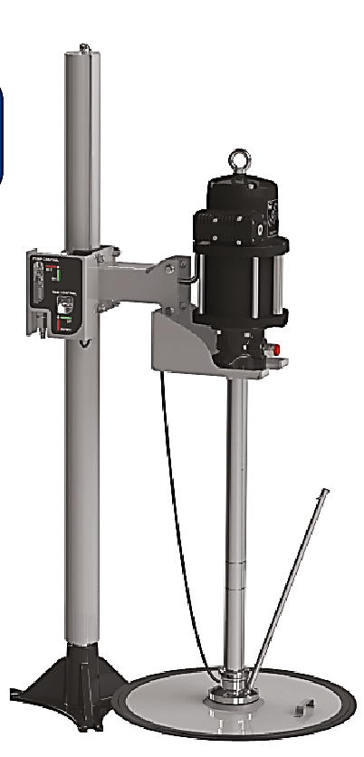
Lion Inductor – Grease Pumps
Customer type
  Cold weather environments
  400 lb. drum applications where higher volume grease is needed
  Environments where drum change out safety is a concern
Fluids
  NLGI #2 grease
Applications
  Trucks/fleets fifth wheel applications
  Medium/large volume vehicle maintenance shops
  Grease transfer
  In-plant grease supply
Pumps available
  Lion 450 40:1 & 70:1
  Lion 600 80:1
Notes:
The Lion Inductor or Fixed follower plate outfit works because the pump lower end is rigidly fixed to the follower plate and the follower plate has a single rubber lip. The weight of the pump, pump bracket and follower plate PLUS atmospheric pressure push the assembly against the grease eliminating channeling and air pockets, keeping the grease free from contaminants, minimizing waste and aiding pump priming.
The fixed follower plate outfit has several advantages; the pump is fixed to the follower plate which makes operation for the technician easier, faster, cleaner and safer!
The system is also more efficient and instead of leaving 4-6” of expensive grease on the bottom of a drum; that will either be wasted or require someone to dig it out. In the case that someone digs the grease out this brings up another issue of cleanliness. If not careful you can contaminate the new grease and let debris get into the system and ultimately into the vehicle being serviced.
- The air operated pump hoist is used to lift and lower a pump making drum changes; easier, faster and SAFER!

Slide 37
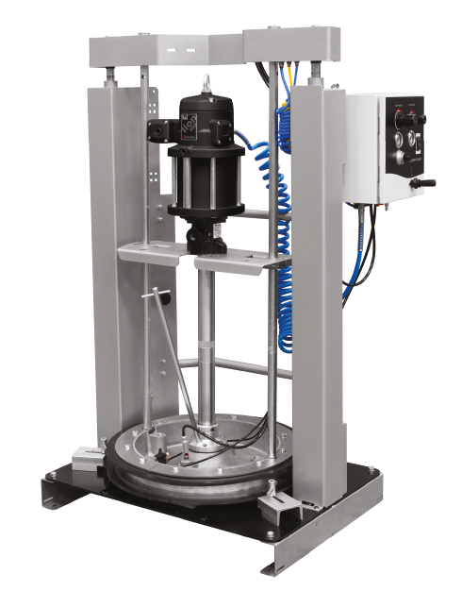
Lion RAM – Grease Pumps
Customer type
  Cold weather environments & higher viscosity grease is used
  400 lb. drum applications where highest volume grease is needed
  Environments where drum change out safety is a concern
Fluids
  NLGI # 2 grease
  NLGI # 3 grease
Applications
  Trucks/fleets fifth wheel applications
  Mining bulk transfer
  Grease transfer
  In-plant grease supply & transfer
Pumps available
  Lion 450 40:1 & 70:1
  Lion 600 80:1 & 12:1
Notes:
The Lion RAM outfit outfit works because the double post RAM is pressurized and the RAM is pushing with force the entire pump assembly into the grease. The pump lower end is also rigidly fixed to the follower plate and the follower plate has a double HD rubber lip which creates a very tight seal allowing for the greater RAM pressure onto the grease. The RAM assembly is exerting the set air pressure onto the pump, pump bracket and follower plate push the assembly against the grease eliminating channeling and air pockets, keeping the grease free from contaminants, minimizing waste and aiding pump priming.
The fixed follower plate outfit has several advantages; the pump is fixed to the follower plate which makes operation for the technician easier, faster, cleaner and safer!
The system is also more efficient and instead of leaving 4-6” of expensive grease on the bottom of a drum; that will either be wasted or require someone to dig it out. In the case that someone digs the grease out this brings up another issue of cleanliness. If not careful you can contaminate the new grease and let debris get into the system and ultimately into the vehicle being serviced.
- The air operated pump hoist is used to lift and lower a pump making drum changes; easier, faster and SAFER!

Slide 38
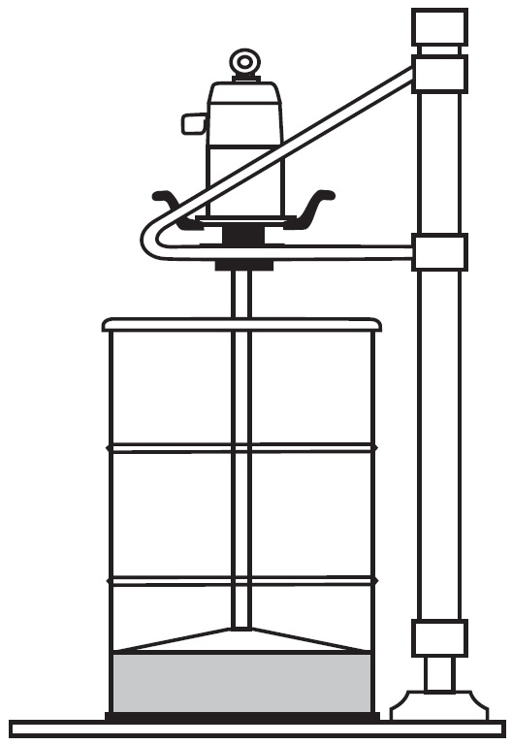
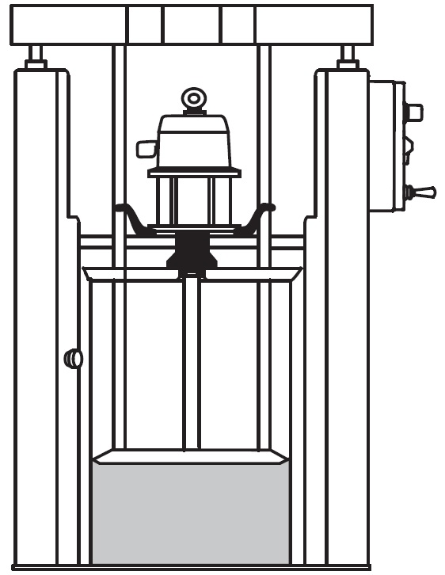
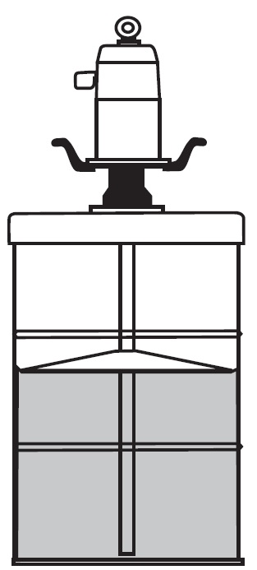
Lion Grease Pumps – Installation
Grease pumps installation:
  400 lb.
NLGI-0-1 greases
Cover + sliding follower plate
(120 or 400 lb)
NLGI-2 grease
Hoist + attached follower plate
(400 lb)
NLGI-3 grease
RAM + attached follower plate
(400 lb)
Can also be used with NLGI-2 grease
If using the correct follower plate
Notes:
Good illustrations above that show the difference in all three types of outfit;
Standard follower plate outfit left side
Fixed-follower plate outfit (Inductor) middle
Ram outfit with added external air pressure and fixed-follower plate (Inductor) right side

Slide 39
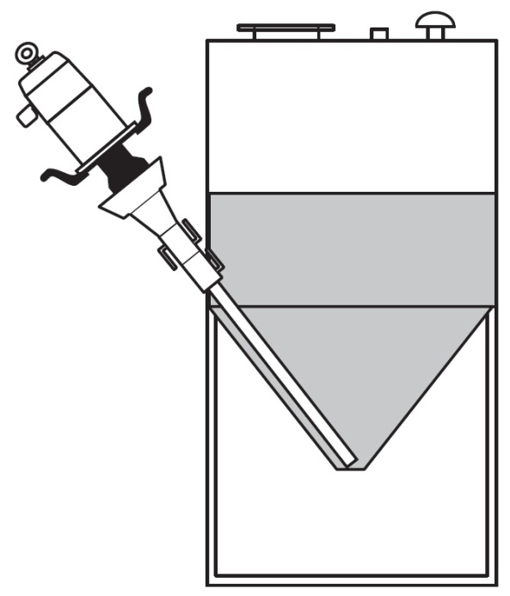
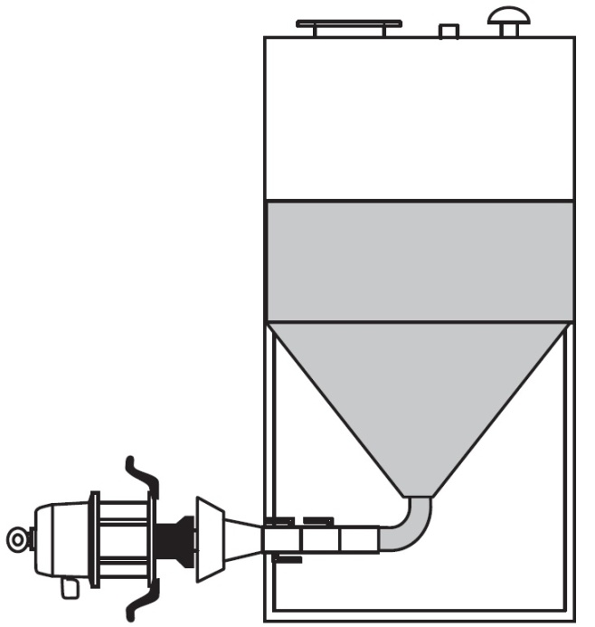
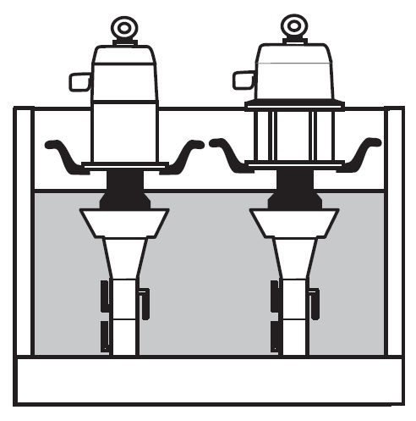
Lion Grease Pumps – In-Plant Installation
Grease pumps installation:
  Container mount via cam-lock
Incline mount
Long pumps
Horizontal mount
Short pumps
Vertical mount
Short pumps
Notes:
Some In-plant application to think about. Good topic of disussion when speaking with Oil Marketers that sell a lot of grease

Slide 40
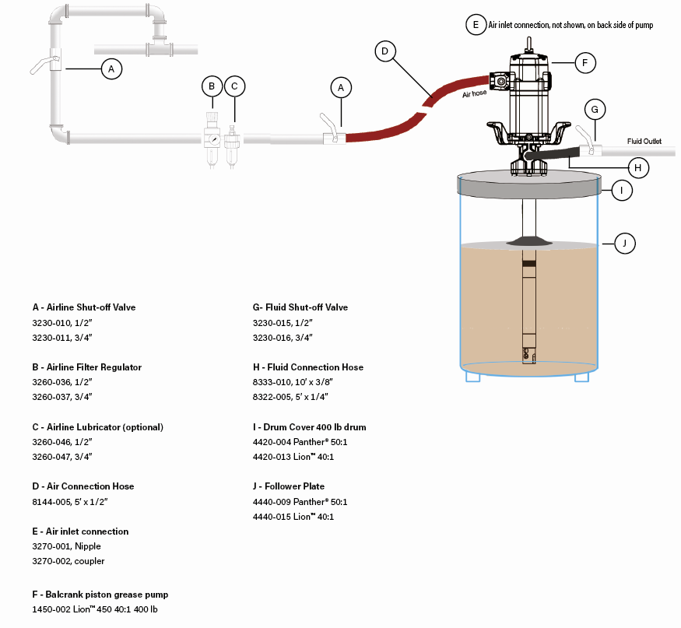
Typical Grease System – Components

Slide 41
Pumping Solutions
AODD Pumps
Pump sizes & Applications

Slide 42
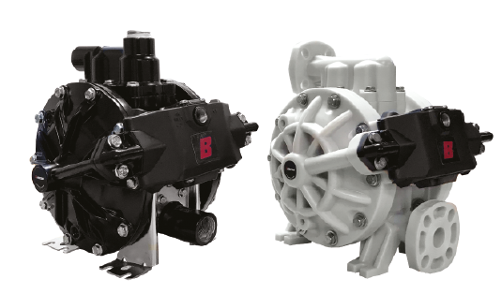
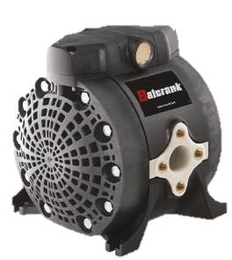


Air Operated Double Diaphragm Pumps
Range from ½” to 2”
10 GPM to 70 GPM
All 1:1 ratio
Aluminum and Polypropylene construction
Applications
  Used oil evacuation
  High volume short distance bulk fill
  Windshield wash
  Anti-freeze
  Mobile lube
Notes:
- AODD’s are typical used in higher volume and lower pressure fluid transfer applications.
The UL version of the 1” AODD is typically used for used oil evacuation and diesel fuel transfer.
The current line of AODD’s are most commonly used for vehicle maintenance applications.
Additional applications requests should be referred to Technical Assistance.

Slide 43

CenterFlo – Technology
CenterFlo Pumps
  Fluid flows through the center of the pump while air is in the outside
Conventional Pumps
  Fluid flows in the outside while air is in the center of the pump
CenterFlo Advantages
  Smaller footprint
  Up to 30% less air consumption
  Ice free air motor design
  Less pulsation
Notes:
Note the difference in the fluid flow of the new CenterFlo vs. the tradtional AODD.
Reverse operation of the air motor vs. the fluid path.

Slide 44

CenterFlo – The New Diaphragm Pump
New valve, seats
and cage allows for precise checking and performance
Simple air motor design – one moving part!
Friction-Free
Pivoting Valve.
No spool valve or o-rings
Flexible Diaphragm Suspension reduces fatigue on the diaphragms, contributing to extend service life
Straight flow through connections
Notes:
The new CenterFlo pump provides improved flow with less air consumption and a smaller compact design.
Balls & seats are closer to the diaphragms which provide less pulsation and improved performance.
Air motor design is ~ 40% more efficeint than traditional pumps.
Flexible Diaphragm Suspension reduces fatigue and assist in extending service life of the diaphragms.
Diaphragm shaft life is also increased since the diaphragm only pushes the shaft but does not transmit non-axial loads
Inlet/outlet orientation allows for pump maintenance without removing the pump from service.

Slide 45



CenterFlo – CF10, 15 & 30
CenterFlo pumps handle a wide range of fluids used for vehicle service
Available in both poly and aluminum, and in ½” and 1” sizes with flow rates from 10–30 Gallons per minute
Fluids
  Synthetic and Mineral based oils,
  Coolant
  WWS (POLY)
  DEF (POLY)
  Used Engine Oils and Coolants
Fresh & Used Fluid Applications
  Automotive dealerships
  Fleets
  Mining/construction
  Railroad
  Mass Transit
  Mobile lube
Notes:
Explain what the CF10, 15 & 30 means as it relates to Maximum flow capacity and to think about the application flow rate needed: Not Thread size!
– CF10 10 GPM with ½” NPT inlet/outlet * CF15 is 15 GPM also ½” NPT inlet/outlet * CF30 is 30 GPM with 1” NPT inlet/outlet
Speak to material pump selection – POLY pumps should be used with Window Wash and DEF fluids as both have unique challenges to be overcome.
Discuss no Lubricators for AODD pump and the need for moisture filtration for the air supply to pumps.
Mention Pressure Relieve is recommended for fresh fluid system transfer as Multi-grade lubricants are designed to expand as heat increases.
Used fluid systems need pump inlet Filtration to reduce potential pump downtime/repair due to debris getting stuck in pump.

Slide 46

CenterFlo – CF15 Mixing
Available in poly, CF15 mixing pumps are ideal for the medium sized user looking to proportion fluids at a 1:1 ratio
Customer type
  Proportioning/mixing of similar viscosity fluids; medium volume
Fluids
  Anti-Freeze
  WWS
Applications
  Quick lubes
  Dealerships
  Oil jobbers
  In-Plant
  Independent Garages
Notes:
- Dual inlet proportion mixing of fluids of similar viscosity. Both fluids and the resulting solution must be compatible with the pump wetted parts
- The pump is a 1:1 ratio with maximum flow rate of 10 GPM with fluid inlet sizes being 3/8” NPT and the Fluid outlet sizes being 1/2” NPT
- Ideal for mixing Coolant or Window Wash Fluid product
_ Wetted Material is Polypropylene and Stainless Steel, Check Balls are PTFE, Diaphragms are Hytrel

Slide 47
CenterFlo – CF50
CF50 pumps are a direct replacement for any 1” AODD rated at 50 GPM
These pumps are most common for used fluid evacuation but also work for other applications
Customer types
  Medium/high volume dispense
  Used fluid evacuation
Fluids
  Anti-Freeze
  WWS
  DEF
  Oil
  Used fluids
Applications
  Quick lubes
  Dealerships
  Oil jobbers
  In-plant
  Lube trucks
Notes:
- CF50 is a high performance 1” AODD pump with many of the unique features of the CF series pumps, the NEW CF50 utilizes the flow through fluid technology and produce’s up to 50 gallon per minute of fluid flow.
- Pressure relieve kit available 3120-202 when pumping multi-grade lubricants
- Notable Features:
Reduction in air consumption, a non-icing air motor,
VERSITLE inlet and outlet ports can be orientated to fit existing installation/application
Same great ease of service; diaphragms and air motor can be serviced in place.
Multi-pattern foot print; can match up to easily replace competitive products
Polypropylene pump includes flange kit 4411-037 for flange pump mounting

Slide 48

CenterFlo – CF65
CF65 pumps are 1 ½”, rated at 65 GPM and made of aluminum only. These pumps are used for high volume applications where the flow rates of the CF30 or 50 are too low
Customer type
  High volume dispense and evacuation for large vehicles
Fluids
  Anti-Freeze
  Oil
  Used fluids
Applications
  Oil jobbers in plant transfer
  In-plant industrial
  Lube trucks
  Mining
Notes:
Cover inlet outlet size – 1 ½” NPT
Maximum Flow rate – 65 GPM
Works with NON-Corrosive fluids
Wetted Parts are Aluminum,

Slide 49

TraditionalFlo – TF170
Balcrank’s TraditionalFlo pump transfers fluid up to 170 gal/min. Combining conventional flow design with pivoting air valve for increased delivery and reliable performance.
Customer type
  Very large volume transfer and evacuation
Fluids
  Anti-Freeze
  Windshield wash solution
  Used oil
  Synthetic and mineral oil
Applications
  Mining and construction
  Railroad and mass transit vehicles
  In-plant transfer
  Agriculture/Farm implement
  Lube trucks
Notes:
Cover inlet outlet size – 1 ½” NPT
Maximum Flow rate – 65 GPM
Works with NON-Corrosive fluids
Wetted Parts are Aluminum,

Slide 50
AODD – Conventional
The traditional 1” UL pump is used primarily with diesel fuel where UL listing is required and lower pressure and flow are needed for this application
Customer type
  Medium large dispense and evacuation
  Applications needing UL listing
Fluids
  Anti-Freeze
  Oil
  Used fluids
  Diesel fuel
Applications
  In-plant
  Lube trucks
  Mining
Notes:
Explain we keep the stsnadr type pumps bacuse of UL listing for the 1” and the other for the 2” sizing

Slide 51

AODD – Typical Evacuation System

Slide 52

AODD – Typical DEF Pumping System

