Slide 1
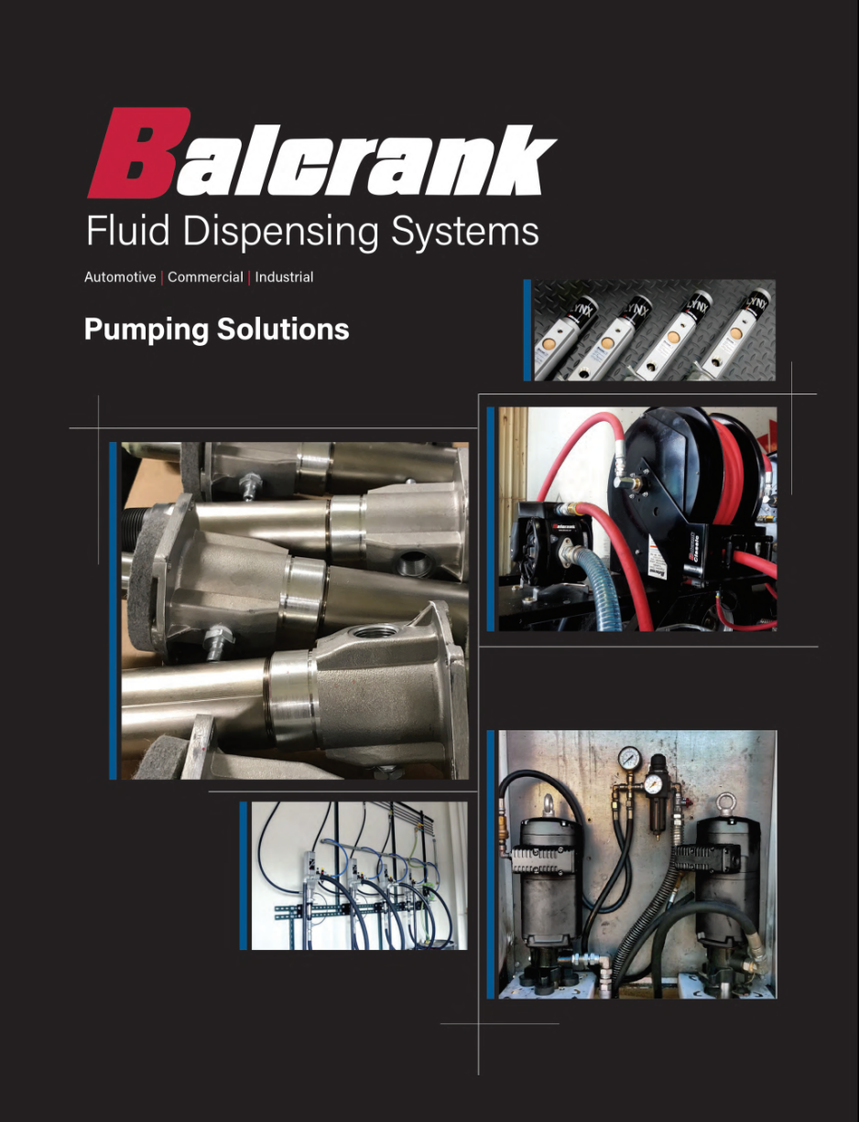
Compressed Air
The Heart or the Cancer?
Compressed air systems and accessories
for removing debris and moisture before entry into pneumatic pumps

Slide 2
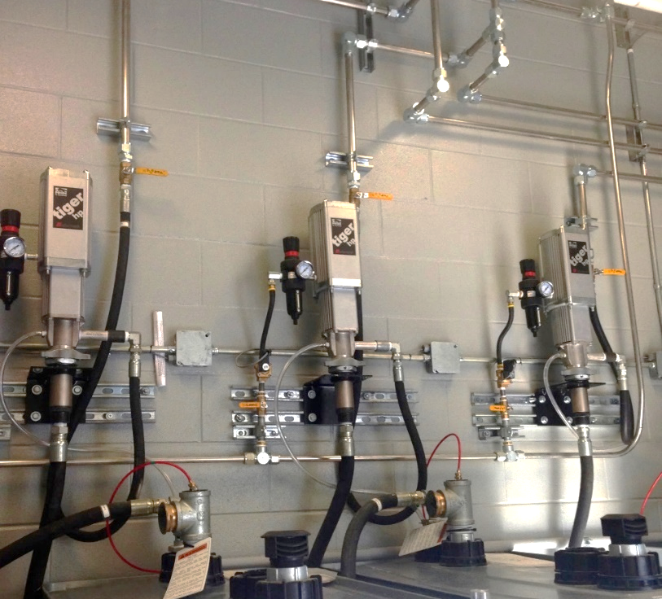
Discussion – Topics to address
Typical System Issue – Water!
Compressed Air Systems
Air/Water filtration
Water/Moisture removal
Notes:
Review the course contents.

Slide 3
Compressed Air & Moisture – The Enemy
A 200 HP compressor operating in a climate of 60°F with 40 percent relative humidity will generate approximately 50 gallons of condensate a day. However, that same compressor operating in a climate of 90°F with 70 percent relative humidity will generate approximately 260 gallons of condensate a day
Notes:
Have one of the participants read the slide. Discuss the importance of compressor maintenance and filter (water traps - minimum defense).

Slide 4
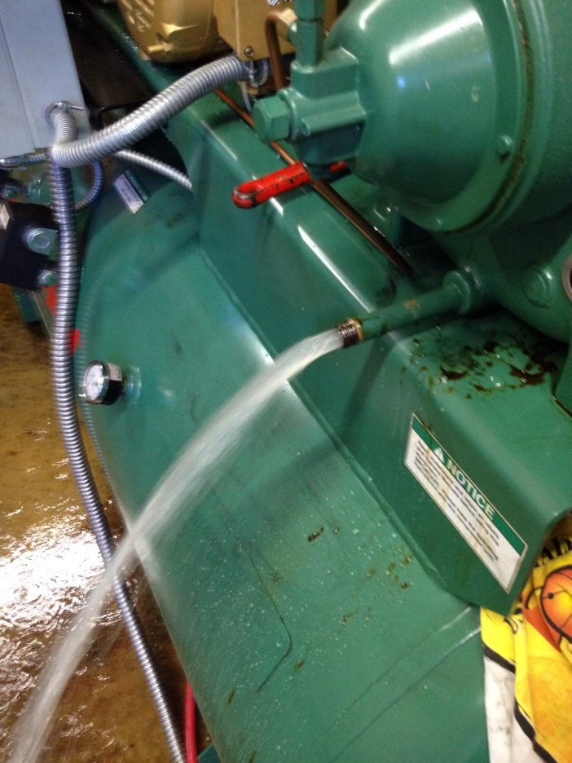
Outcome & Solution – How bad can it get?

Slide 5
The Air System – Importance
Debris and Moisture generated in an air system can cause premature pump failure, air tool failure, and compressor failure.
Air filtration and moisture separation is the key to long term equipment reliability & compressor performance.
Most shops require a large volume of air. Failure of the compressor, pumps, pneumatic equipment stops business in its tracks!
Air compressor and equipment break downs cause serious shop disruptions that cost $$$ in repairs and down-time.
Notes:
All air operated pumps are assembled using grease as a lubricant. Water introduced from the air system can prematurely wash the grease from the air motor causing premature pump failure.
Correctly sizing the compressor to the application is the 1st step to minimizing water in the system.
Correctly sizing the filter to the application is the 2nd step to minimizing water in the system.
Proper daily and weekly maintenance which includes draining the compressor tank and drop legs is the 3rd step in minimizing water in the system.
The #1 cause for a pump failure is water in the air motor……and it is not covered under warranty!

Slide 6
The Air System – Minimizing Debris & Moisture
Size your system properly
An electric compressor will generate 5 CFM/HP generally
Install the correct pipe system
Proper pipe or tubing sized to volume required
Drip leg to catch water – to be drained daily (Minimum)
Drops to pneumatic equipment and tools face upward
Air Main slants back towards the compressor with manual tank drain (Minimum)
Install air filter and MOISTURE separator to protect your investment
Air filter removes dust, dirt, rust and other particles; poor at removing moisture!
Water Filtration BEST method to remove moisture molecules
Manual tank drains – most affordable; Auto-drain is preferred method
Manual water traps/drop leg – most affordable method, BUT …
Best solution to protecting the pneumatic pumps is a Liquid Separator
Other more expensive solutions – Aftercooler/separator remove about 70% moisture and for even dryer air the addition of a desiccant dryer may be needed but both options work well but at a cost. DO you need this?
Notes:
-Reiterate the comments from the previous slide.
It is important to note that an in-line-filter is not the same as a moisture separate. The filter will catch water in its liquid state, but water molecules in their vapor state are small enough to flow through most air filters.

Slide 7
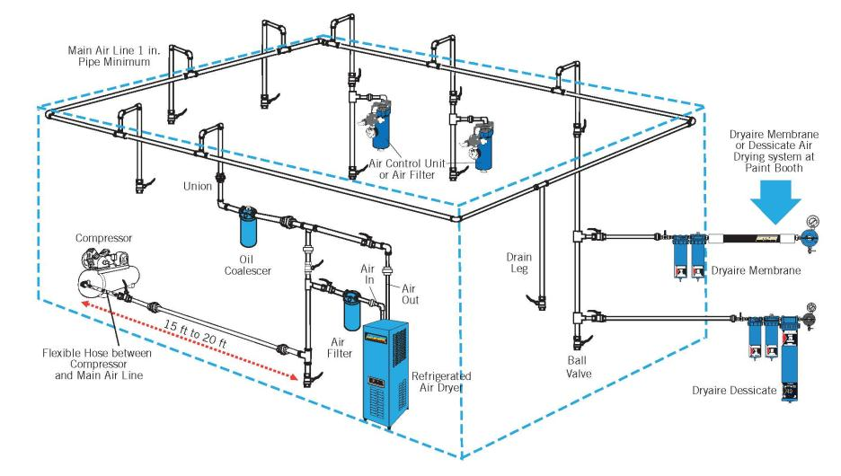
Looped Air System – With Drop Legs
Liquid
Separator
Notes:
Note the slope of the main air line to allow moisture to drain from the system.
Note the design of the air drops to not allow moisture to drain back to pumps or air tools.
- Automotive air systems typically do not include dessicate or refrigerated air dryers.

Slide 8
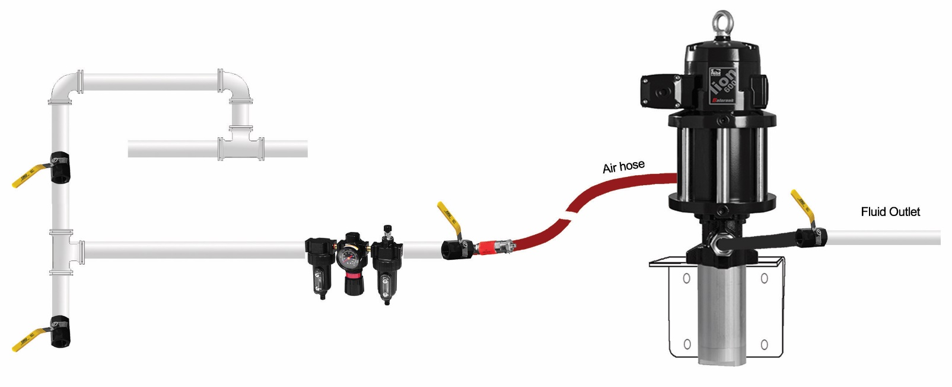
Compressed Air Supply – Pump Layout
Pump overrun valve stops pump when tank empty or downstream hose leak. Not required if low-level cut-off is used.
Size pump air supply hose to at least equal to the pump air inlet fitting size. Quick Disconnects can restrict air flow impacting pump performance.
Bleed-type master air valves relieve air trapped between the valve and downstream components. Prevents pump from unexpected cycling.
Ball valve for releasing collected moisture in header
Filter, Regulator and Lubricator. Filter and regulator recommended. Lubricator recommended only if properly maintained or specified.
Use air hose between header and pump to prevent air leakage at fittings due to pump vibration. Do not hard plumb the air line to the motor. On new systems distributor to obtain system air pressure and volume available.

Slide 9
Comparison – Why a Liquid Separator over an Air Filter?
Operation
Air enters the Liquid Separator inlet and turns into the Separator module. The inlet of the separator module contains a set of fixed vanes which the air pass through
The vanes force the air to spin inside the vessel, the spinning air is then forced to change direction as it passes the impinger
A vortex is created; which narrows and intensifies as it reaches the lower part of the separator module
Bulk liquid is removed from the airstream due to:
Directional changes of airstream
Velocity changes
Centrifugal action of the vortex
As the vortex reaches the bottom of the module, air is forced through the center of the vortex
Aerospace turning vanes, located in the outlet, turn the inefficient corner into beneficial motion. The turning vanes reduce turbulence, minimizing pressure loss and increase air output efficiency

Slide 10
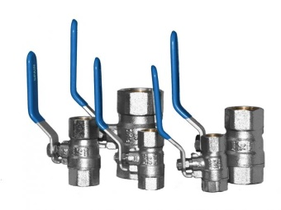
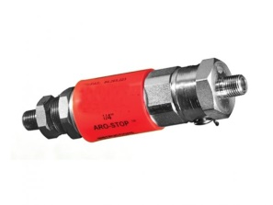
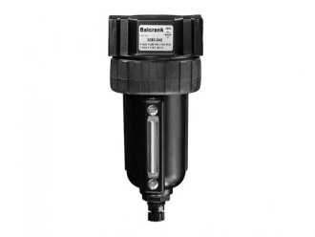
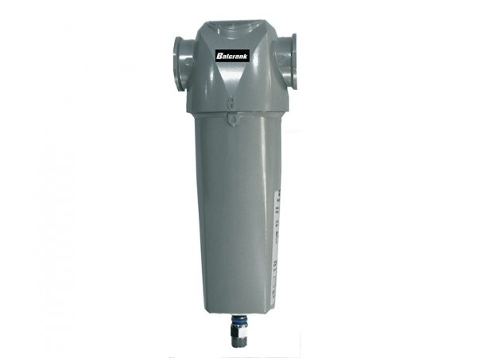
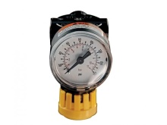
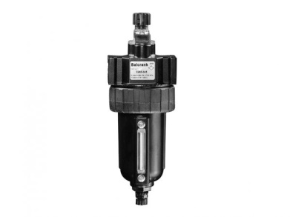
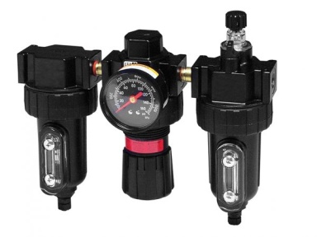
Components – Beneficial Air System Components
Ball valve - Pressure relieving - isolates pneumatic pump for after hours safety and ease of repair
Valve - Over-run control - Control SCFM flow to Grease pumps. Senses dramatic increase in air flow and shut off air supply to pump
Filter - reduces solid contaminants - such as dust, dirt, rust scale etc. from entering the pump
Separator Liquid - removes moisture - before entering into pneumatic pump
Regulator - regulates air pressure - to pneumatic pump based on viscosity of fluid and flow needed and should be set between 40-80 psi
Lubricator - injects lubricant - into air stream and should only be used where maintenance prevention is established and maintained
Notes:
Describe the critical components and their function.
Balcrank recommends including a check valve be placed on the bottom of the down tube for applications greater than 42” vertical lift.
The air supply components (air hose and FLR) should match the air requirements of the pump.
Filter/Regulators are required for warranty.
Lubricators are only recommended when specified or under extreme conditions. If used, the lubricator must be maintained and adjusted properly using 10W non-detergent only.
Pressure relief must be installed in hard piped systems. Lack of pressure relief valves can cause tips, hose reel swivels, and the hose to burst in extreme conditions.
Ball valve locations should include air supply to the pump, out-bound fluid supply to piping, and all hose reels.
The inclusion of the suggested air and fluid components can add significantly to your sales and commissions!

Slide 11
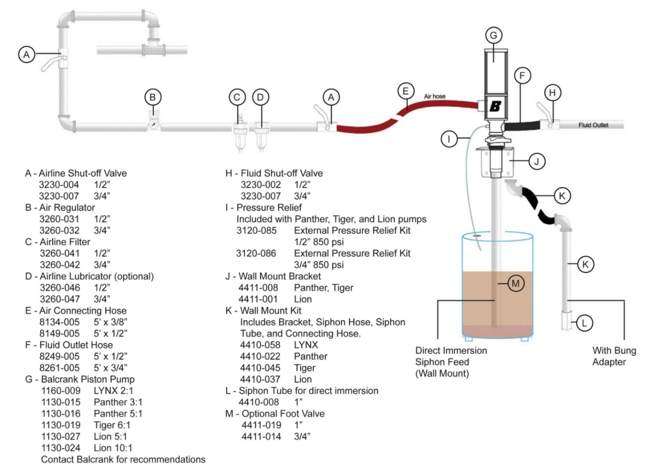
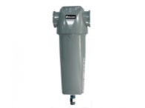
Components – Typical Oil System Components
C – Liquid Separator
3260-067 ½” NPT(F)
3260-068 ¾” NPT(F)
3260-069 1” NPT(F)
When assembling a system BOM, follow the trail of the oil from pump intake to dispense point

