Slide 1

Dispensing Solutions
Hose Reels, Control Handles

Slide 2
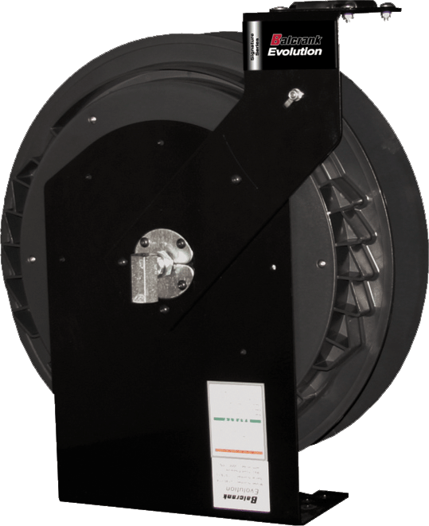
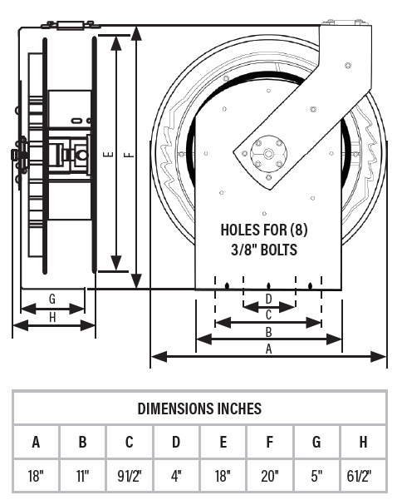
Signature Series Reels – Evolution
Features
  Spool mounted ball bearings
  Multi-position outlet arm
  Easy in place service and maintenance
  Easy on-site Tension adjustment
Sizes
  Air/Water up to 50’
  Oil up to 50’
  Grease up to 50’
  Diesel up to ¾” x 30’
Applications
  Car dealerships
  Quick lube
  Independent garage
  Tire shop
 | Air, Water & Anti-freeze LP – 300 psi | Lubricants MP – 2,750 psi | Grease HP – 5,000 psi
Fluid inlet | 1/2” NPT(F) swivel | 1/2” NPT(F) swivel | 3/8” NPT(F) swivel
Fluid outlet | 1/2” NPT(F) swivel | 1/2” NPT(F) swivel | 3/8” NPT(F) swivel
Outlet thread | 1/4” NPT(M) for 3/8” ID Hoses | 1/4” NPT(M) for 3/8” ID Hoses | 1/4” NPT(M) for 3/8” ID Hoses
 | 1/2” NPT(M) for 1/2” ID Hoses | 1/2” NPT(M) for 1/2” ID Hoses
Wetted materials | Brass, Acetal & Buna-N | Steel (plated) & Buna-N | Nickel Plated Steel, Hardened steel & Polyurethane
Notes:
Key selling points:
Composite spool – light weight, corrosion resistant.
All steel, powder coated pedestal and arm.
Same footprint as the classic and premium reels.
Dual, permanently lubricated ball bearings for easy retraction.
Fully ported, pressure balanced swivel for increased flow.
Multi position arm for mounting flexibility.
2.5’ inlet hose is included.
All key components are easily accessible without removing the reel.

Slide 3
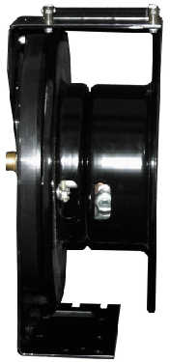
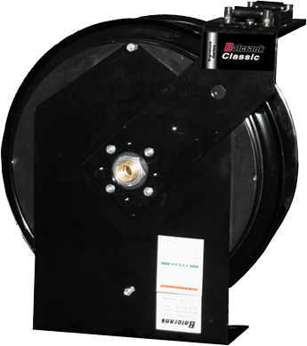
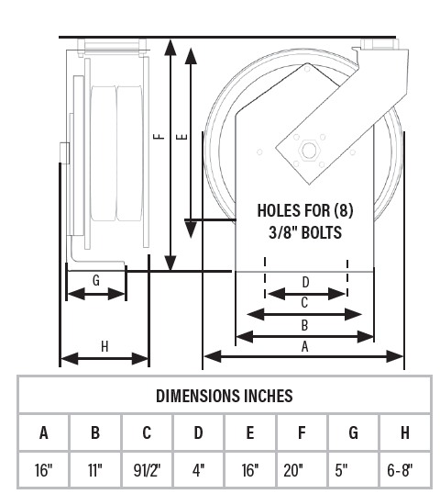
Signature Series Reels – Classic
Features
  Proven design for over a decade
  Heavy duty frame construction
  Compact design
  Easy installation and mounting accessories
Sizes
  Air/Water up to 50’
  Oil up to 50’
  Grease up to 50’
  Diesel up to ¾” x 30’
  DEF ¾ x 30’
Applications
  Car dealerships
  Quick lube
  Independent garage
  Tire shop
 | Air, Water & Anti-freeze LP – 300 psi | Lubricants MP – 2,750 psi | Grease HP – 5,000 psi | DEF LP – 150 psi | Diesel LP – 50 psi
Fluid inlet | 1/2” NPT(F) swivel | 1/2” NPT(F) swivel | 3/8” NPT(F) swivel | 3/4” BSPP(F) swivel | 3/4” NPT(F) swivel
Fluid outlet | 1/2” NPT(F) swivel | 1/2” NPT(F) swivel | 3/8” NPT(F) swivel | 3/4” BSPP(M) swivel | 3/4” NPT(F) swivel
Outlet thread | 1/4” NPT(M) for 3/8” ID Hoses | 1/4” NPT(M) for 3/8” ID Hoses | 1/4” NPT(M) for 1/4” ID Hoses | 3/4” BSPP(M) for 3/4” ID Hoses | 3/4” NPT(M) for 3/4” ID Hoses
 | 1/2” NPT(M) for 1/2” ID Hoses | 1/2” NPT(M) for 1/2” ID Hoses | 1/4” NPT(M) for 3/8” ID Hoses
Wetted materials | Plated steel, Brass, bronze & Buna-N | Steel (plated) & Buna-N | Plated steel, hardened steel & Buna-N | Stainless steel, Viton® | Plated steel and Buna-N
Notes:
Key selling points
All steel construction.
Welded and gusseted pedestal for strength and durability.
Powder coated for corrosion resistance.
Heavy gauge stamped rims and outlet arm.
Compact design.
High quality, name brand hose.
Proven, trusted design.

Slide 4
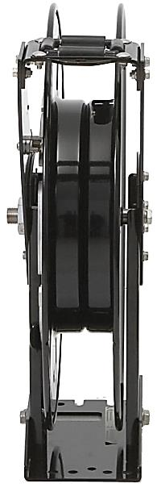
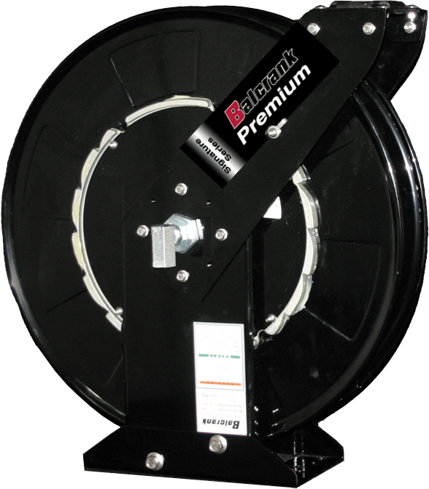
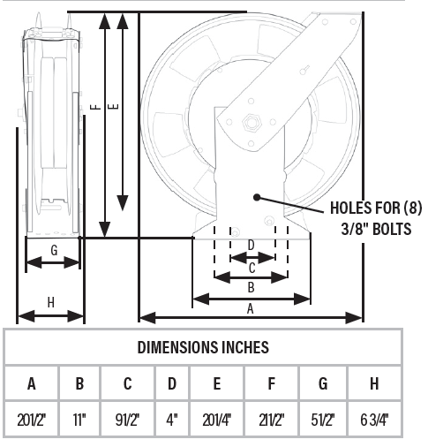
Signature Series Reels – Premium
Features
  Spool mounted ball bearings
  Ten position latch mechanism
  Double arm and pedestal
  Fully ported shaft and swivel
  Easy maintenance
Sizes
  Air up to ½” x 60’
  Oil up to ½” x 60’
  Grease up to 3/8” x 60’
Applications
  Heavy duty truck/fleet
  Municipality
  Mobile lube/service trucks
  Large car dealership
  Industrial manufacturing
  Trains/bus/aviation
 | Air, Water & Anti-freeze LP – 300 psi | Lubricants MP – 2,750 psi | Grease HP – 5,000 psi
Fluid inlet | 1/2” NPT(F) swivel | 1/2” NPT(F) swivel | 3/8” NPT(F) swivel
Fluid outlet | 1/2” NPT(F) swivel | 1/2” NPT(F) swivel | 3/8” NPT(F) swivel
Outlet thread | 1/2” NPT(M) for 3/8” ID Hoses | 1/2” NPT(M) for 3/8” ID Hoses | 1/4” NPT(M) for 1/4” ID Hoses
 | 1/2” NPT(M) for 1/2” ID Hoses | 1/2” NPT(M) for 1/2” ID Hoses | 1/4” NPT(M) for 3/8” ID Hoses
Wetted materials | Brass, Acetal & Buna-N | Steel (plated) & Buna-N | Nickel Plated Steel, Hardened steel & Polyurethane
Notes:
Key selling points
Duel pedestal, dual arm for added strength and durability.
Fully ported, pressure balanced swivel for increased flow.
Multi position arm for mounting flexibility.
2.5’ inlet hose is included.
New design allows for easy maintenance.

Slide 5
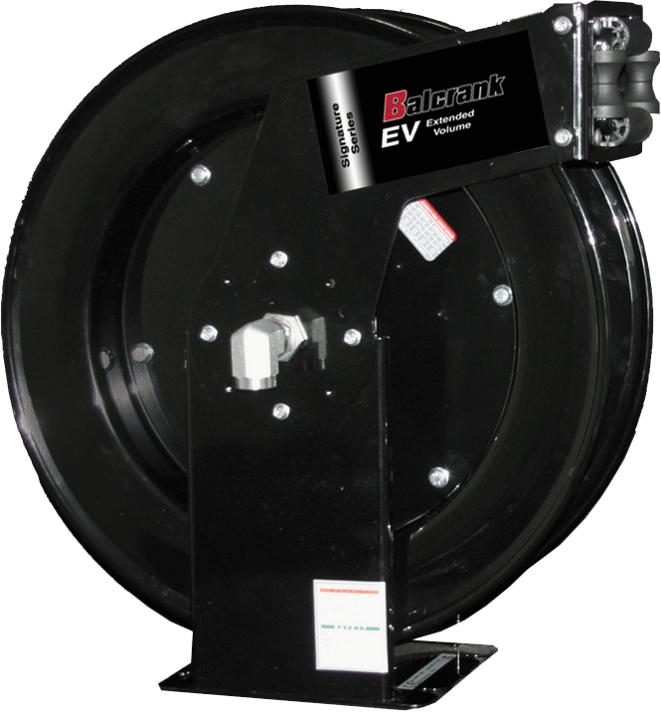
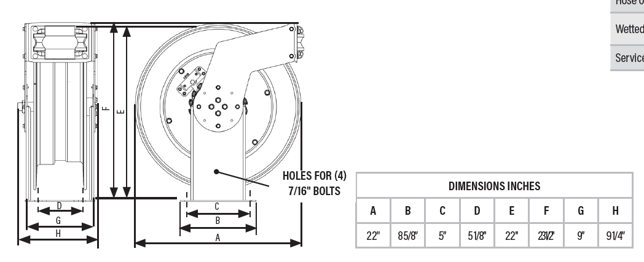
Signature Series Reels – EV
Features
  Multi-position outlet arm
  Fully ported shaft and swivel
  Ten position latching mechanism
  Dual ball bearings
  8-guage steel base and pedestal
Sizes
  Air up to ½” x 65’
  Oil up to ½” x 65’
  Diesel up to 3/4” x 50’
Applications
  Large diameter hose
  Heavy duty/truck/fleet
  Fuel & used oil evac
  Lube/service trucks
  Aviation/marine
  Large diameter, long lengths
 | Air, Water & Anti-freeze LP – 300 psi | Lubricants MP – 2,750 psi | Grease HP – 5,000 psi | DEF LP – 150 psi | Diesel LP – 50 psi
Fluid inlet | 3/4” NPT(F) swivel | 3/4” NPT(F) swivel | 3/8” NPT(F) swivel | 3/4” BSPP(F) swivel | 3/4” NPT(F) swivel
Fluid outlet | 3/4” NPT(F) swivel | 3/4” NPT(F) swivel | 3/8” NPT(F) swivel | 3/4” BSPP(F) swivel | 3/4” NPT(F) swivel
Outlet thread | 1/2” NPT(M) for 1/2” ID Hoses | 3/4” NPT(F) swivel | 3/8” NPT(M) | 3/4” BSPP(M) for 3/4” ID Hoses | 1/2” NPT(M) for 1/2” ID Hoses
 | 3/4” NPT(M) for 3/4” ID Hoses | 3/4” NPT(M) for 3/4” ID Hoses |  |  | 1/2” NPT(M) for 1/2” ID Hoses
Wetted materials | Nickel plated steel & Buna-N | Nickel plated steel & Buna-N | Nickel Plated Steel, Hardened steel & Polyurethane | Stainless Steel, Polypropylene, & Viton® | Nickel plated steel & Buna-N

Slide 6
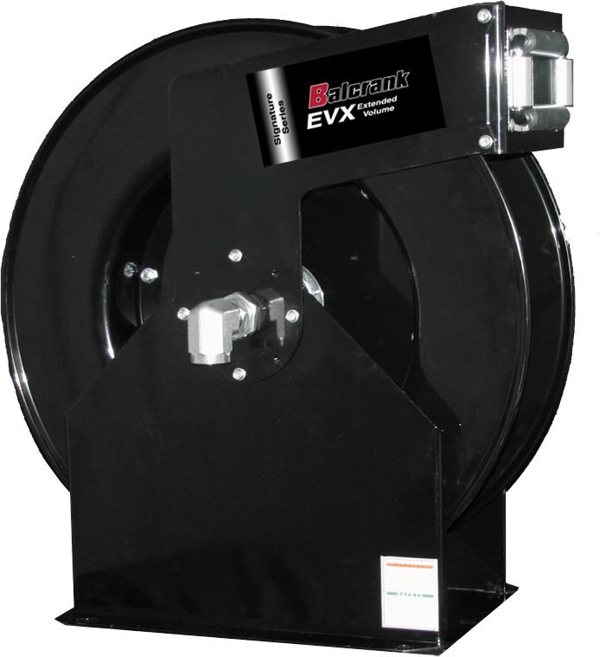
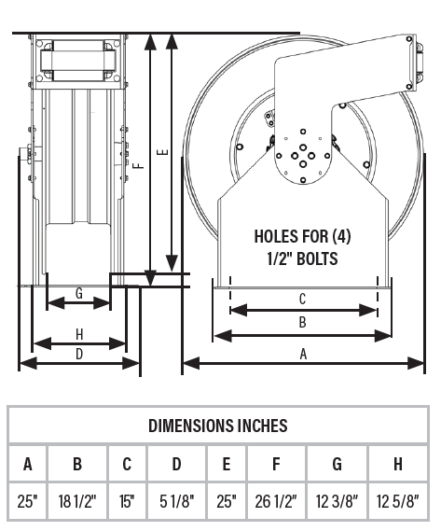
Signature Series Reels – EVX
Features
  Zinc plated steel rollers
  Multi-position outlet arm
  8 gauge steel base and pedestal
  Dual ball bearings
  Fully ported shaft and swivel
Sizes
  LP ½ x 100’
  LP ¾ x 75’
  MP ½ x 100’
  Diesel 1” x 50’
Applications
  Large diameter hose
  High volume air/water applications
  High volume oil dispense
  Heavy duty fleet and mobile lube trucks
  Diesel fuel and used oil evacuation
 | Air, Water & Anti-freeze LP – 300 psi | Lubricants MP – 1,525 psi | Diesel LP – 50 psi
Fluid inlet | 1” NPT(F) swivel | 1/2” NPT(F) swivel | 3/8” NPT(F) swivel
Fluid outlet | 1” NPT(F) swivel | 1/2” NPT(F) swivel | 3/8” NPT(F) swivel
Outlet thread | 1/2” NPT(M) for 1/2” ID Hoses | 1/2” NPT(M) for 1/2” ID Hoses | 1/2” NPT(M) for 1/2” ID Hoses
 | 3/4” NPT(M) for 3/4” ID Hoses | 3/4” NPT(M) for 3/4” ID Hoses | 3/4” NPT(M) for 3/4” ID Hoses
 | 1” NPT(M) for 1” ID Hoses | 1” NPT(M) for 1” ID Hoses | 1” NPT(M) for 1” ID Hoses
Wetted materials | Nickel plated steel & Buna-N | Nickel plated steel & Buna-N | Nickel plated steel & Buna-N

Slide 7
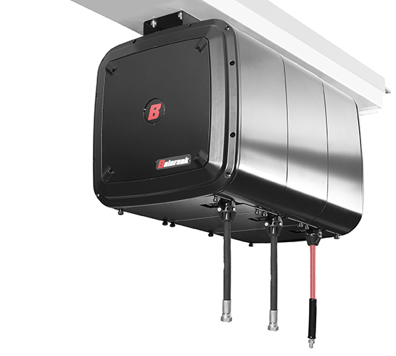
Signature Series Reels – Enclosed Cabinets
Features
  All steel with high quality powder coated finish
  Multi-directional hose outlets
  Rigid design ties all reels together to form one complete rigid structure
  Aluminum end-panels with plastic inserts
  Can be installed using mounting channels or unistrut
Sizes
  Air up to ⅜” x 50’
  Oil up to ½” x 50’
  Grease up to ⅜” x 50’
Applications
  Car dealerships
  Quick lubes
  High performance, high dollar shops
Notes:
Key selling points
All steel construction for durability.
Custom paint colors are available.
Inlet hose and ball stops are included.
Note: Order end panels separately.

Slide 8
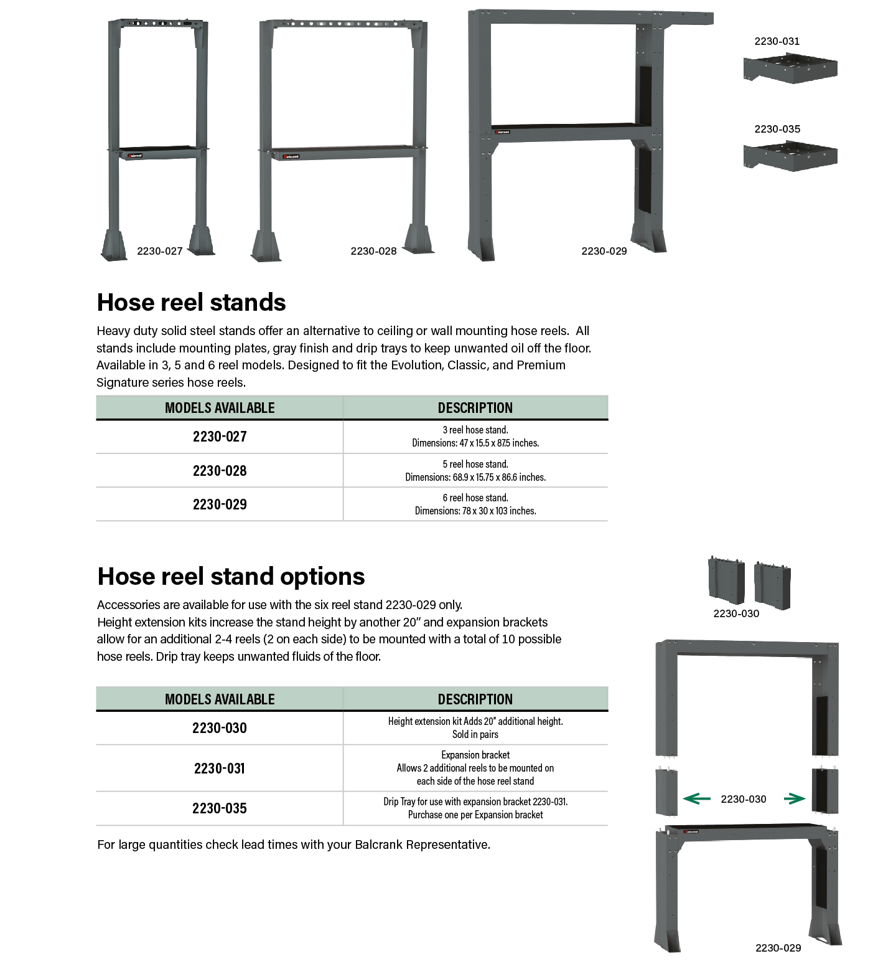
Hose Reels – Heavy-Duty Stands
Hose Reel Stands
Heavy-duty hose reel stands
  Perfect for large truck shops with high ceilings
  Alternative to ceiling or wall mounting hose reels
  Gray finish
  Available in 3, 5- and 6-reel configurations which include drip trays
  6-reel stand can be extended to mount an additional two reels per side for a total of 10. Drip tray extensions and 20” height extenders available for the 6 reel stand

Slide 9
Control Handles
Metered & Non metered

Slide 10

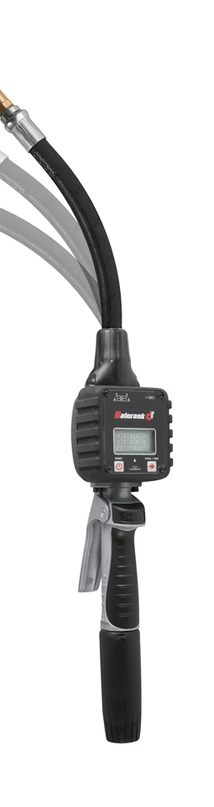
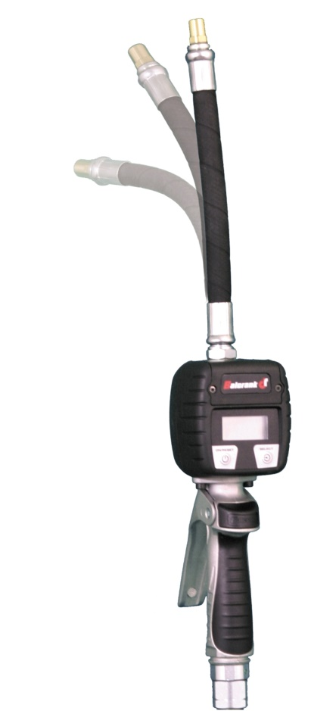
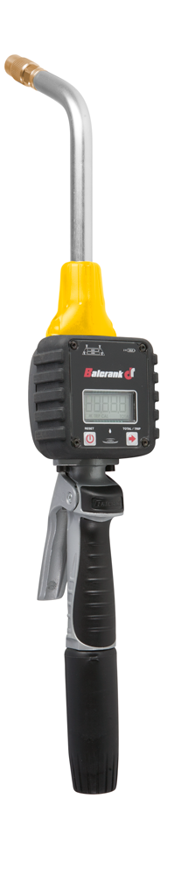
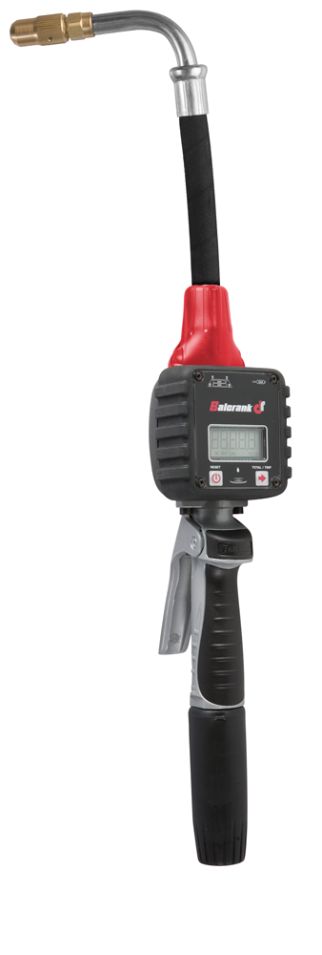
The DR Meter - The Cure for the Common Meter
Have you tried
the “Doctor”?

Slide 11
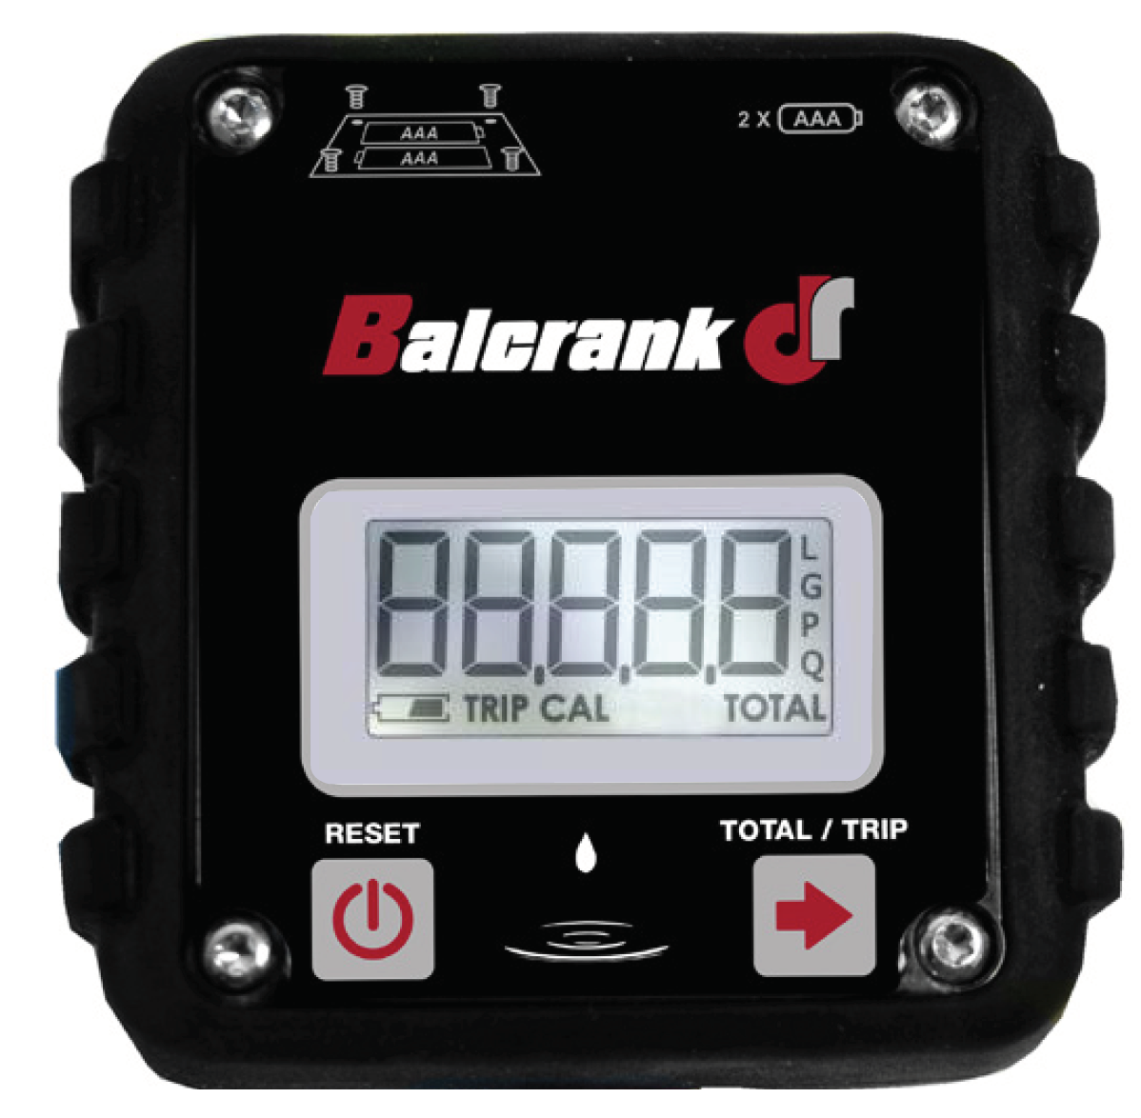
The DR Meter – Meter Face
2 x 1.5 V AAA standard batteries
Five digit display. 2 decimals shown in partial, trip and total readings.
Measure units: Liters, Gallons, Pints and Quarts
Batch, Trip and Total select button
Battery charge indicator
Partial | Trip | Total
Liters | Liters | Liters
Gallons | Gallons | Gallons
Quarts | Quarts | Gallons
Pints | Pints | Gallons
On / Reset button
Trip Mode
Calibration Mode
Total Mode
Notes:
No calibration required: Liquid Crystal Polymer gears (LCP), stainless steel shafts and a precision machined fluid chamber maintains the tight tolerances needed for repeatable accuracy. Together with individual testing for performance and accuracy guarantees precise dispensing regardless of the fluid viscosity, outside temperature and system pressure.
Non-re-settable totalizer function: shows total fluid flow through the meter from day 1 and is unaffected by low or dead batteries
----- Meeting Notes (10/23/13 09:11) -----
Mention: Battery leakage test performed at factory w/Randy
Mention: Poor man's FIC

Slide 12
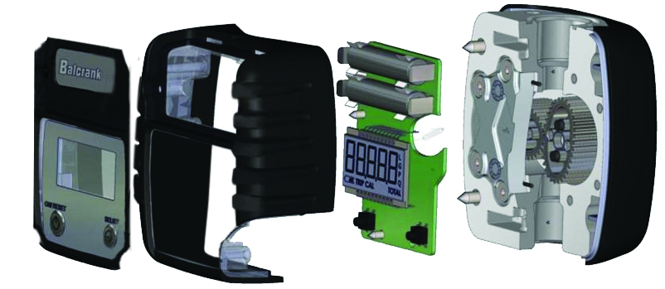
The DR Meter – Meter Components
Battery clips mounted on ERC, no cables for battery contact which ensures protection against impact or vibrations.
Neodymium magnets ensure long life and reliable pulses transmission to reed switch.
Sealed battery compartment.
Polycarbonate housing with TP Elastomer over mold provides superb impact resistance while isolating the ERC from the environment providing an air tight seal with the meter body.
Cable-less mechanical buttons to avoid contact failures.
Low consumption ERC with auto-sleep function for improved battery life.
LCP gears, stainless steel shafts and precision machining provides repeatable accuracy.
Notes:
Sealed battery compartment: battery clips are mounted directly on the ERC, no cables for battery contact which ensures protection against impact or vibrations.
Meter housing: unique totally encased polycarbonate housing with TP Elastomer over mold provides superb impact resistance while isolating the ERC (electronic register module) from the environment which provides an airtight seal with the meter body.
Affordable reparability: ERC can be changed easily

Slide 13
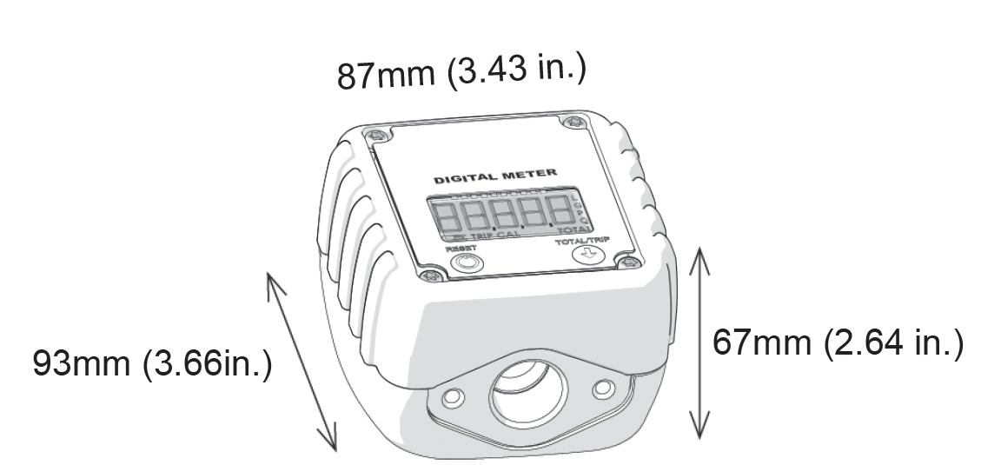
The DR Meter – Shroud Dimensions
3.43 in
2.64 in
3.66 in

Slide 14
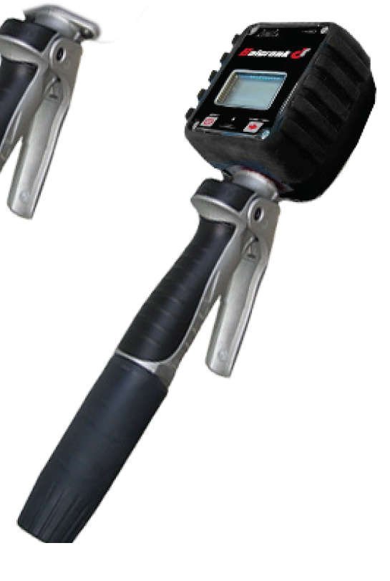
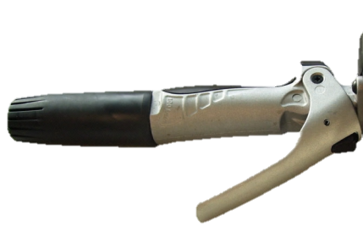
The DR Meter – Handle Elements
Handle Features
Flange coupled meter, no connections.
Aluminum body with soft grip handle.
Trigger lock button,
Prevents accidental opening and allows
the gun to be locked in open position
Large port swivel with hytrel cover.
Notes:
All new handle: aluminum body with lightweight ergonomic soft grip handle for comfort and precision balance.
Flange coupling at the control valve: eliminates the use of connection adaptors which can become loose, providing superior integration of the meter and handle
Trigger lock button: prevents accidental dispense and also allows the gun to be locked in open position

Slide 15
The DR Meter – Flange Coupling
Meter and Handle
Flange coupling at the control valve: eliminates the use of connection adaptors which can become loose, providing superior integration of the meter and handle

Slide 16
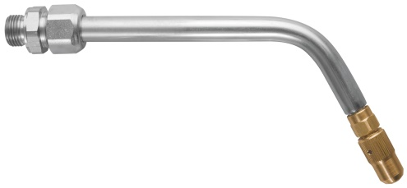
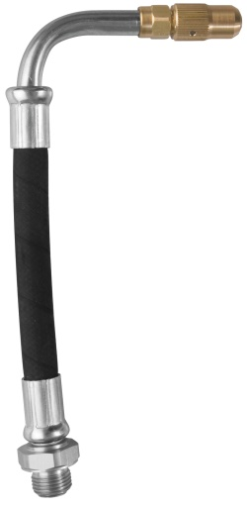


The DR Meter – New Tips & Extensions
Rigid extension with ¼ turn manual tip
Flex 90 flex extension with ¼ turn
manual or auto tip
Flex extension with ¼ turn manual tip
Flex memory with auto tip
Notes:
Unique ¼ turn manual tip: effective and very fast, high flow, no splash and very easy to use

Slide 17
The DR Meter – New Memory/Flex Extension
Innovative new feature
  Combines the features of a flex, rigid and 90 in one extension
  ¼ turn manual tip
  Stainless steel rod under hose cover stays in bent position
Applications
  Transmission
  Oil
  Gear oil
  Hydraulic fluid
  Hard to reach fill caps
  One Extension Does It All

Slide 18
DR Series – Digital Meter
Fluids
  Synthetic and mineral based lubricants
  Gear oil
  Hydraulic oil
  ATF
  Anti-freeze
Applications
  Car and truck dealers
  Fast lube & maintenance shops
  Fleets
Units of measure | Gallons, Quarts, Pints, and Liters (in 0.01 increments)
Flow range | 0.26-8 gal/min (1-30 l/min)
Max pressure | 1,450 psi (100 bar)
Swivel Inlet | 1/2" NPT(F)
Dispense Nozzle OD | Auto = 0.605" Manual 1/4 turn for OIL = 0.705" Manual 1/4 turn for ATF= 0.315" Verify ID of ATF fill port for compatibility
Battery | 2 x 1.5 v alkaline "AAA"
Weight | 4 lb (1.80 kg)
Compatible fluids | Oil, transmission fluid, hydraulic fluid, and anti-freeze solutions
Wetted materials | Liquid Crystal Polymer (LCP), aluminum, Buna-N™, zinc plated steel, stainless steel, neodymium, and brass
Notes:
Key Selling Points
PG series are one piece, cast aluminum housing.
Dual outlet nozzle positions – inline or pistol grip.
Comes with automatic nozzle.

Slide 19
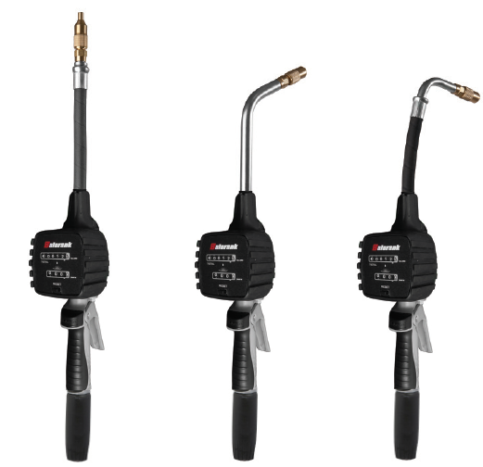

MO Series – Mechanical Oval Gear Meter
Fluids
  Synthetic and mineral based lubricants
  Gear oil
  Hydraulic oil
  ATF
  Anti-freeze
Applications
  Car and truck dealers
  Fast lube & maintenance shops
  Fleets
Units of measure | Gallons, Quarts
Flow range | 0.26-8 gal/min (1-30 l/min)
Max pressure | 1,000 psi (70 bar)
Swivel Inlet | 1/2" NPT(F)
Weight | 4 lb (1.80 kg)
Compatible fluids | Oil, transmission fluid, hydraulic fluid, and anti-freeze solutions
Wetted materials | Acetal, aluminum, stainless steel, NBR, Zinc plated steel, TPU, Polyamide
3.5 (90)
5.6 (143)
4.2 (106)
Notes:
Key Selling Points
PG series are one piece, cast aluminum housing.
Dual outlet nozzle positions – inline or pistol grip.
Comes with automatic nozzle.

Slide 20
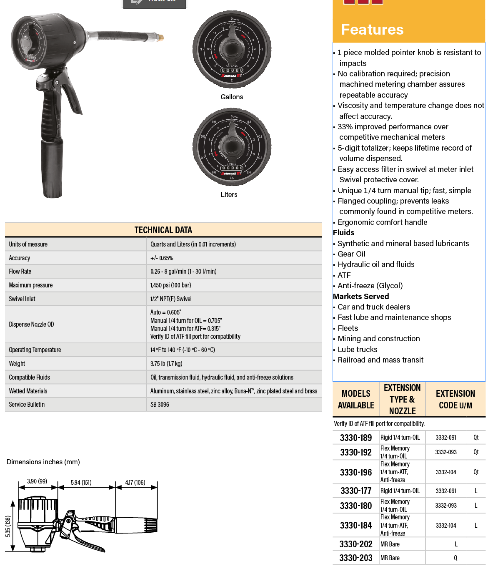
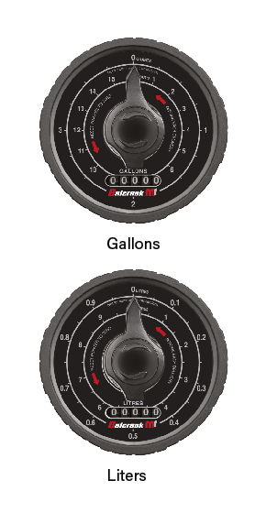
MR Series – Mechanical Meter
Fluids
  Synthetic and mineral based lubricants
  Gear oil
  Hydraulic oil
  ATF
  Anti-freeze
Applications
  Car and truck dealers
  Fast lube & maintenance shops
  Fleets
  Mining & construction
  Lube trucks
  Railroads & mass transit
Units of measure | Quarts and Liters (in 0.01 increments)
Flow range | 0.26-8 gal/min (1-30 l/min)
Max pressure | 1,450 psi (100 bar)
Swivel Inlet | 1/2" NPT(F)
Dispense Nozzle OD | Auto = 0.605" Manual 1/4 turn for OIL = 0.705" Manual 1/4 turn for ATF= 0.315" Verify ID of ATF fill port for compatibility
Weight | 3.75 lb (1.7 kg)
Compatible fluids | Oil, transmission fluid, hydraulic fluid, and anti-freeze solutions
Wetted materials | Aluminum, stainless steel, zinc alloy, Buna-N™, zinc plated steel and brass
Notes:
Key Selling Points
PG series are one piece, cast aluminum housing.
Dual outlet nozzle positions – inline or pistol grip.
Comes with automatic nozzle.

Slide 21
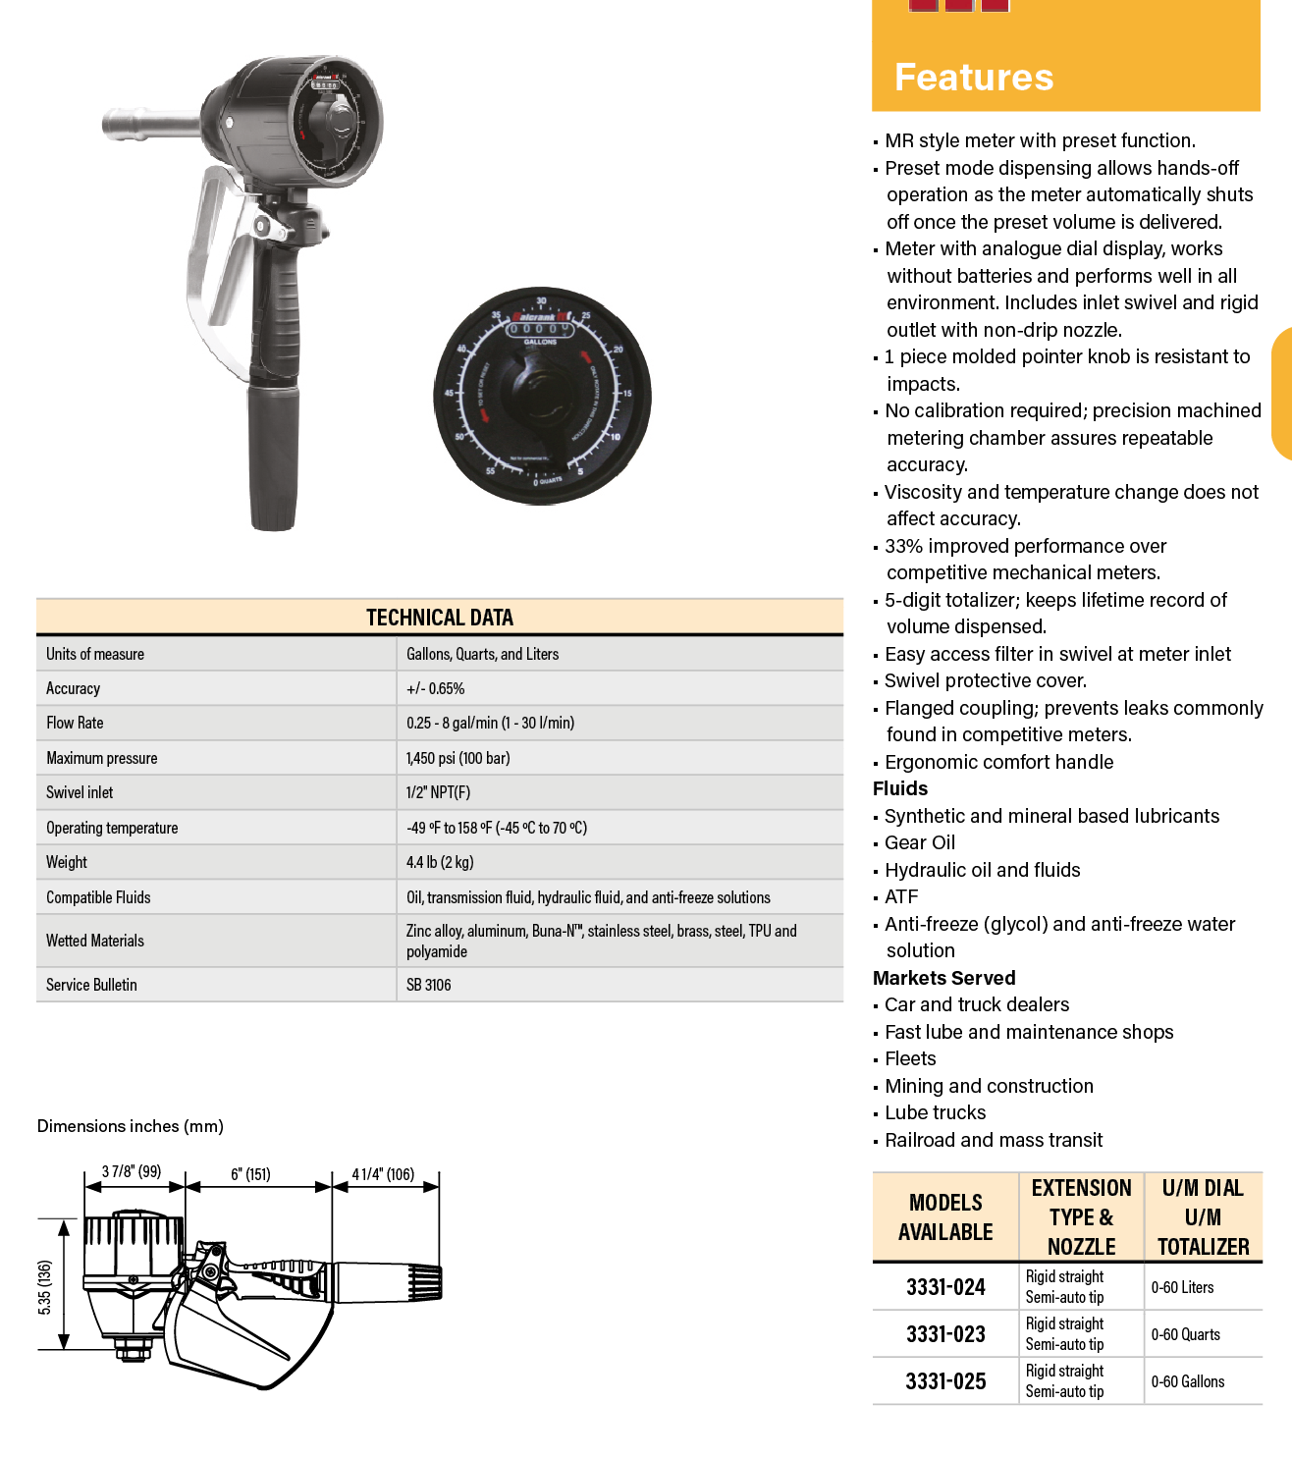
MR Series – Mechanical Preset Meter
MR Preset Meter
Fluids
  Synthetic and mineral based lubricants
  Gear oil
  Hydraulic oil
  ATF
  Anti-freeze
Applications
  Car and truck dealers
  Fast lube & maintenance shops
  Fleets
  Mining & construction
  Lube trucks
  Railroads & mass transit
Units of measure | Gallons, Quarts and Liters
Flow range | 0.25 - 8 gal/min (1 - 30 l/min)
Max pressure | 1,450 psi (100 bar)
Swivel Inlet | 1/2" NPT(F)
Weight | 4.4 lb (2 kg)
Compatible fluids | Oil, transmission fluid, hydraulic fluid, and anti-freeze solutions
Wetted materials | Zinc alloy, aluminum, Buna-N™, stainless steel, brass, steel, TPU and polyamide

Slide 22
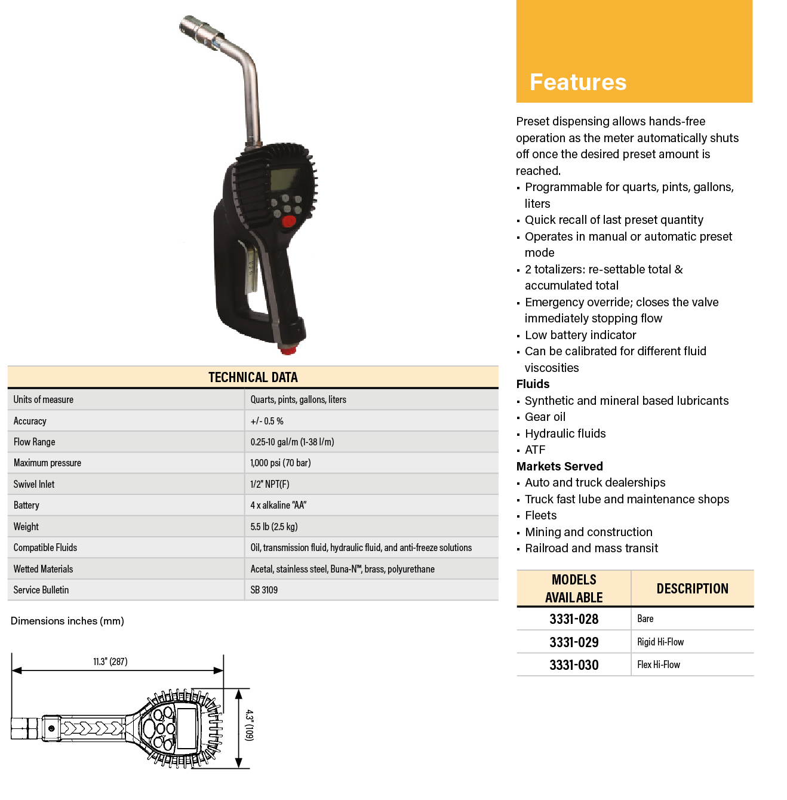
EP Meter – Electronic Preset Meter
Electronic Preset
Fluids
  Synthetic and mineral based lubricants
  Gear oil
  Hydraulic oil
  ATF
  Anti-freeze
Applications
  Car and truck dealers
  Fast lube & maintenance shops
  Fleets
  Mining & construction
  Lube trucks
  Railroads & mass transit
Units of measure | Gallons, Quarts, Pints, and Liters
Flow range | 0.25-10 gal/min (1-38 l/min)
Max pressure | 1,000 psi (70 bar)
Swivel Inlet | 1/2" NPT(F)
Battery | 4 x alkaline "AA"
Weight | 5.5 lb (2.5 kg)
Compatible fluids | Oil, transmission fluid, hydraulic fluid, and anti-freeze solutions
Wetted materials | Acetal, stainless steel, Buna-N™, brass, polyurethane

Slide 23
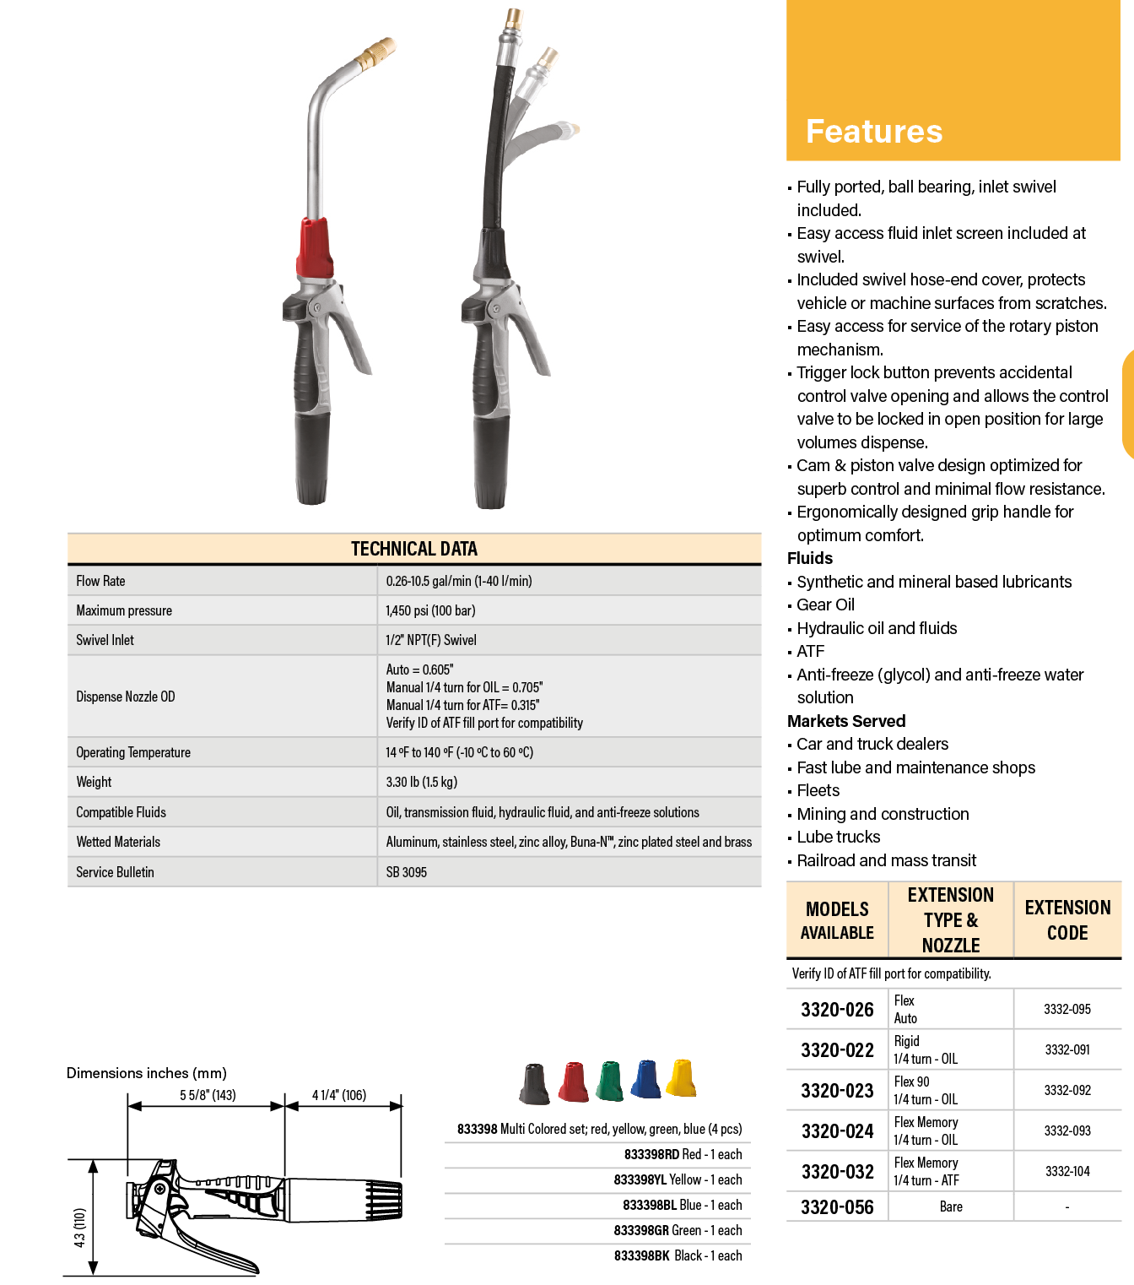
Non-Metered – Control Handles
Fluids
  Synthetic and mineral based lubricants
  Gear oil
  Hydraulic oil
  ATF
  Antifreeze
Applications
  Car and truck dealers
  Fast lube & maintenance shops
  Fleets
  Mining & construction
  Lube trucks
  Railroads & mass transit
Flow range | 0.26-10.5 gal/min (1-40 l/min)
Max pressure | 1,450 psi (100 bar)
Swivel Inlet | 1/2" NPT(F)
Dispense Nozzle OD | Auto = 0.605" Manual 1/4 turn for OIL = 0.705" Manual 1/4 turn for ATF= 0.315" Verify ID of ATF fill port for compatibility
Weight | 3.30 lb (1.5 kg)
Compatible fluids | Oil, transmission fluid, hydraulic fluid, and anti-freeze solutions
Wetted materials | Aluminum, stainless steel, zinc alloy, Buna-N™, zinc plated steel and brass
Notes:
Key Selling Points
Built in trigger guard.
Manual non-drip tip.
Set of colored product identification caps are included.
New product introduction of a high volume oil meter.

Slide 24
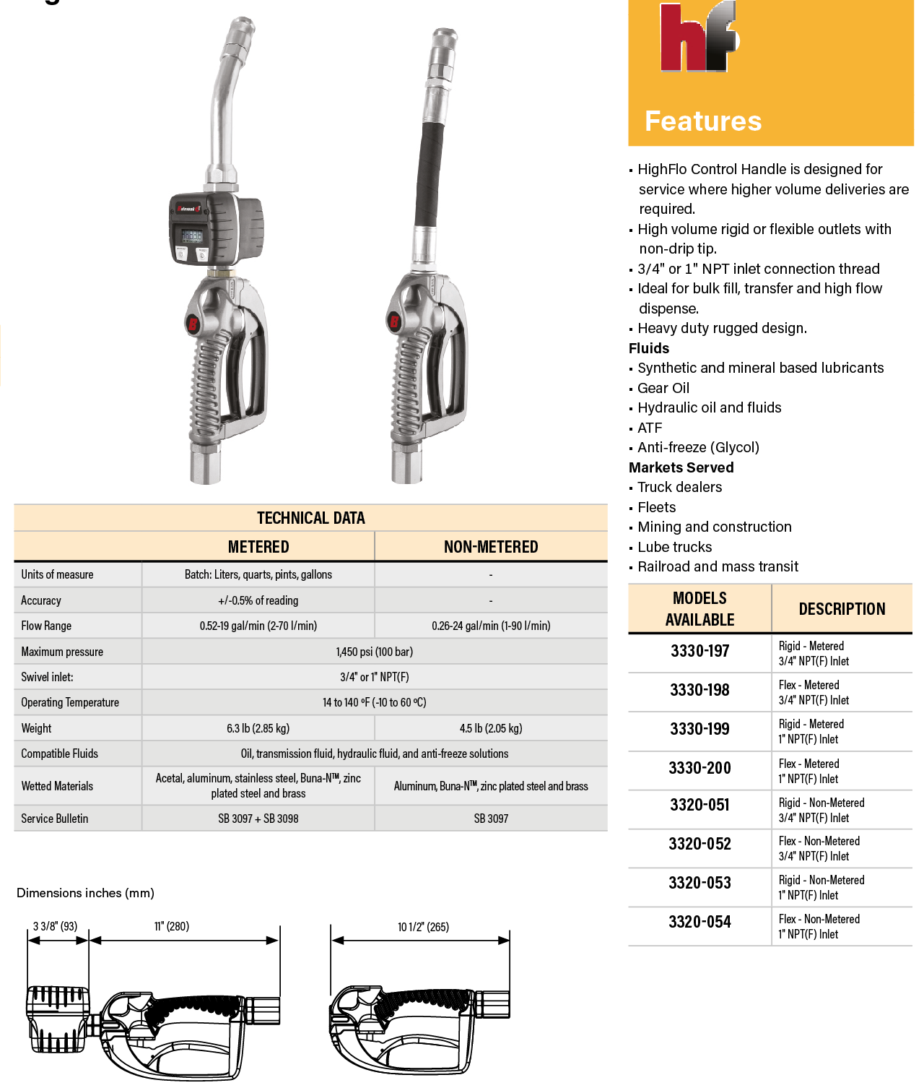
HighFlo – Metered and Non-Metered
Fluids
  Synthetic and mineral based lubricants
  Gear oil
  Hydraulic oil
  ATF
  Antifreeze
Applications
  Mining
  HD construction
  Bulk fill
  Packaging
  HD Truck/bus
  Diesel
 | Metered | Non-Metered
Units of measure | Gallons, Quarts, Pints, and Liters | -
Flow range | 0.52-19 gal/min (2-70 l/min) | 0.26-24 gal/min (1-90 l/min)
Max pressure | 1,450 psi (100 bar) | 1,450 psi (100 bar)
Swivel Inlet | 3/4" or 1” NPT(F) | 3/4" or 1” NPT(F)
Weight | 6.3 lb (2.85 kg) | 4.5 lb (2.05 kg)
Compatible fluids | Oil, transmission fluid, hydraulic fluid and anti-freeze solutions | Oil, transmission fluid, hydraulic fluid and anti-freeze solutions
Wetted materials | Acetal, aluminum, stainless steel, Buna-N, zinc plated steel and brass | Aluminum, Buna-NTM, zinc plated steel and brass

Slide 25
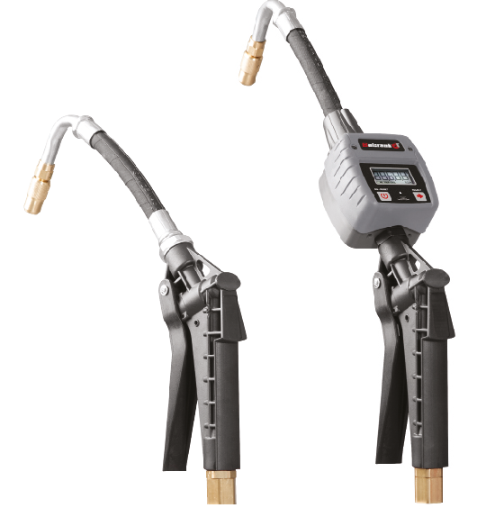
Water Based Fluids – Control Handles
Fluids
  Antifreeze
  WWS
  Water
Applications
  Car and truck dealers
  Fast lube and maintenance shops
  Fleets
 | Metered | Non-Metered
Units of measure | Gallons, Quarts, Pints, and Liters | -
Flow range | 8 gal/min (30 l/min) | 8 gal/min (30 l/min)
Max pressure | 725 psi (50 bar) | 725 psi (50 bar)
Swivel Inlet | 1/2” NPT(F) | 1/2” NPT(F)
Weight | 1 lb (0.4 kg) | 2.2 lb (1 kg)
Compatible fluids | Anti-freeze, windshield wash solution and water | Anti-freeze, windshield wash solution and water
Wetted materials | Fiberglass reinforced thermoplastic, polyurethane rubber, and brass | Fiberglass reinforced thermoplastic, polyurethane rubber, Viton®, brass, and stainless steel

