Slide 1
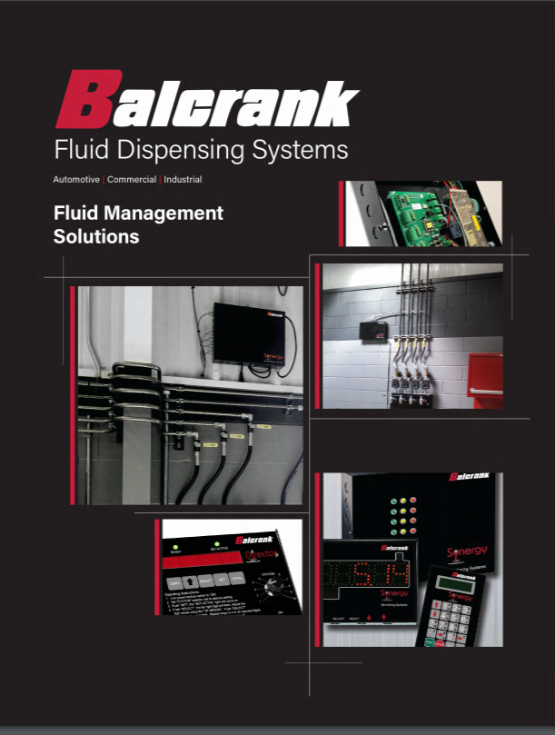
Fluid Management Solutions
Introduction to FIC

Slide 2
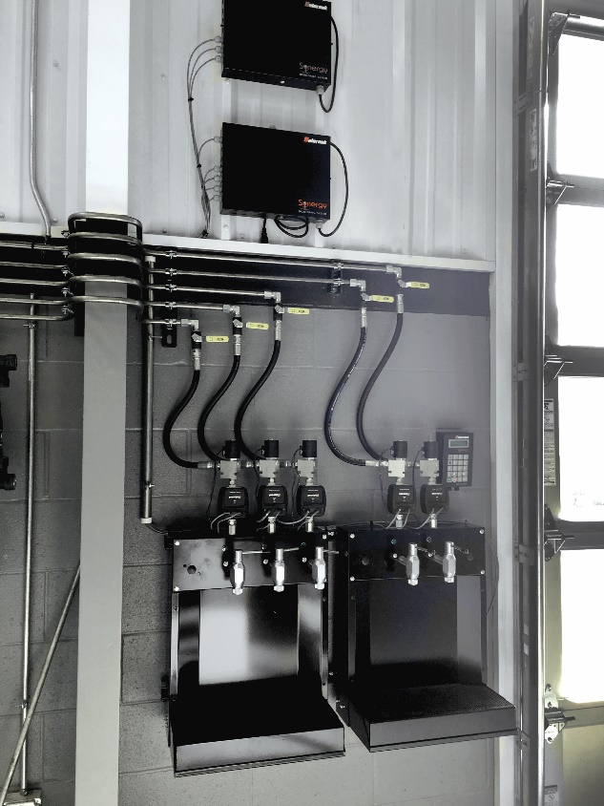
Fluid Management – Why Manage Lubricant Inventory
In the current world of lubrication products, synthetic lubricants continue to be introduced at ever higher costs than traditional products. This means that the dollar investment in bulk lubricant inventories is climbing in value every year.
Service and repair costs and the parts associated with those repairs have been managed by DMS systems for several years, but bulk lubricant inventories are not always controlled and managed in the same manner.
Without an efficient and accurate way to control and manage a lubricant inventory, the potential for inventory shrinkage or loss is present.
Reducing lost labor hours can also be a benefit
The right FIC system can help keep techs where they are most productive by eliminating trips to the parts department

Slide 3
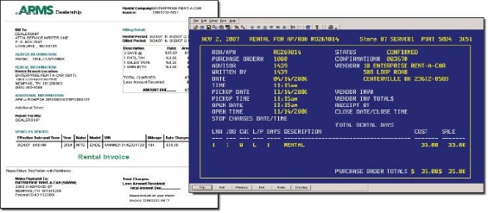
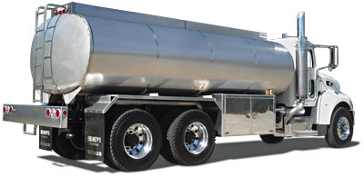
Fluid Management – Inventory Losses
There Are Multiple Ways This Can Occur
Unbilled Dispenses
Delivery Errors
Unauthorized Dispenses
Improving security in each of these areas can provide substantial benefits

Slide 4
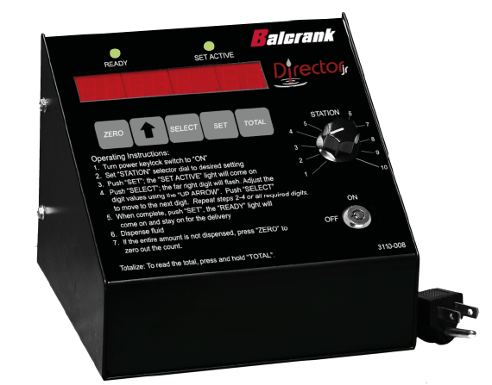
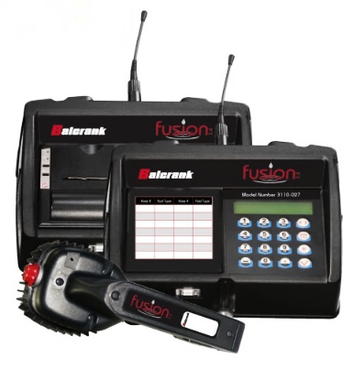
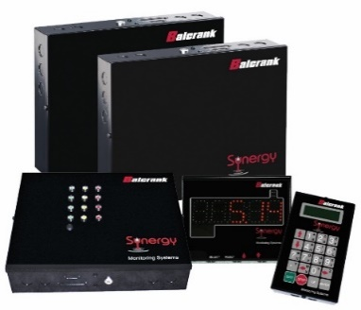
Fluid Management – Choosing the Right System
One Product Control
Wireless & PC Interface
Network & Keypad Dispense
Answering the Following Questions Will Help:
How many fluids need to be controlled?
How many dispense points will there be per fluid?
Which types of fluids will be dispensed?
How large is the facility?
Where is the tank room?
Where is the parts room?
Will there be simultaneous dispensing?
What dispense flow rate do you need?

Slide 5
Director Jr. – Dispense Console
Dispense Console is generally located in the Parts Department
Director Jr.
Capacity: 1 fluid to 10 stations
Large LED information display
Totalizing feature for fluid inventory record-keeping
Console Input power 110-volt DC – Output 24 V DC
Solenoids activated by 24-volt DC
Fluid measurement: pints, quarts, gallons, or liters
Service fluids: motor oils, synthetics, ATF, gear oil and anti-freeze
Metered or Non-Metered control handles can be used at each reel

Slide 6
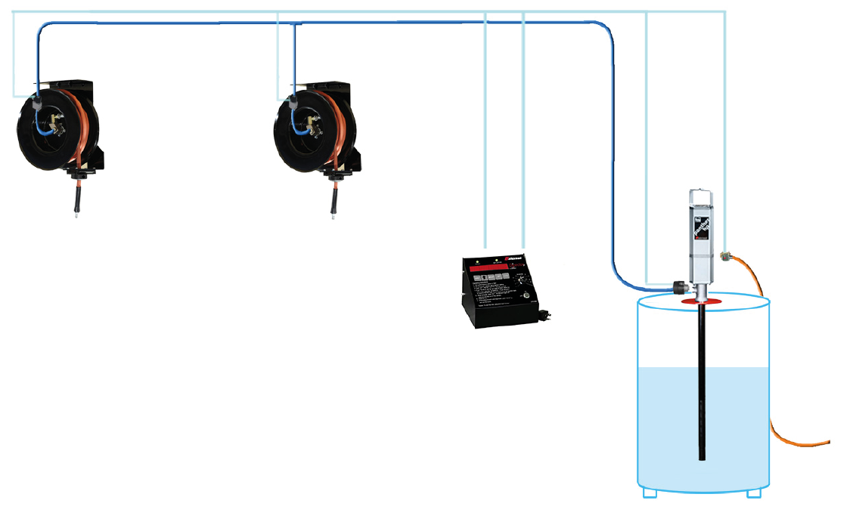
Director Jr. – System Layout
Component List:
1 - Console
2 - Fluid Solenoid
1 - Air Solenoid
1 – Y Strainer
1 - Pulse Meter
2 - Metered / Non-metered control handle
Each of the components is connected
to the console by wire

Slide 7
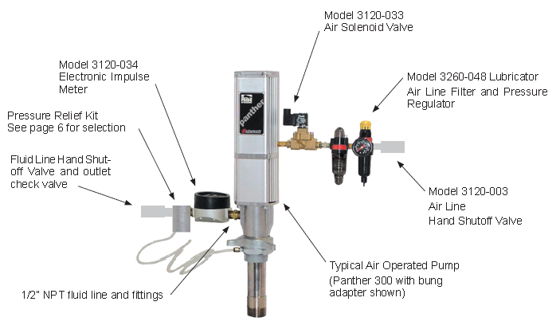
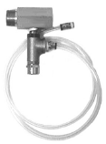
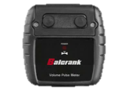
Director Jr. – Pump Related Components
Don’t overlook a pressure relief valve in the system
Model 3120-114
Electronic Impulse Meter

Slide 8
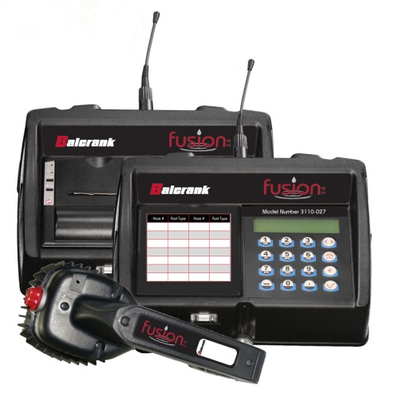
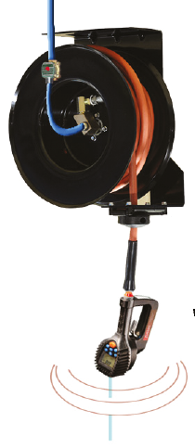
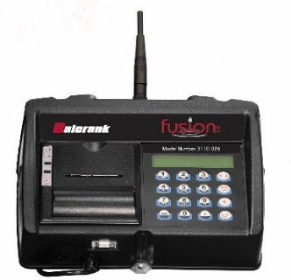
Fusion – Two Wireless Systems
Fusion CCS & DCS Multiple Fluid Capable
Wireless Systems
Fusion 2.4
DCS 16 Fluids to 250 Dispense Points
CCS 8 Fluids to 30 Dispense Points (No PC, No Reports)
Control Handles Communicate with Dispense Keypads
Dispense Information is entered into the Keypad when dispense is complete a “Ticket with Dispense Info” is printed

Slide 9
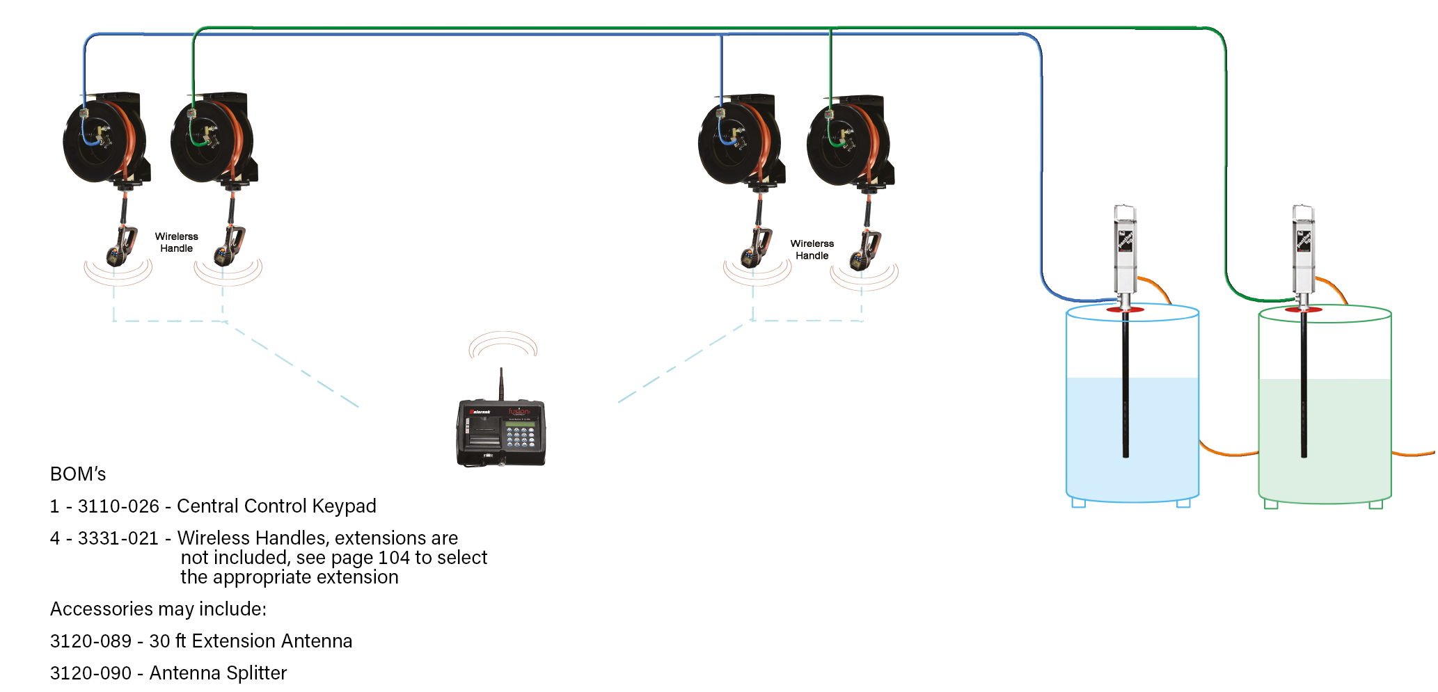
Fusion 2.4 CCS – System Layout
Small to Medium Shop – One Dispense Keypad
Up to - 8 Fluids / 30 Dispense Points

Slide 10
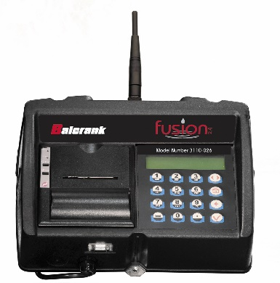
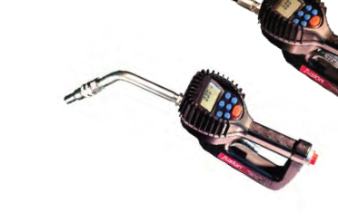
Fusion 2.4 DCS – Communication
Fusion DCS has Enhanced Features & Distance over the Fusion CCS by utilizing a PC and Master Console
Generates Reports by Product, Vehicle, Work Order & Technician
Wired to PC

Slide 11
Fusion 2.4 DCS – Repeating Network Enhances Communication
DCS communication routes from one component to another
The need to communicate over long distances has been solved
300 feet
Master Keypad
Dispense Keypad
300 feet
A dispense keypad that cannot connect directly to the master keypad will route through a keypad that can:
Automatic channel selection – minimizes detected interference
Automatic gain control adjusts signal strength
Auto retry communications protocol – resends multiple times if necessary
300 feet
Dispense Keypad

Slide 12
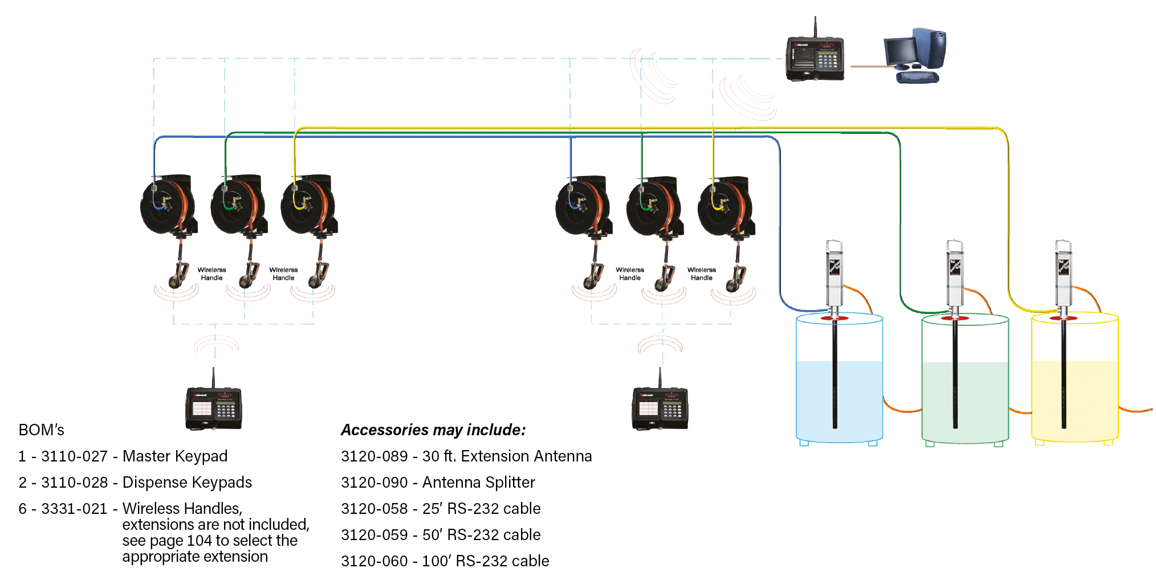
Fusion 2.4 CCS – System Layout
Medium to Large Shop – Multiple Dispense Keypads
Up to – 16 Fluids & 250 Dispense Points

Slide 13
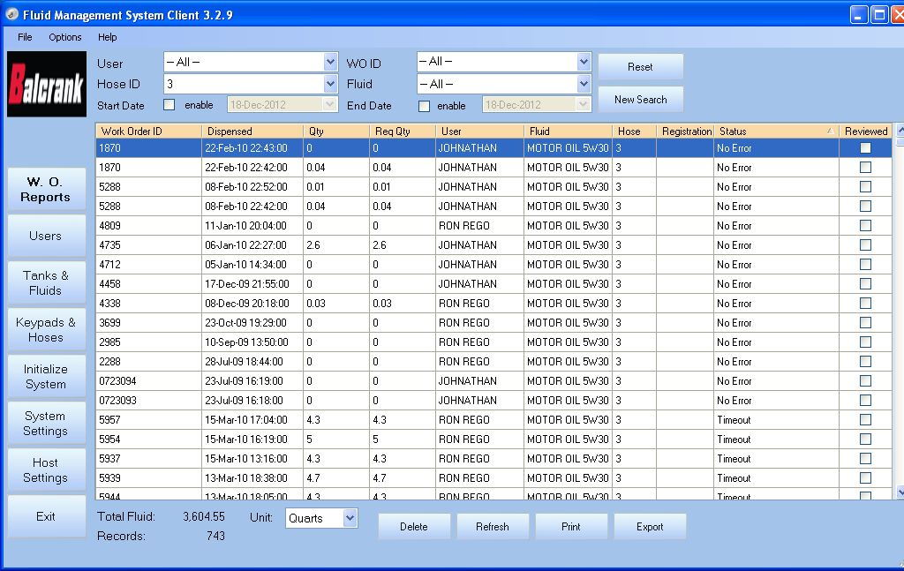
Fusion DCS – Database
All dispenses are saved in a database
Easily check dispenses against work orders before closing Management Reports are available with DCS

Slide 14
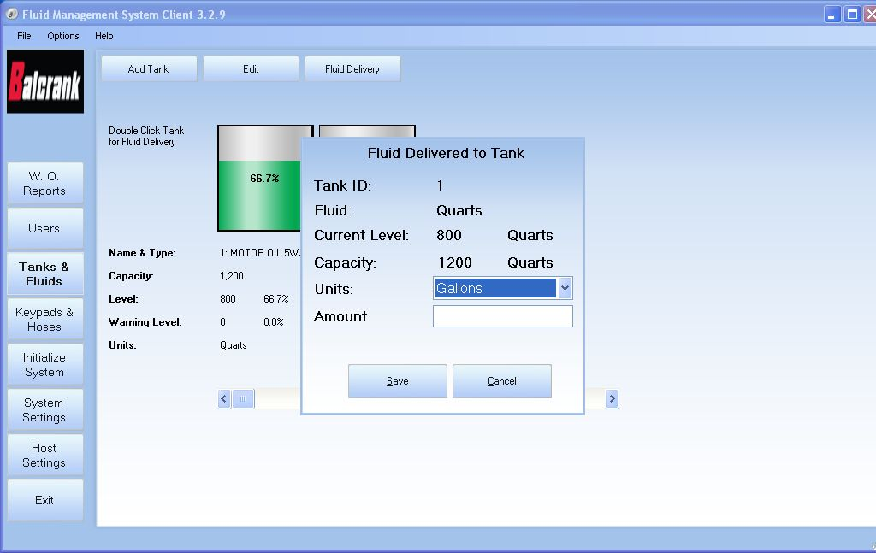
Fusion DCS – Monitor & Adjust Tank Levels
Tank levels can be checked easily via this screen

Slide 15
Synergy – Network Connectivity & More
No Limit on The Number of Fluids or Keypads & up to 255 Dispense Points
Synergy Defined:
Working Together
Connectivity
Joint Action
Enhanced
Interaction
Harmony
Teamwork
This system is all that and more!
Synergy” the fix for Today’s Challenges
Multiple Dispense Points
Simultaneous Dispensing
Multiple Fluids – Oil, ATF, Grease, DEF, Diesel Fuel, Windshield Wash Solvent & Coolant
Fluid Security
Inventory Reconciliation
Tank Monitoring – both Fresh and Used fluids
Remote Dispensing
Link PC’s via Network
Low Level Email Alert

Slide 16
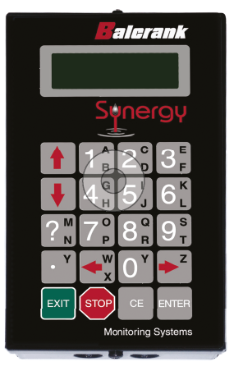
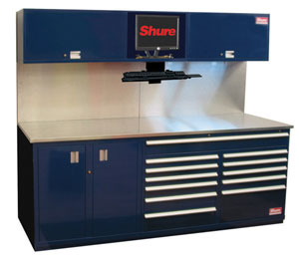
Synergy – Dispense Access Options
Dispense commands can be entered via 3 methods
remote keypads throughout the service bays
Keypad
PC in the parts department
the Technician’s PC in the service bay
Note: Dispenses at Keypads & Technician PC’s show on the Main PC in the Parts Department
Parts department
Service Bay

Slide 17
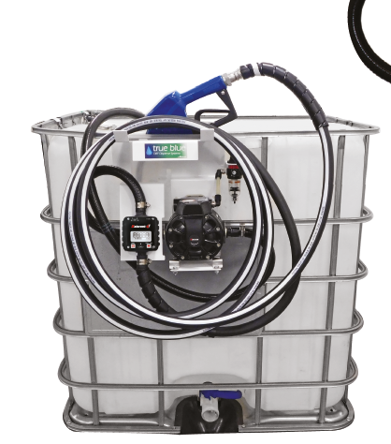
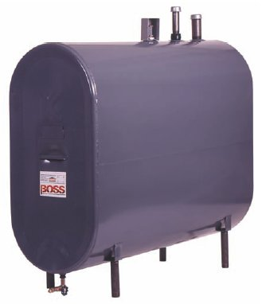
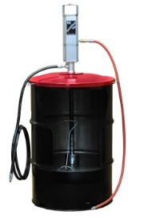
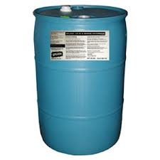
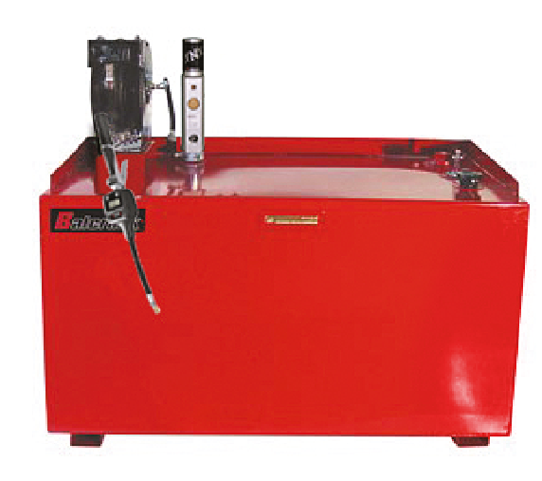
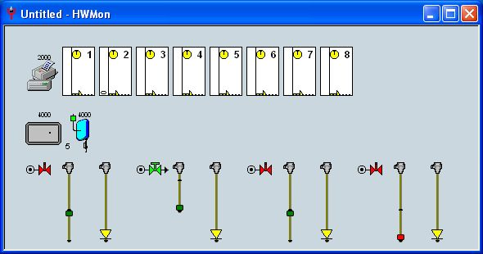
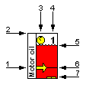
Fluid Management – Controls Range of Fluids
The Balcrank Synergy FIC system is not only capable of controlling lubricants and anti-freeze like other systems, but will also control the dispensing of greases and DEF fluids in fleet applications
Lubricants
Anti-freeze
Grease
DEF
Analog Probes provide up to the minute tank level data, making it possible to check tank levels quickly and accurately

Slide 18
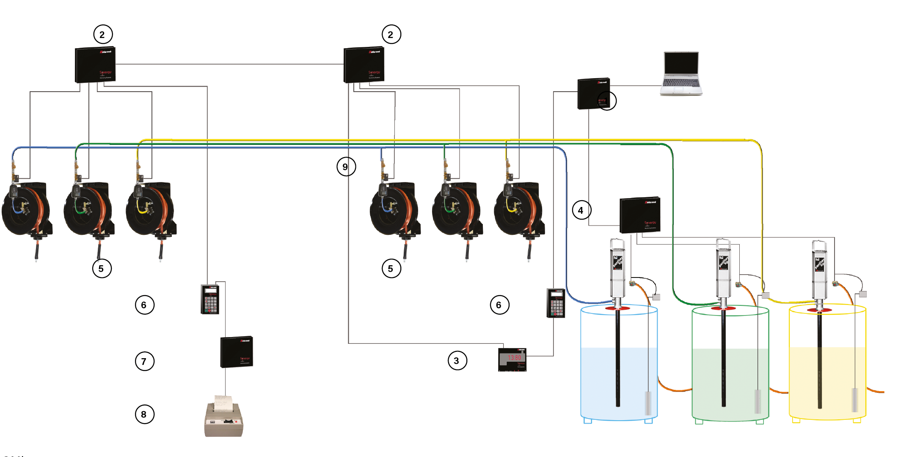
Synergy – System Layout
Small, Medium & Large Shops
Unlimited Fluids / 255 Dispense Points

Slide 19
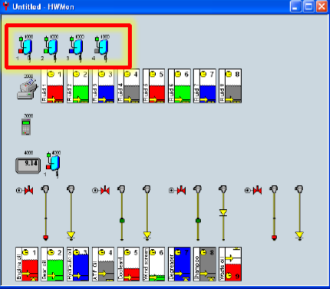
Synergy – Quick View & Control
Custom layouts to your specific need
Monitor fluid levels at a glance
Dispense product quickly
Visually monitor complete system on one screen

Slide 20
Synergy – Management Reports
Various Reports:
Fluid Usage, by Work Order, by Dispensing Technician, by Fluid & More
(Examples of two Reports below)
1
2

