Slide 1
System Design

Slide 2
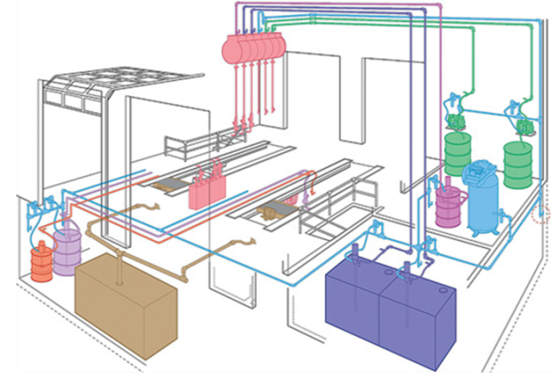
System Design - Contents
Typical Applications
Compressed Air Supply
Fluid Properties
Moving Fluids
Feed Methods
Pump Performance Charts
System Plumbing
System Commissioning, Flushing
Startup/Shutdown/Maintenance
System Design Tools Review (Excel)
System Design Requirements Worksheet
Automated Worksheets and Conversions
Technical Reference Data
Fleet System Case Study (Excel)
Municipal Garage

Slide 3
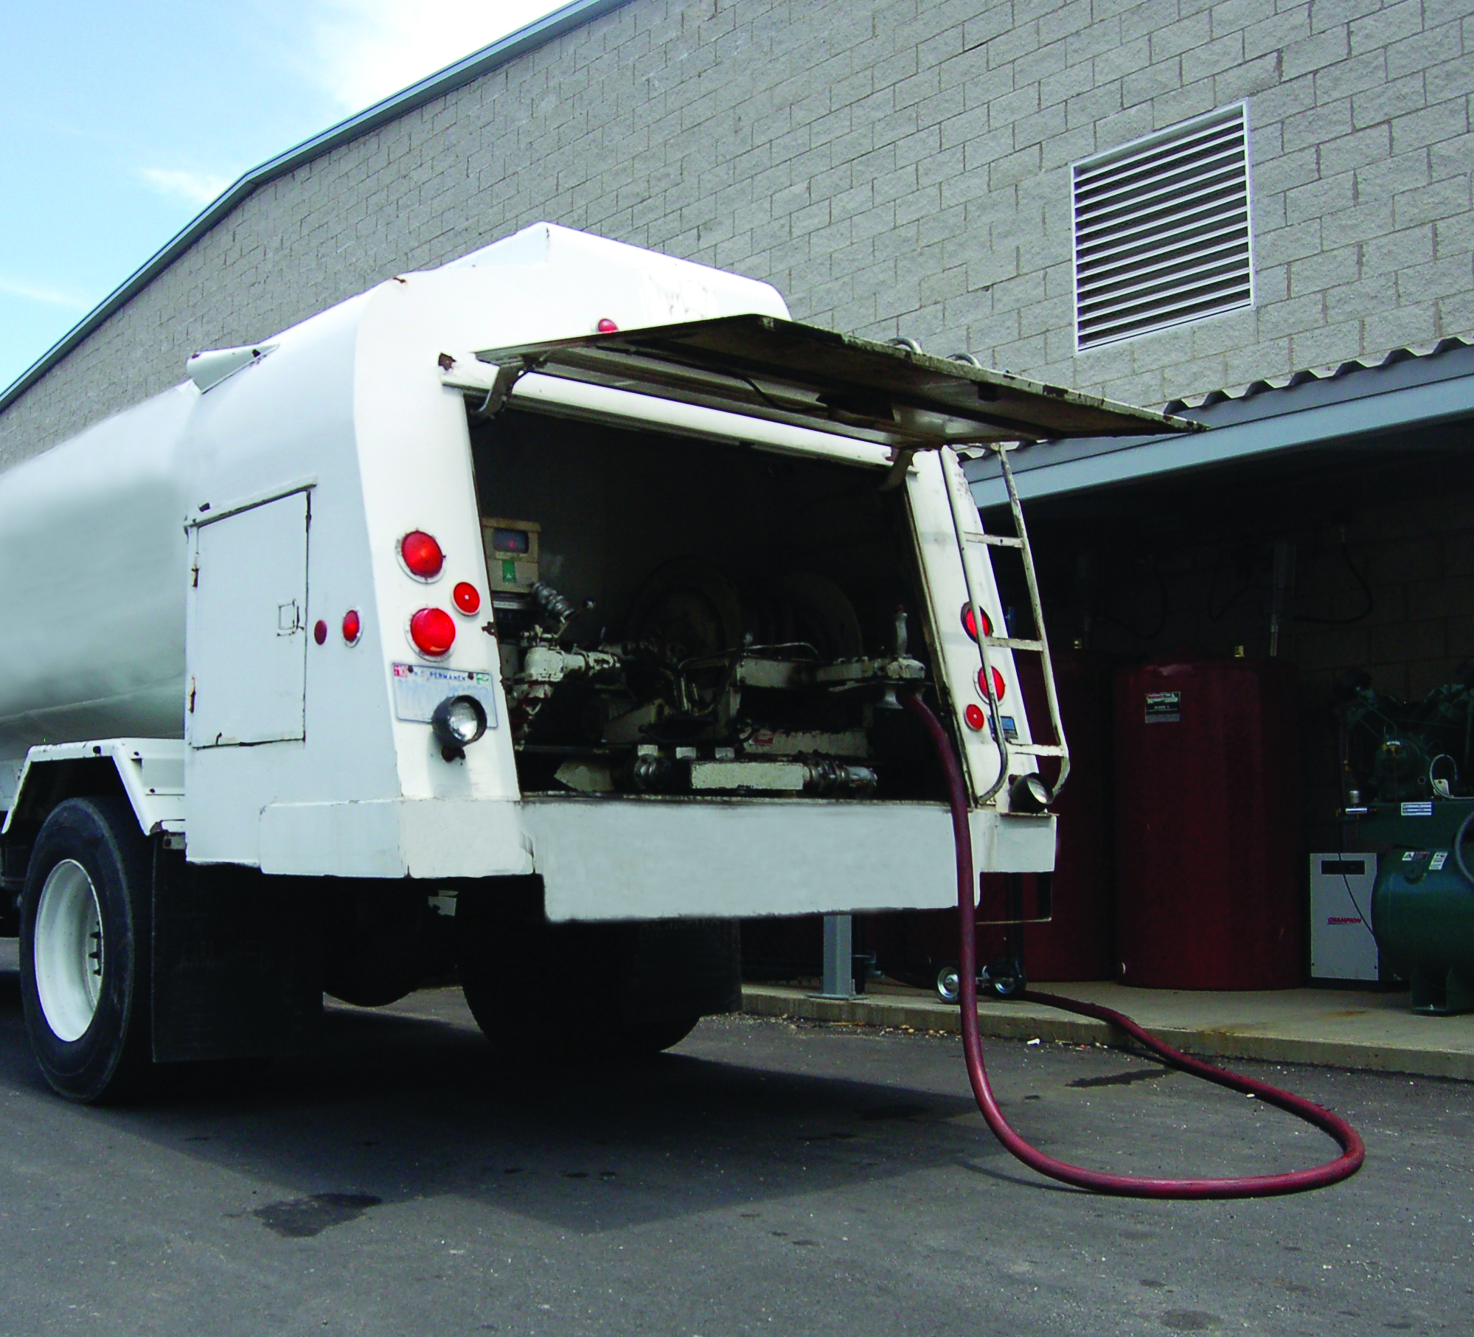
Typical Applications
Large automotive dealerships
Construction vehicle maintenance
Off-road vehicle maintenance
Fleet maintenance
Large truck/bus maintenance
Public works maintenance
Other transportation segments

Slide 4
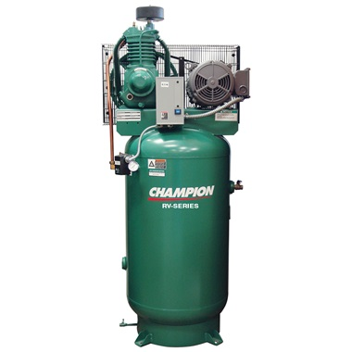
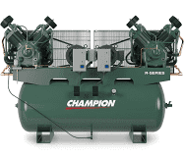
Compressed Air Supply - Compressors
Compressors take in free air from the environment and compress it. This compressed air is then supplied to air operated pumps in the system.
The compressor must be capable of supplying both sufficient pressure and air volume to the pneumatic-driven pumps and other air operated products in the shop (i.e. air tools).
To prolong the life of the pumps and compressor, operate the pumps at the lowest possible air pressure to meet the demands of the system.

Slide 5
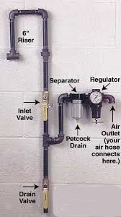
Compressed Air Supply - Plumbing
Header systems must be properly sized to supply the correct air volume and pressure to air driven devices in the system.
Drip legs designed to allow moisture in the header to be drained daily. The header pipe should be slopped about 1/8” to 1/4” per foot towards the drains. Compressed air drops should be designed to supply air off the top of the header plumbing to reduce contaminants from entering the air motor or directional valve of the pump.

Slide 6
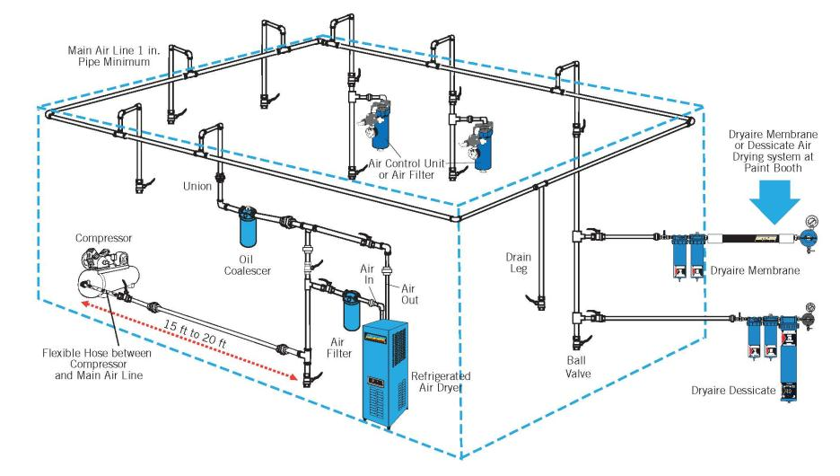
Compressed Air Supply - System Layout
Compressed Air Supply, Typical System
Liquid
Separator
Notes:
Mention Liquid Separator picture in the schematic and explain its importance to remove Moisture and an air filter mainly removes dirt and debrie and is poor at removing water/moisture.

Slide 7
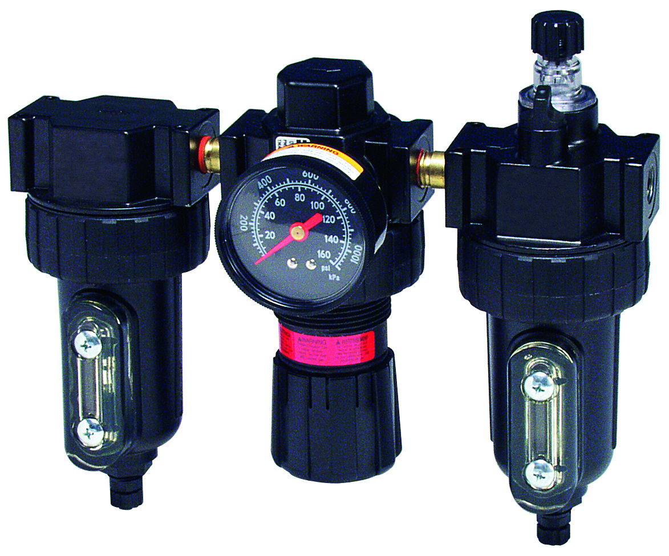
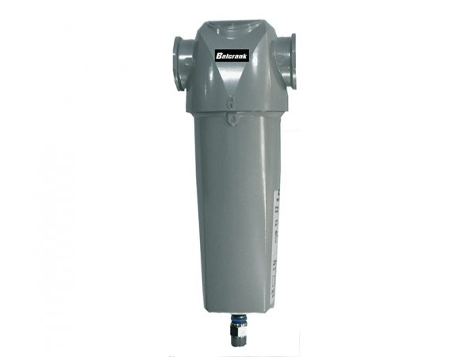
Compressed Air Supply - Air Quality
Balcrank recommends the use of air filters and regulators on all pumps in the system.
Balcrank recommends the use of a liquid separator when high moisture content is present in an end users air system to prolong the life of the pneumatic pump
Lubricators can extend the life of air motors and air valves. Balcrank recommends the use of lubricators only when properly adjusted and maintained per the instruction manual. If lubricators cannot be adjusted, monitored and maintained, they are not recommended.
To adjust the lubricator, screw the adjustment knob in all the way then back off ¼ turn. This will yield 1-2 drops per hour of pump run time. Refill lubricator bowl with 10W non-detergent oil as required.
Lubricators are not recommended on a Balcrank air-operated double diaphragm pumps.

Slide 8
Compressed Air Supply - Compressor Sizing
To estimate air volume when double-acting piston pumps are used, multiply the ratio times the flow rate. This will allow you to estimate the horsepower you will need for the pumps.
6:1 Tiger x 2 gpm = approximately 12 scfm
Actual: 7.4 scfm/gallon x 2 gpm = 14.8 scfm
This does not apply to AODD pumps
Compressor sizing efficiency varies and can be estimated with the formulas below:
B.H.P. (Electric Compressor) = scfm/4
B.H.P. (Gas/Diesel Compressor) = scfm/2

Slide 9
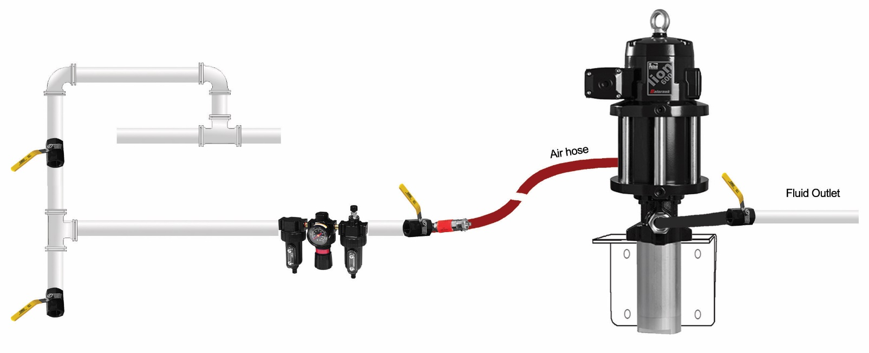
Compressed Air Supply - Pump Layout
Pump overrun valve stops pump when tank empty or downstream hose leak. Not required if low-level cut-off is used.
Size pump air supply hose to at least equal to the pump air inlet fitting size. Quick Disconnects can restrict air flow impacting pump performance.
Bleed-type master air valves relieve air trapped between the valve and downstream components. Prevents pump from unexpected cycling.
Ball valve for releasing collected moisture in header
Filter, Regulator and Lubricator. Filter and regulator recommended. Lubricator recommended only if properly maintained or specified.
Use air hose between header and pump to prevent air leakage at fittings due to pump vibration. Do not hard plumb the air line to the motor. On new systems distributor to obtain system air pressure and volume available.

Slide 10
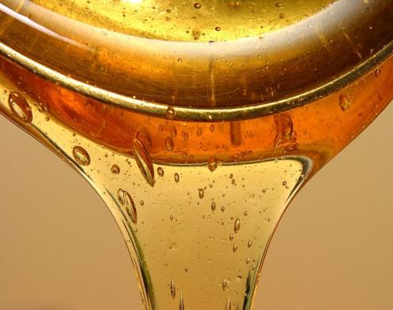
Fluid Properties - Viscosity
Viscosity
Definition: a measurement of a fluid’s resistance to flow at a given temperature or simply stated, it’s how thick or thin the fluid is at a given temperature
Temperature changes viscosity
Warm temperatures reduce viscosity making them easier to prime and pump
Cold temperatures increase viscosity and may impact pump priming and increase frictional pressure loss in the plumbing and viscosity will also change due to shear in grease
Heating a service fluid especially grease; always check with material suppliers before recommending any heat source or product
Oils become separated from the base component of the grease which can impact the performance of the grease

Slide 11
Fluid Properties - Viscosity Measurement
Motor Oil, transmission fluid and gear lube
Viscosity may be expressed in Saybolt Universal Seconds (SSU/SUS) or Centistokes (cks). These values are converted to centipoise (cp) to calculate frictional pressure loss.
Grease
Grease will decrease in viscosity as it is pumped due to shear (thixotropic).
Defined by NLGI Number (National Lubricating Grease Institute). NLGI numbers from lowest viscosity to highest are 000, 00, 0, 1, 2, 3, 4, 5 and 6.
NLGI 0, 00, and 000 grease easily flows and can be pumped with a standard two-check oil piston pump without follower plate, inductor or ram use.
NLGI 1 and 2 grease will be follower plate or inductor fed using two-check and priming piston pumps.
The most common grease used is NLGI 2.
NLGI 3 and 4 grease will be inductor or ram fed with priming piston pumps.
NLGI 5 and 6 grease will be ram fed using priming piston pumps.

Slide 12
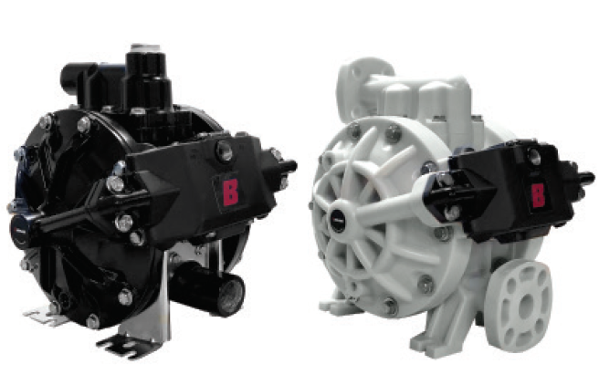
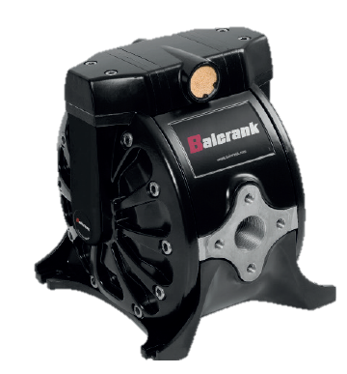
Fluid Properties - Chemical Compatibility
Generally, lubricants are friendly fluids and are pumped using carbon steel piston pumps using ${\text{Buna}\text{−}\text{N}}^{®}$ and polyurethane seals.
Exceptions are those listed below using AODD pumps:
Anti-freeze (water and ethylene glycol)
CF10, CF15 & CF15 Mixing Poly pumps,
CF30 & CF50 1” Poly and Aluminum pumps
Windshield washer fluid (solvents)
½” Poly Pumps: CF10, CF15 & CF15 Mixing
1” Poly & Aluminum Pumps: CF30 & CF50
Used Lubricants
1” UL Aluminum
Used Coolants
1” Aluminum

Slide 13
Moving Fluids - Flow and Pressure
Flow
Flow is volume per unit by time measured as gallons per minute (gpm) and Cubic feet per minute for air (scfm).
Fluid flow only takes place if there is a pressure differential
Some energy is transformed (lost) and is observed as pressure loss caused by fluid friction in the system.
Pressure
Pressure is the force per unit area and commonly measured as pounds per square inch (psi).
Atmospheric pressure at sea level is 14.7 psia (pounds/sq. in. absolute). This pressure decreases with increases in elevation.
Gauge pressure (pisg) uses “0” as a reference point for atmospheric pressure. Often (psi) is referenced when meaning gauge pressure (psig).

Slide 14
Moving Fluids - Frictional Loss and Lift Loss
Frictional pressure loss
The formula to calculate frictional pressure loss is noted below.
Delta P = .000273 x Q x V x L/D4
“Q” = flow in gpm, “V” = viscosity in centipoise, “L” = line length in feet and “D” = the I.D. of the plumbing to the 4th power
The formula has been automated in an Excel worksheet to save time when quoting a system.
Vertical Lift Loss
Pressure loss due to the weight (specific gravity) of a fluid. Most service fluids S.G. is near the weight of water (S.G. 1). Lift loss of water is .44 psi/ft. (S.G. 1).
Lift loss can be critical when evaluating siphon feeding applications. This will be discussed when we review siphon feed

Slide 15
Pump Feed Methods - based on viscosity range
Pump Feed Methods | Viscosity
Feed Method | Approximate Viscosity Range | Service Fluid Example
Immersed | 5,000 to 20,000cp | All service fluids and 0, 00, and 000 grease
Siphon | Up to 5000cp | All service fluids and 0, 00, and 000 grease
Gravity | Up to 20,000cp | All service fluids and 0, 00, and 000 grease
Pressure Feed | 5,000 to 150,000cp | All service fluids and 0, 00, and 000 grease
Follower Plate | 15,000 to 50,000cp | NLGI #1 and #2 grease without filler and tackifier additives
Inductor | 20,000 to 100,000cp | NLGI #3 - #4 grease with or without filler and tackifier additives
Ram | 100,00 to 6,000,000cp | NLGI #5 - #6 grease with or without filler and tackifier additives

Slide 16
Immersion Feed
Most effective way to prime a pump
Used when the fluid flows easily (up to 20,000cp).
Path to fluid inlet is short compared to gravity or siphon feed methods
Atmospheric pressure and fluid head (the weight of the fluid) pressure are available to push material into the pump during pump priming.
Follower plates, inductors and ram systems used for grease.

Slide 17
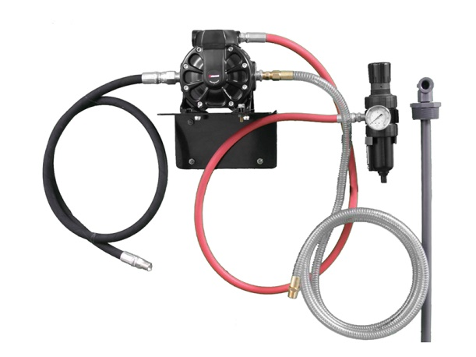
Siphon Feed
Siphon feed used for wall mounted pumps and below ground installations.
Used when fluid flows very easily (up to 5000cp).
Below ground systems common in the past, but no longer desired due to EPA restrictions.
Vertical lift loss (the weight of the fluid) and frictional pressure loss of the siphon hose and tube must be calculated to determine if a fluid can be siphon fed.
Special reinforced hose must be used for siphon feeding. Standard hose will collapse during priming and cause the pump to cavitate.

Slide 18
Siphon Feed - Vertical Lift Loss Calculation
Assume you wanted to siphon feed 30W weight motor oil 6.0 ft:
30W (.891 Specific Gravity - SG)
0.44 psi/ft. is lost for water (1.0 SG)
0.44 psi/ft. x .891 SG (30W) = 0.4 psi/ft. loss
0.4 psi/ft. (30W) x 6.0ft. = 2.4 psi lift loss
Most service fluids are near the SG of water and a good guide for calculating lift loss is about 0.5 psi/ft. for all service fluids.
Vertical lift loss and frictional pressure loss is compared to available atmospheric pressure to determine if the pump will prime.
Vertical lift loss applies to pumping fluid vertically on the discharge side of the pump; however the loss is typically very small compared to the outlet pressure capacity of the pump.

Slide 19
Siphon Feed - Frictional Pressure Loss Calculation
Assume the desired dispense flow is 3.0gpm, the viscosity of the oil is 540cp at 70°F (30W), and the siphon hose is 1.0” x 6ft. The supply pump is a double-acting piston pump.
Delta P = .000273 x 6.0gpm x 540cp x 6ft/1.0”⁴ or 5.3 psi.
Balcrank piston pumps prime or load on one stroke (upstroke) and dispense half the volume of the pump on both the up and down strokes.
So, in this example the desired output flow is 3gpm requiring the calculated flow to be doubled (6gpm) for the calculation.
Doubling the flow is not required when calculating siphon feed pressure loss for air-operated double diaphragm pumps.

Slide 20
Siphon Feed - Summary
In the example on the previous slides we know:
Vertical lift loss for 30W in six feet = 2.4 psi
Frictional loss in 1.0” x 6ft. of hose = 5.3 psi
However, the pressure loss past the inlet check of the pump cannot be calculated.
Balcrank recommends using a 5.0psi loss for inlet check pressure loss.
The total loss in this example is the sum of lift loss, frictional loss and inlet check loss (12.7 psi).
For the pump to prime the atmospheric pressure available must be greater than this loss to avoid pump cavitation.
The example assumes viscosity at 70°F. Colder conditions will increase viscosity and increase frictional pressure loss.

Slide 21
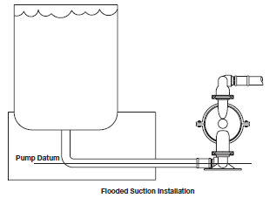
Gravity Feed
Used when the fluid flows easily (up to 20,000cp).
Gravity feed is evaluated in a similar manner to siphon feed except the weight of the fluid above the pump inlet (head pressure) assists with pump priming.
As the container is emptied, the available weight of the fluid decreases and will have little effect on priming so sizing the inlet hose and fittings is critical.
Use frictional pressure loss calculations to evaluate inlet plumbing and hose diameter.

Slide 22
Pressure Feed
When using a secondary pump to pressure feed the inlet of the primary pump, the feed supply pressure should not exceed 25% of the outbound pressure of the fed pump (primary pump).
For example, if the fed pump is dispensing at 300psi, the inlet pressure of the pump feeding it should not exceed 75psi.
Feed pressure too high:
The fed pump inlet valve will not operate properly impacting outlet pressure and flow.
Increases seal wear of the fed pump.
Feed pressure too low:
The fed pump will cavitate. Ideally, always use the lowest feed pressure to prime the fed pump.

Slide 23
Grease - Frictional Pressure Loss Calculation
As we discussed, grease is non-newtonian (thixotropic) meaning the viscosity changes based on the rate of shear from the pumping system. This makes calculating frictional loss less exacting than oils and other service fluids.
As a guide using #2 NLGI grease, calculate loss using a range (20,000 to 30,000 cp):
Delta P = .000273 x .2gpm x 20,000cp x 230ft/1.405”⁴ or 64.0 psi.
Delta P = .000273 x .2gpm x 30,000cp x 230ft/1.405”⁴ or 97.0 psi.
This guide may vary when evaluating waterbased grease or greases using unusual fibrous or tackifier fillers. Be sure to contact the material supplier in these instances.

Slide 24
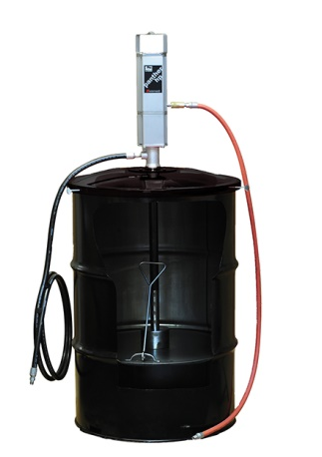
Follower Plate Feed
Used when the fluid moves slowly (15,000 - 50,000cp).
The weight of the flower plate and atmospheric pressure assists priming.
Follower plate systems are used with priming piston pumps.
Frequently used for 35 lb. (16 kg) pail, 120 lb. (55 kg) and 400lb (180kg) drum applications of #2 and specific #3 grease types.
Not recommended for grease using high fibrous or tackifier additives. Use inductor and/or ram systems.

Slide 25
Fixed Follower Plate/Inductor Feed
Used when the fluid moves slowly (20,000 - 100,000cp).
The weight of the flower plate, atmospheric pressure on the inductor plate and the weight of the pump assists priming.
Inductor systems are primarily used with priming piston pumps.
Used on 400 lb. (180 kg) drum applications of #3 and #4 grease
Recommended for fibrous or tackifier additives. Inductors also used for higher flow rates.

Slide 26
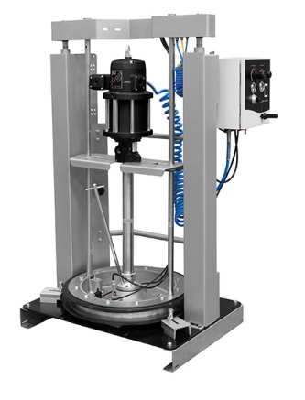
Ram/Inductor Feed
Fluid moves very slowly or may be semi-solid (100,000 - 6,000,000cp).
Atmospheric pressure, the weight of the ram plate and pump, and the downward pneumatic or hydraulic force from the ram cylinder(s) assist with priming.
Rams are used for NLGI #5 - #6 grease.
Double-post ram systems used with 400 lb. (180 kg) open head drums are typical ram systems in the market.

Slide 27
Pump Performance Charts - Pump Ratio and Stall Pressure
Pump ratio is the relationship between the effective area of the air motor’s piston and the effective area of the pump’s piston.
The ratio is determined by dividing the motor piston effective area by the pump piston effective area.
For example: If the motor piston has a 5 square inch (32.25 cm²) effective area and the pump piston has a 1 square inch (6.45 cm²) effective area, the ratio would be 5:1. Applying 100psi (7 bar) to the motor in this case would develop 500psi (35 bar) of fluid pressure with the fluid outlet closed.
This pressure is called stall pressure (maximum pressure at zero flow).
5 SQ. IN.
5 X 1 RATIO
100 PSI AIR =
500 PSI FLUID
1 SQ. IN.

Slide 28
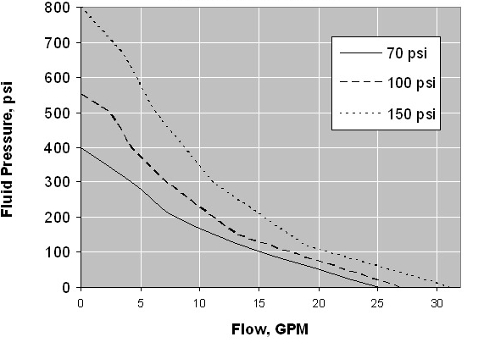
Pump Performance Charts - Lion 5:1
Air Inlet Pressures

Slide 29
Pump Performance Charts - Lion 5:1 Stall Pressure
Stall Pressure is maximum pressure at zero fluid flow.
Stall pressure at 70psi air pressure is 400psi fluid pressure.
Stall pressure at 100psi air pressure is 550psi fluid pressure.
Stall pressure at 150psi air pressure is 800psi fluid pressure
Air Inlet Pressures

Slide 30
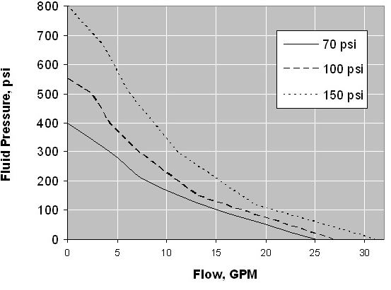
Pump Performance Charts - Lion 5:1 Duty Cycle
Duty Cycle is pump speed measured in cycles/minute.
Lion 5:1 Tech Data:
Runs at 14cpm for each gallon pumped.
For example: Duty cycle at 5gpm is 70cpm (14cpm/gallon x 5gpm)
Typical service fluid cycle rates are 80-90cpm due to the intermittent duty nature of the application and friendly fluid properties of most service fluids

Slide 31
Pump Performance Charts - Lion 5:1 Free Flow
Free flow is a measure of a pumps flow performance without downstream pump restriction.
Maximum flow at high cycle rate and low outlet pressure performance).
Note: Pumps are typically not sized at points on the curve near free flow or stall pressure.
When comparing pumps for an application, it is important to know the actual operational flow, pressure, duty cycle, air pressure and air volume performance.
Free Flow

Slide 32
Pump Performance Charts - Operational Flow / Pressure
Operational Flow and Pressure is:
6 gpm@300psi fluid pressure at 85-90 psi air pressure.
Based on a duty cycle of 14 cpm per gallon pumped, the duty cycle would be 84 cpm (14 cpm x 6 gpm). This is a good pump speed for lube intermittent duty applications.
Operational
Flow and Pressure

Slide 33
Pump Performance Charts - Air Consumption
Lion 5:1 Tech Data:
Air consumption @ 100 psi of air pressure at 8 gpm is 47 scfm or 5.88 scfm/gallon.
At 6 gpm the Lion 5:1 would consume 35.3 scfm @ 100 psi air pressure.
Air Consumption

Slide 34
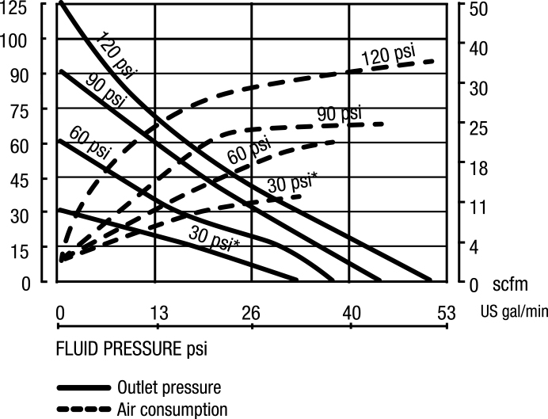
Pump Performance Chart - 1” AODD Pump 1120-037

Slide 35
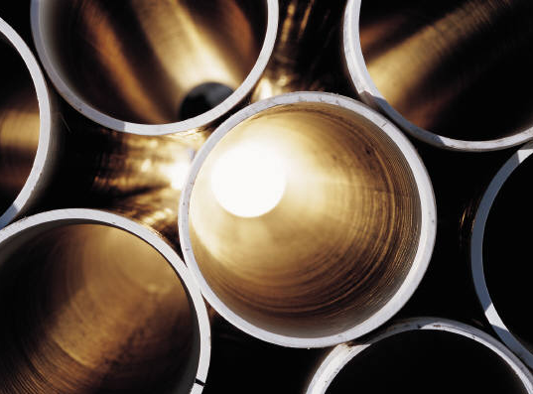
Plumbing - Minimizing Pressure Loss
Large diameter pipe or tubing
Changing the diameter of the pipe or tubing has the most significant impact on frictional pressure loss in a system
Constant tubing or pipe size
Long runs without bends
Use of long radius elbows
Constant tubing size, long runs without bends and use of long radius elbows eliminates turbulent flow which causes frictional pressure loss

Slide 36
Plumbing - Tubing and Fittings
Best choice for fluid lines and air lines
Specified by O.D.
Comes in seamless steel, copper and polyethylene
Annealed hydraulic grade steel tubing is recommended for service fluids – easy to bend and light weight
Balcrank recommends 37° flared fittings.
Bite-style fittings are often favored due to the ease of fabrication. If used, caution should be taken to select the bite-style fitting compatible with the wall thickness of the tubing.
Parker (Triple-Lok™) 37° flare (Avoid Feru-Lok™, bite and Seal-Lok™, face)
Lenz (Lenz) O-seal™
Crawford (Swage-Lok™) compression
Imperial Eastman (Hi-Seal™) compression
Imperial Eastman (800) 37° flare

Slide 37
Plumbing - Pipe Schedule
All pipe weights have the same O.D., but the I.D. changes with weight.
Standard weight (Schedule 40)
Schedule 40 is the most frequently used pipe for low pressure systems like transfer fluid systems and compressed air supplies.
Extra heavy weight (Schedule 80)
Double extra heavy weight (Schedule 160)
Schedule 160 is sometimes used for grease header systems.
Pipe drawbacks:
Pipe is heavy compared to tubing making installation difficult
Installation is labor intensive - requires threaded or welded fittings
Tends to have rust and scale – supply air contaminants
Hard to flush
Vibration can loosen threaded fittings
Should not be bent
Note: Piping material cost is less than tubing, but more expensive to install than tubing. In general, equipment/install costs are a wash between pipe and tubing, but tubing install time is faster.

Slide 38
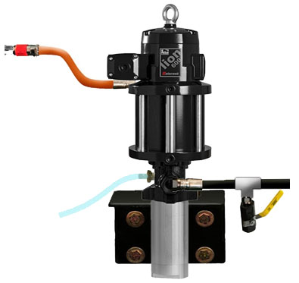
Plumbing - Thermal Fluid Expansion
Motor oils, transmission fluids, gear oils, hydraulic oils, anti-freeze and windshield wash fluid will expand as temperature of the fluid increases in the plumbing system
This can happen quickly in some applications. For example, for each 1°F of temperature rise, the fluid pressure will increase 45 psi (3.1bar)
40°F temperature increase in a system will cause an increase of fluid pressure to 1800 psi (124 bar) in a system.
Balcrank recommends the use thermal pressure relief on all service fluid header systems.
Notes:
Explain the differences in the two pictured PRV in illustration. 1) being the one included in pump and placed on pump body. The 2nd option is after the pump outlet and in the fluid outlet path. The 2nd option in many case may be needed in special circumstances when one pump is feeding two inline meters

Slide 39
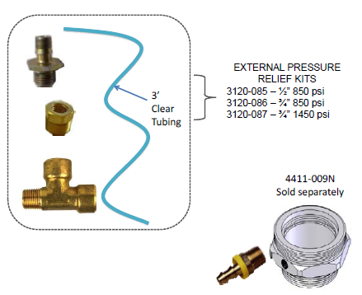
Plumbing - Thermal Fluid Expansion
Since March 1, 2012 all Pride Series pumps are supplied with an external thermal relief valve kit.
Two valve models are available: (850psi and 1450psi).
AODD’s pumps will continue to use the 125 psi relief valves (3120-023 and 3120-024)

Slide 40
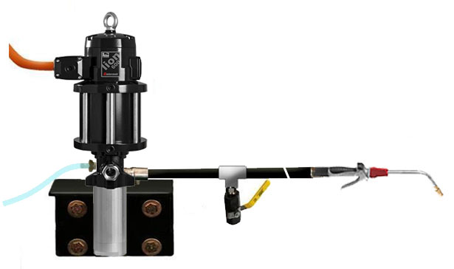
Fluid System Components - Pump Layout
Drain valve assists in relieving pressure in pump, hose, reel and dispense valve. Triggering the dispense valve to relieve pressure may not be sufficient.
The drain valve also assists with pump priming during system commissioning or after pump service.
Per PEI/RP700-09, use 4:1 safety factor for tubing and 3:1 for pipe.
Thermal pressure relief kit required. Route relief tubing back to supply tank or waste container.
Install dispense valve after flushing is completed on newly fabricated fluid lines.
Use fluid hose to isolate pump vibration from fluid header. Do not hard plumb as this will cause fluid leakage at fittings due to pump vibration.

Slide 41
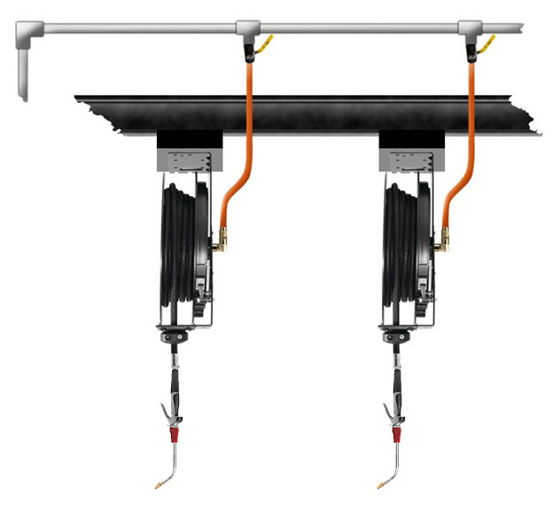
Fluid System Components - Reel Drop Layout
Fluid shut-off valves used to isolate reel and dispense valve for service. Needle valves used to balance fluid pressure on grease header systems. Power outlets should be installed for service light or power reel installation.
Use fluid hose to isolate reel vibration from fluid header. Do not hard plumb as this will cause fluid leakage at fittings due to reel vibration.
Install dispense valves after flushing is completed on newly fabricated fluid lines.

Slide 42
Supply Line Installer Selection
Select and partner with a supply line installer with experience installing air and fluid lines for vehicle service maintenance shops.
Be sure the installer follows Balcrank recommendations:
Use tubing for air and fluid lines.
Per PEI/RP700-09, use a 4:1 safety factor for tubing and 3:1 safety factor for pipe.
Use 37° flared tube fittings instead of bite fittings.
Schedule 160 can be used for grease if tubing sizes are unavailable or cost prohibitive.
Flush newly fabricated fluid lines per the information in this presentation before installing new dispense valves to prevent costly damage.
Proper priming of service fluid lines after flushing.
Never hard plumb equipment components. Use hoses to isolate vibration and hydraulic shocks in the system to avoid leaks.
Installation must be performed by an Authorized Balcrank Distributor.

Slide 43
System Commissioning - Flush Time and Flow
Measure the approximate length of the fluid line from the pump to the dispense end including the length of hose on the reel if applicable.
Determine the largest inside diameter (I.D.) of pipe or hose in the line. Using the table below, select the line length and the larger I.D. of pipe or hose to determine flush time. Flush at 2.0gpm or higher.
Combined length of pipe and hose (ft.) | Flush Time (minutes) Largest ID of pipe or hose (in.)
 | 0.5 | 0.625 | 0.75 | 1.0 | 1.5
50-100 | 0.5 | 0.5 | 0.5 | 1.0 | 2.0
100-200 | 0.5 | 1.0 | 1.0 | 2.0 | 4.0
200-300 | 1.0 | 1.0 | 1.5 | 3.0 | 6.0
300-400 | 1.0 | 1.5 | 2.0 | 3.5 | 8.0
400-500 | 1.0 | 2.0 | 2.5 | 4.0 | 10.0
500-750 | 1.5 | 2.5 | 3.5 | 6.5 | 15.0
750-1000 | 2.0 | 3.5 | 5.0 | 6.5 | 20.5

Slide 44
System Commissioning - Flushing
Two people should flush and prime a system. One operating the pump and the other dispensing through the reel drops. Use walkie-talkies or cell phones for communication.
New fluid lines should be flushed of contaminants created during the fabrication of the system. Flushing media varies, but mineral spirits, kerosene or service fluids are commonly used. Thinner flush liquids clean better than thicker flushing fluids.
Install temporary ball valves at each drop. Do not connect hose reel or dispense valves until flushing is completed preventing contamination of the equipment seals and valves.
With the air regulator closed, open the master bleed-type air valve and/or if equipped, connect the QD coupler to the pump.
Open the Isolation ball valve farthest from the pump into a metal used fluid container, making firm metal-to-metal contact between the valve and container to avoid static shock.
Slowly open the pump air regulator until the pump runs. Run the pump at 2.0 gpm or higher for the time specified in the chart based on the line length and size. When flushing is complete close the valve.
Continue flushing all drops from the farthest drop back to the supply pump using the same flow rate and chart times appropriate for the drop length and diameter.
After flushing is complete install the hose reels and dispense valves.
Repeat this procedure for each service fluid.

Slide 45
Startup, Shutdown & Maintenance
Startup
Turn on compressor and open the main air valve.
Daily Shutdown
Turn off compressor and close the main air valve.
Drain water from compressor tank, air filters and drip legs.
Clean dispense valves and wipe hoses.
Check level in tanks and drums and refill if needed.
Check overall system for wear, leaks especially hoses and valves. Replace or repair as needed.
Weekly Maintenance
Check compressor oil level and refill if needed.
Refill air lubricators with non-detergent 10W oil if applicable.

Slide 46
System Design Tools - Excel File
System Design Requirements Worksheet
Used to capture important design information for the purpose of running pressure loss calculations.
Automated Worksheets and Conversions
Delta P Frictional Pressure Loss Calculator
Plumbing Fluid Volume Calculator
Fluid Inside Tube Diameter Calculator
Common Conversions
Technical Reference Charts
Tubing and Pipe Data
Resistance of Valves and Fittings
Viscosity of Common Service Fluids
Viscosity Conversion
Service Fluid Viscosity vs. Temperature
Service Fluid Line Recommendations

Slide 47
Case Study - Municipal Garage
Service Fluids
15W40 Engine Oil (750-gallon bulk tank)
5W30 Motor Oil (500-gallon bulk tank)
10W Hydraulic Oil (120-gallon bulk tank)
Automatic Transmission Fluid (120-gallon bulk tank)
NLGI #2 Grease (400lb 0pen head drum)
50W Transmission Fluid (120-gallon bulk tank)
Gear Lube (120lb drum portable roll-around package)
Pre-mixed Windshield Wash Solvent (55-gallon tight head drum)
Pre-mixed Anti-freeze (55-gallon tight head drum)
Used oil evacuation station (1000-gallon bulk tank)
Application
Four bays for cars, pick-ups and other service vehicles
Eight bays for large diesel trucks and off-road construction equipment
Pump room enclosed on one end of service shop
Other details captured in the “Lubrication Equipment System Design Requirements” worksheet

