Slide 1
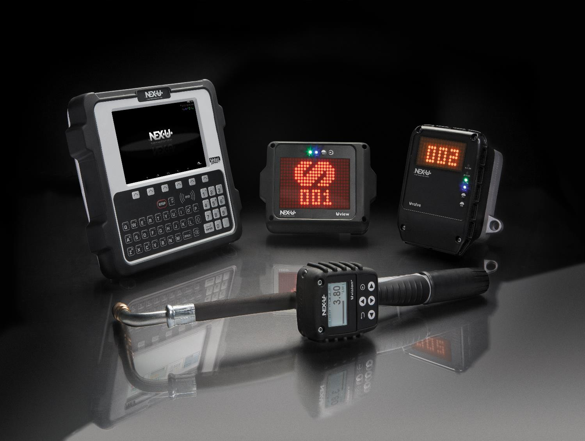
NEX·U·® has been conceived with the user in mind, making fluid management and fluid inventory control an easy and trouble free activity.

Slide 2
NEX·U·® Wireless Flexibility and Hard-wired reliability
NEX·U·® is a hybrid system that brings you the advantages of wireless flexibility and hard-wired reliability:
Wireless flexibility
Data can be transmitted wirelessly from bay to bay, eliminating long cable runs
Allows new component add-ons if shop needs grow or change
Uses customers existing Wi-Fi® network or you can establish its own Wi-Fi® network
Hard-wired reliability
Constant power source to solenoid valves and meters that control fluid delivery.
Hard-wired CANBUS data transmission - avoids interferences and other obstacles which may interfere from time to time with wireless data transmission.

Slide 3
NEX·U·® System components
NEX·U·® Main components
U·net – Network Computer
U·track - Software
U·dat - Keypad
U·vision(+) – Handle Module
U·valve (+) – Meter,
U·tank – Tank/Pump Control
Notes:
What we will cover in this presentation

Slide 4
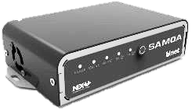
U·net “The Brains”
U·net Central Processing Unit. It stores the U-track software and controls and manages all functions and communications.
U·net is a 2.4 GHz processor with 4 GB RAM. It controls the system Functions and it manages both wired and wireless communication between the NEX·U·® components.
It offers (2) CAN BUS ports (in/out) for wired communication and an ethernet port to connect to shop LAN.
NOTE: BALCRANK may deploy a dedicated network with an additional Wi-Fi® router (U·net is not a router), contact BALCRANK for further information.

Slide 5
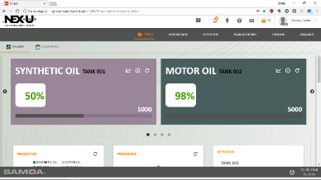
U·track software
U·track software:
Maintains and manages: users, tanks, fluid inventory, and tank levels
Records and manages all fluid transactions (validated preset transactions require DMS connection)
Control and track all fluid quantities dispensed in the system
Generates automatic warnings and email notifications for reorders at predefined levels
Generates reports, to track dispensed information by date and time, technician, work order, fluid type (CSV or TXT formats)
U·track is compatible with: Chrome, Firefox, and Microsoft Edge.

Slide 6
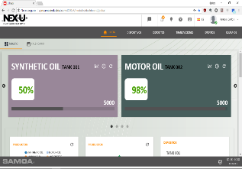
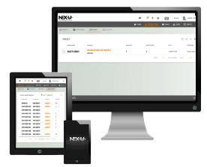
U·track Equals efficiency and profitability
With U·track software the shop manager will experience better shop flow and profitability:
U·track dashboard provides instant inventory and fluid usage just by clicking on any tank
U·track allows any computer, smart phone or tablet to connect to the network creating a mobile access keypad converting any devise into a secure fluid dispense keypad. (additional access licenses are required)
Notes:
*Virtual License remote dispensing
*U-Track Dashboard screen
*Transactions monitored and followed in real time

Slide 7
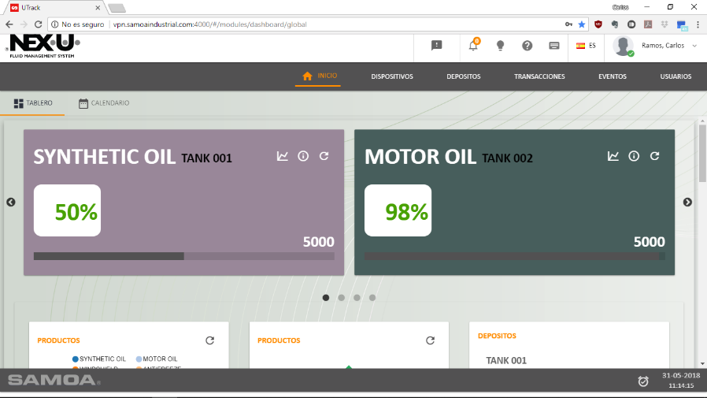
U·track Home page
DISPOSTIONS
DEPOSITS
TRANSACTIONS
EVENTS
USERS
TABLE
CALENDAR
PRODUCTS
PRODUCTS
DEPOSITS

Slide 8
U·track, Fluid activity & Tank level deposits
PRODUCTS
PRODUCTS
DEPOSITS
NEX·U·® U-track can be set to show the manager in several different views as illustrated above. The manager can choose which best fits his style of viewing and capturing these data points

Slide 9
DMS – Dealer Management System Interface
NEX·U·® DMS interface offers bidirectional communication to integrate the shop job transaction information.
DMS Features:
Enhanced security: work orders are checked and validated before fluid is dispensed
Automated data entry: automatically downloaded from the DMS) (BALCRANK Distributor to assist with the DMS license software)
Bidirectional Interface communication is established through web service.
Technician enters PIN number and work order
DMS will prompt a message whether this information exists or not
Fast and effective for technician to use
Bidirectional integration with CDK / For other DMS suppliers contact Balcrank.

Slide 10
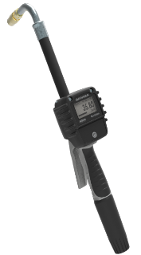
NEX·U·® can be accessed through
NEX·U·® adapts to the shops work flow and offers multiple ways of dispense access.
System accessed by:
U·dat: NEXU keypad
U·vision+: Uses a 6-button keypad mounted on a non-metered Balcrank handle
Virtual Keypad: Use any smart phone, tablet or PC/Laptop on a Wi–Fi network

Slide 11
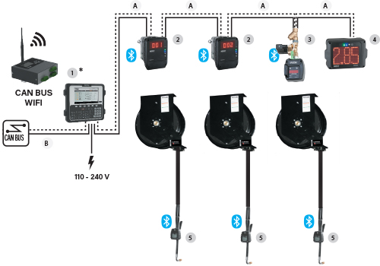
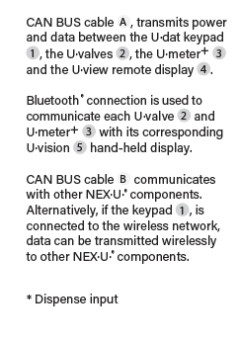
NEX·U·® U-dat Connected Dispense
Notes:
Example of U-dat typical system

Slide 12
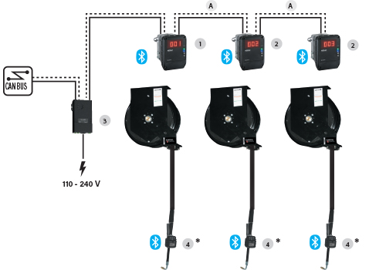
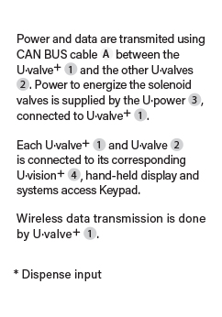
NEX·U·® U-vision+ Connected Dispense
Notes:
Example of U-vision+ typical system

Slide 13
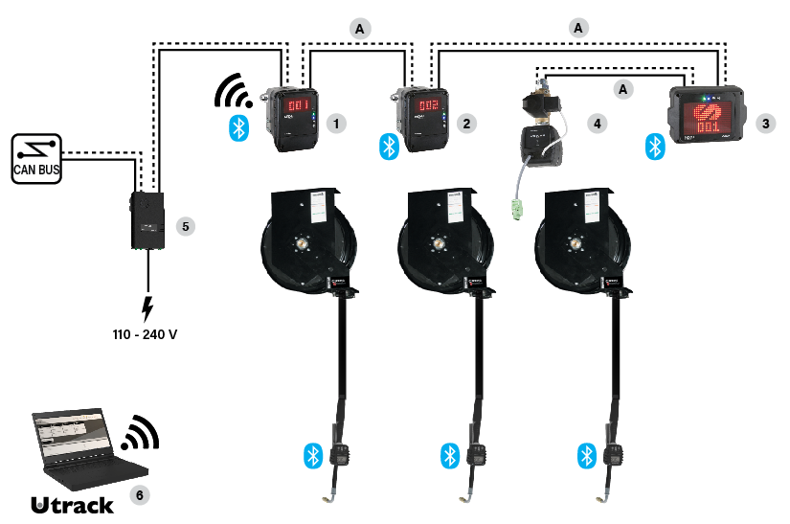
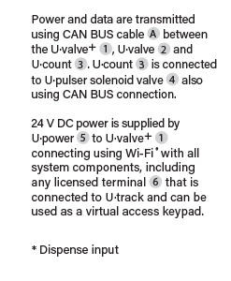
NEX·U·® PC-Laptop Connection
Notes:
Example of PC-Laptop and or Virtual Keypad by tablet and or cell phone typical system

Slide 14
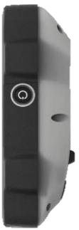
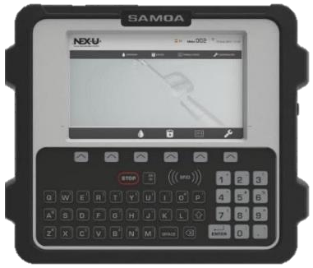
U•Dat• Dispense mode access, Keypad
U·dat System keypad. With a touchable colored 7 inch screen with a full QWERTY keypad provides full access to NEX·U·® and U·track.
USB
**Key Switch on keypad
is for system override if
network issue exists.
Dallas Key Reader
Integrated power 110VAC
320W or 75W models
convert/supply 24VDC
Bottom View
7” LCD screen
ON/OFF button
RFID Reader
Membrane Keypad

Slide 15
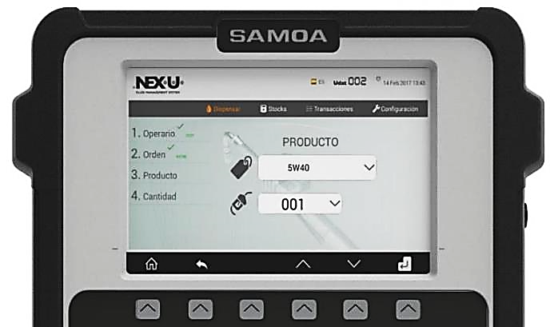
U•Dat• Screen shots, Products
Dispensing

Slide 16
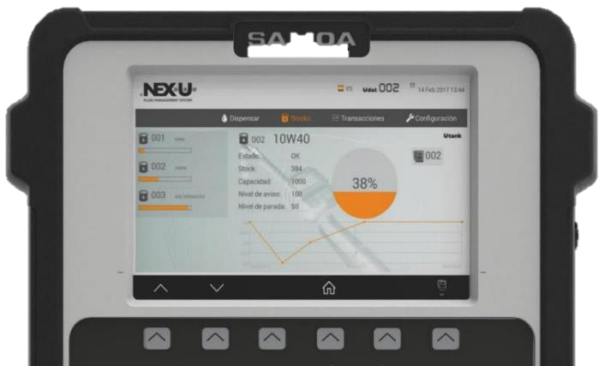
U•Dat• Screen shots, Inventory
Stocks
Notes:
English please

Slide 17
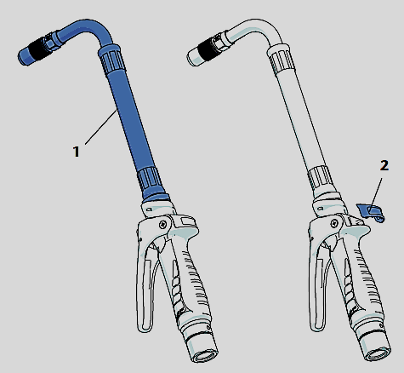
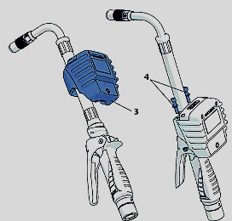
U-vision & U-vision+ Simple installation
Install the extension (1) on the gun.
Remove the cover plate (2). The lid is press-fitted, it should come off with a slight effort.
Slide the U-vision module (3) over the extension (1) until it is properly seated in its housing on the flange.
Using the supplied nut, screw and washer kit (4), secure the module to the gun flange as shown in the picture.

Slide 18
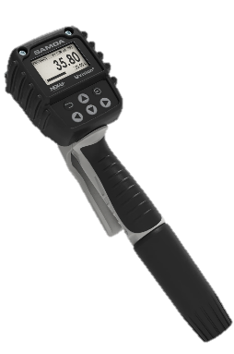
U·vision+ Handheld display with access keypad
U·vision+ 6-button keypad, it can replace a U·dat keypad for data entry in a system as it allows the following operations:
User access through PIN entry.
Allows scrolling through existing job orders or by entering job order directly with number (digits only).
Enter the volume of fluid to be dispensed.
Confirm fluid type and transaction, start dispense.
Features:
Bluetooth® connection with U·valve, U·valve+. Backlight display
Powered by 4 “AA” 1.5 V alkaline batteries.
Transforms a non-metered Balcrank handle into a hand-held display with dispense keypad

Slide 19
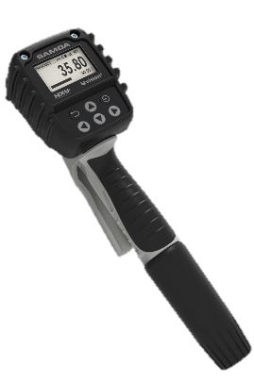
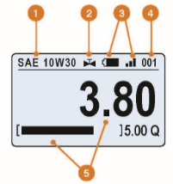
U·vision+ Dispense modes
It can dispense in standard mode or Data-base pre-selection mode
Example below shows data provided to a technician
1
Product
2
Solenoid valve mode
3
Bluetooth signal and battery life
4
Hose reel / Fluid outlet number
5
Delivered volume and operation progress bar with target quantity

Slide 20
U·vision+ Dispensing mode options
Standard system dispense
After entering authorized PIN and work order number, the technician must enter the type and quantity of fluid to deliver, and the hose reel number that will be used.
1
Validate User/Pin
2
Insert Job Order
3
Insert fluid Quantity

Slide 21
U·vision+ Dispensing mode options
Preset system dispense
A previous set up must be done before validation. *The shop manager MUST enter the fluid and volume associated to each order number in the database prior to dispense
After the technician enters their PIN, work order and hose reel number, the system downloads the type of fluid and the preset volume associated to the work order entered.
1
Validate User/Pin
2
Select Job Order
* Fluid Type and
Amount is supplied
By database entry

Slide 22
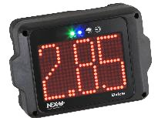
NEX·U·® Remote displays
U·vision is a hand-held display to fit BALCRANK non-metered handle. It is a backlight display connected via Bluetooth® with a U·valve, U·meter+ and U·count.
U·view is a high visible, LED display that shows the volume delivered from a U·valve (no simultaneous operation supported).
U·view supports Wi-Fi® and hard- wired communications. U-view requires 24V DC power supplied by a Udat or U·power module.
U·vision and U·view display the following parameters:
Hose reel (fluid outlet number and fluid dispensed).
Battery life and Bluetooth® signal strength.
Volume delivered and operations progress.
Solenoid valve open or closed.

Slide 23
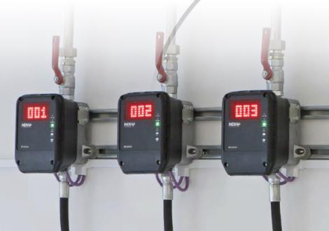
U·valve & U·valve+ Volume meters
U·valve & U·valve+ with its electronic module, combines a high accuracy pulse meter, a solenoid valve and a large cleanable fluid filter.. This module controls the meter and valve operation and communicates with other system components.
Reduces installation time and possible leak points
High visibility LED display reports job progress
Four LED lights show the U·valve operation and assist in diagnostics, 2-buttons used for system configuration.
U·valve supports CAN BUS communication and power required to open the solenoid valve and Bluetooth® connection to the other components
U·valve+ supports Wi-Fi® communications to other system components. (U·valve and U·valve+ require 24 V DC supplied by a U·dat or U·power module).

Slide 24
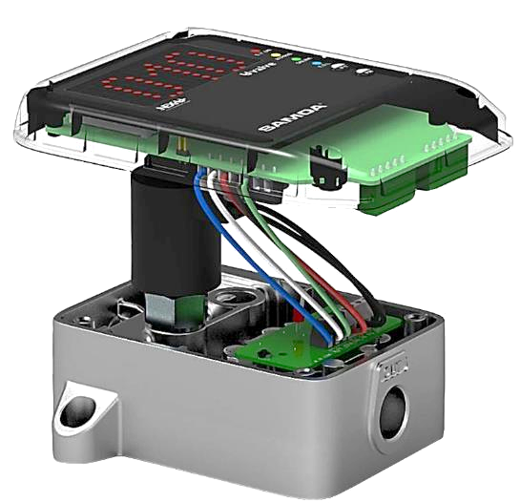
U·valve & U·valve+ Features
Electronic communication board
Fluid Y-strainer
Solenoid Valve controls fluid flow.
Pulser board measures fluid amount precisley +/- 0.5%
Wired power supply (24 VDC) U*power
CAN BUS or Wi-Fi® data transfer (U-valve+)
Notes:
I made some text change to better represent the message – see first and third bullet
May need back ground change

Slide 25
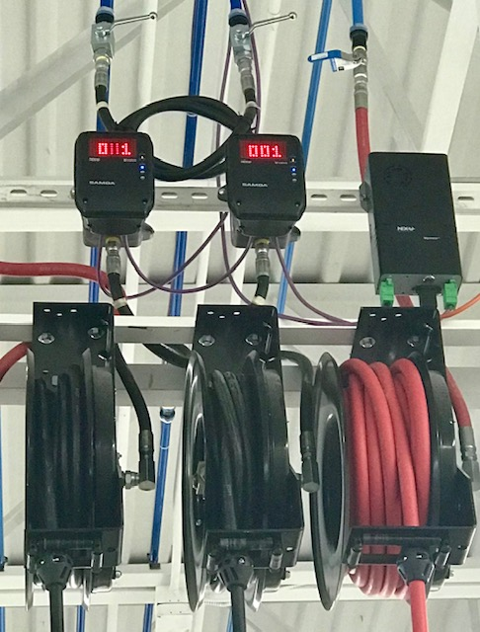
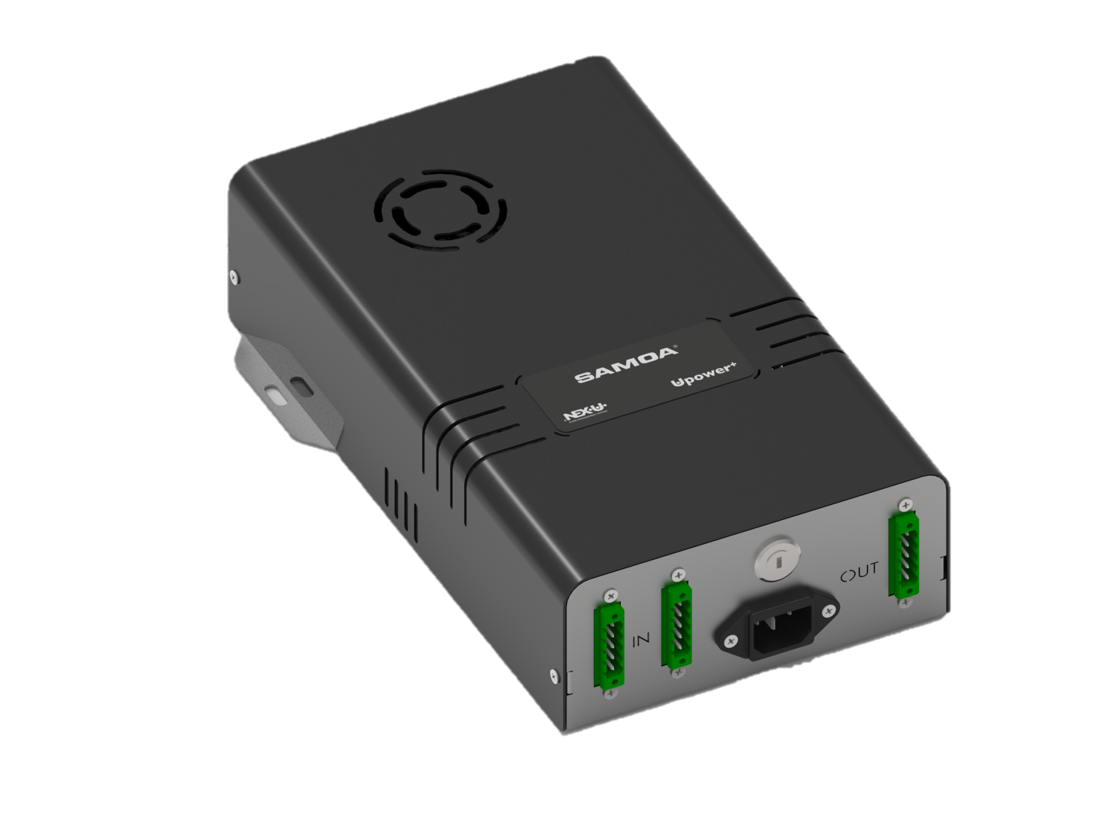
U·power Provides reliable power - 110V to 24V
U·power supplies power to solenoid valves and other system components. U*power connects using CAN BUS cable to a U*valve, U*valve+, U*count, or U*view whenever the power supplied by a U-dat keypad is not present.
Three available models:
One that can power 2 solenoid valves, a second that can power up to 8-solenoid valves and a third that offers a third connection for branched shop layouts and control up to 8-solenoid valves
**Key Switch on U*power+ units
is for system override if network
issue exists.

Slide 26
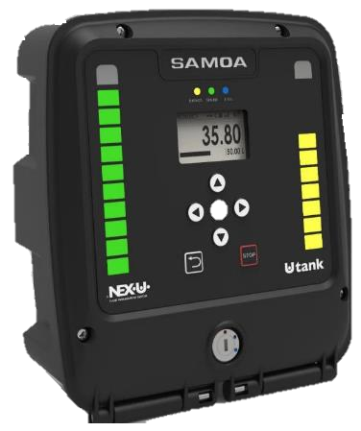
U·tank General overview
Tank level control module - monitors fluid level’s for one or two tanks.
Device utilizes fluid level probes, solenoid valves and external buzzer and light
24-7 monitoring
Indication LEDs
Status indication
Bypass mode
End of line indication
Graphic Display
Level indication – Graphic LEDs
Membrane Keypad
3 positions keylock (standard, bypass, restart)

Slide 27
U·tank Level module
Provides real-time inventory levels with an analog probe, eliminating concerns about running out of fresh fluids or used fluid tank overflow.
When not using an analog probe NEX·U·® will use declining balance for inventory control and will require manual inventory adjustment when fluid is added.
U·tank - When connected to solenoid valves, will control pump operation.
The number of input and output ports are:
One analog input per tank for a pressure probe with 4-20 mA or 0-10V.
Three digital inputs per tank for a low, intermediate or high-level probe (1).
One output per tank for a solenoid valve to control air supply to each pump.
One output per tank for controlling a flash warning light or an acoustic alarm.
U·tank supports Wi-Fi® and CAN BUS communication with NEX·U·® components. (110-24VAC supply required / CAN BUS to Wi-Fi® convertor required with Wi-Fi® communication)

Slide 28
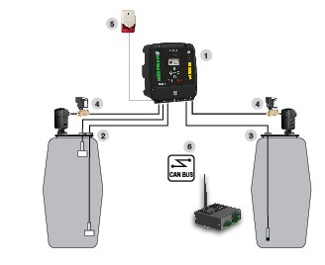
NEX·U·® Tank monitoring
^{U·tank}
1 can control pump operation by opening or closing air solenoid valve. It can monitor up to two tanks. Each tank can be fitted with low and high level sensors, or 2 with a pressure gauge
3 provides real-time control of the inventory in the tank with an analog tank probe. U·track
4 air solenoid valve prevents pump from running dry or air entering the oil distribution lines if there is no fluid in the tank.
1 can communicate with NEX·U·® components using CAN BUS to Wi-Fi ® or through CAN BUS 6 wired connection.
^{Optional:}
1 can also control a remote flash light or siren 5 to warn when any tank is empty or full.

Slide 29
CAN
BUS
CAN
1
2
WIRED
HYBRID
So lets recap … The NEXU system is flexible and can conform to the customers wants and needs. Its not only good for standard dealership use but can also be flexible enough to meet complex industrial applications and fluids.

Slide 30
NEX·U·® SMART – ACCURATE & COST EFFECTIVE
On behalf of Balcrank, I thank you for investing your time with us today.
Contact your regional manager
for further discussion:
Donald Smith
SE Regional Sales Manager
P 404-307-5423
dsmith@balcrank.com
www.balcrank.com
US Mfg. - Weaverville NC
Business Is Done Through The Lens Of Mutual Trust, Integrity, Professionalism And Long Standing Relationships.
“We believe firmly that when you build strong relationships, business will follow.”

